Slide 1
COS Standard 5
Evaluate the impact of social changes and the influence of key figures in the United States from World War I through the 1920s, including Prohibition, the passage of the Nineteenth Amendment, the Scopes Trial, limits on immigration, Ku Klux Klan activities, the Red Scare, Susan B. Anthony, Margaret Sanger, Elizabeth Cady Stanton, the Harlem Renaissance, the Great Migration, W. C. Handy, the Jazz Age, and Zelda Fitzgerald.

Slide 2
Analyzing works of major American artists and writers, including F. Scott Fitzgerald, Ernest Hemingway, Langston Hughes, and H. L. Mencken, to characterize the era of the 1920s

Slide 3
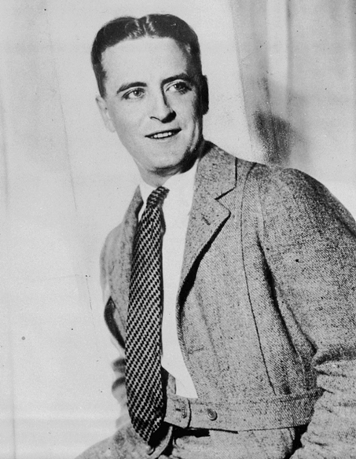
F. Scott Fitzgerald
Born in St. Paul Minnesota
Wife-Zelda Sayre(AL)
Writer of novels and short stories
  Great Gatsby
  This Side of Paradise

Slide 4
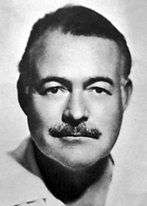
Ernest Hemingway
Born-Oak Park, Illinois
Writer
  The Sun Also Rises
  A Farewell to Arms
  The Old Man and the Sea
  For Whom the Bell Tolls

Slide 5
Hemmingway cont…..
The Sun Also Rises- group of American and British expatriates in the 1920’s journey from Paris to Pamplona, Spain to watch bullfighting
A Farewell to Arms-American ambulance driver on the Italian front during World War I, and his love for a beautiful English nurse

Slide 6
Hemmingway cont…..
For Whom the Bells Tolls- Young American fighting with a band of guerrillas in the Spanish civil war
The Old Man and the Sea- battle between an aging, experienced fisherman named Santiago, and a large marlin.

Slide 7
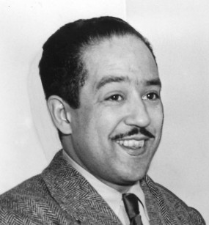
Langston Hughes
Born- Joplin, Missouri
Poet
Popular poems-
  The Negro Speaks of Rivers
  Harlem
  The Weary Blues
  Let America be America Again

Slide 8
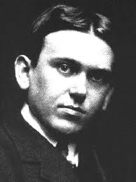
H L Mencken
Born- Baltimore, Maryland
“Sage of Baltimore”
Writer for newspapers and magazines
Known for his satirical influence on the Scopes “Monkey” Trial

Slide 9
Artists of 1920s
They challenged the traditional ideas.
Charles Sheeler-American Painter/ Commercial Photographer
  A founder of American modernism //used style of painting known as Precisionism
Edward Hopper-American realist painter and printmaker. (Oil paintings and watercolorist)
  uses Realism to convey isolation and disenchantment.
Carl Sandberg: Swedish-American poet, writer, and editor
  Poet who glorifies the Midwest
  Biography of Abraham Lincoln- famous work that won a Pulitzer Prize

Slide 10
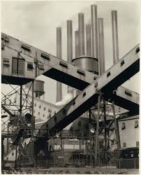
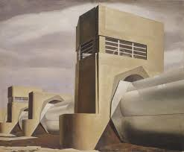
Charles Sheeler

Slide 11
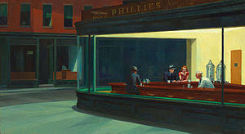
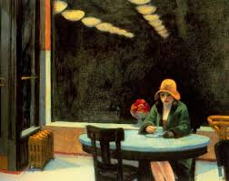
Edward Hopper

