Slide 1
COS Standard 5
Evaluate the impact of social changes and the influence of key figures in the United States from World War I through the 1920s, including Prohibition, the passage of the Nineteenth Amendment, the Scopes Trial, limits on immigration, Ku Klux Klan activities, the Red Scare, Susan B. Anthony, Margaret Sanger, Elizabeth Cady Stanton, the Harlem Renaissance, the Great Migration, W. C. Handy, the Jazz Age, and Zelda Fitzgerald.

Slide 2
Analyze radio, movies, newspaper, and popular magazines for their impact on the creation of mass culture
Chapter 20-2

Slide 3
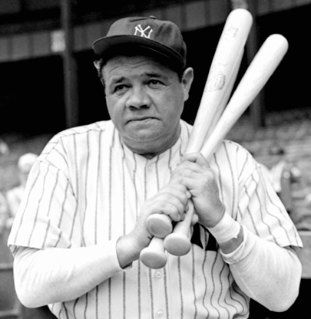
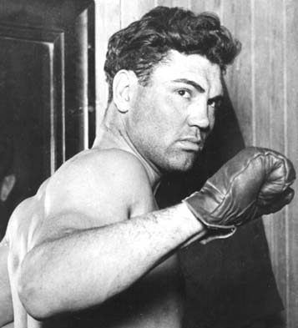
Mass Media
Mass Media influenced sports.
  People used mass media to make sports more popular
    Baseball
      Babe Ruth and Lue Gehrig
    Boxing
      Jack Dempsey
    College Football
    Golf
      Bobby Jones and Walter Hagen
    Tennis
    Swimming

Slide 4
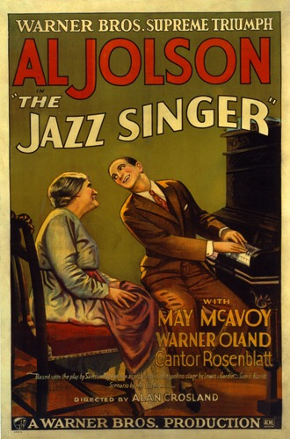
Mass Media—Motion Pictures
In the beginning, motion pictures had no sound.
Piano players were hired to play music while subtitles revealed the plot of the movie.
Major actors and actresses: Charlie Chaplin, Carla Bow, Mary Pickford, Tom Mix, Douglas Fairbanks, Gloria Swanson, Rudolph Valentino
First Talking picture: Jazz Singer (1927)

Slide 5
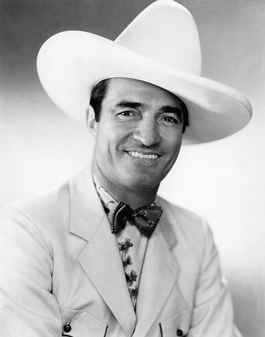
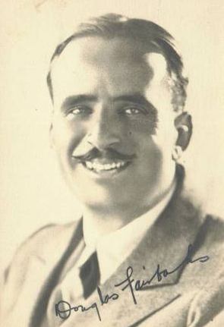
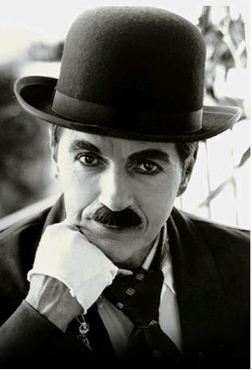
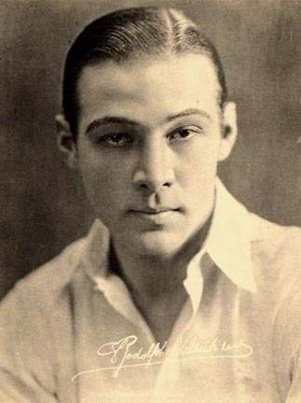
Mass Media—Motion Pictures
Charlie Chaplin
Rudolph Valentino
Tom Mix
Douglas Fairbanks

Slide 6
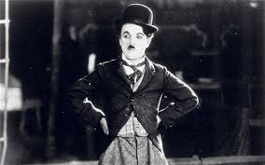
Actors
Charlie Chaplin
  The Tramp- 1915

Slide 7
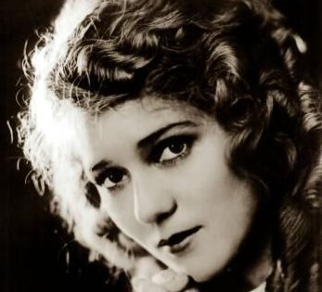
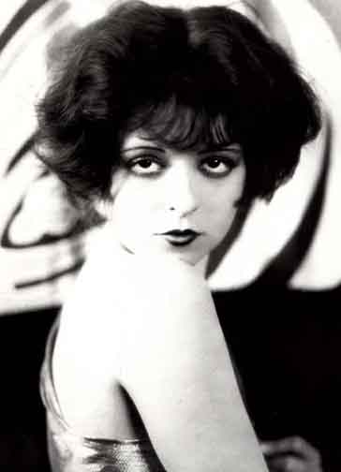
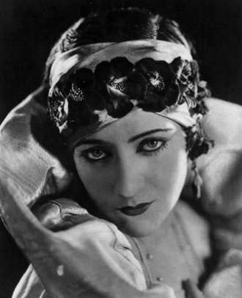
Mass Media—Motion Pictures
Gloria Swanson
Mary Pickford
Clara Bow

Slide 8
Mass Media—Radio
In 1920, one of the first radio broadcasts was of Warren G. Harding’s victory in the presidential election.
Broadcasted things like: popular music, sporting events, newscast, weather
  People liked being able to hear the Presidents voice
  People could listen to events with out actually attending them

Slide 9
Impact of Mass Media
Entertains America
Allowed people to look at the national level, not just focusing on themselves.
Unifies the nations and spreads new ideas and attitudes of the time.

