Slide 1
COS Standard 5
Explain key cases that helped shape the US Supreme Court, including Marbury versus Madison, McCullough versus Maryland, and Cherokee Nation versus Georgia.
Chapter 6 Section 1

Slide 2
Marbury versus Madison: background
Thomas Jefferson wins the election of 1800.
He takes office March 4, 1801, meaning John Adams is still president until then.
Before leaving office, Adams fills these positions with Federalists.
Adams passes The Judiciary Act of 1801: increased number of federal judges by 16
  Midnight Judges
The letters to the appointed had to be delivered before the end of Adams term.

Slide 3
Marbury versus Madison: background
When they were not completely delivered on time, Jefferson and James Madison (Secretary of State under Jefferson) see the letters as void.
When Jefferson takes office on March 4, he and the Republicans repeal the Judiciary Act of 1801.
Midnight judges removed from office.

Slide 4
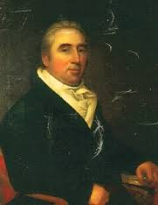
Marbury v. Madison
William Marbury- appointed as a justice of the peace for the District of Columbia in Adams final hours
  Doesn’t receive letter
Marbury petitions that the Supreme Court issue a writ of mandamus to force Madison to issue the appointment

Slide 5
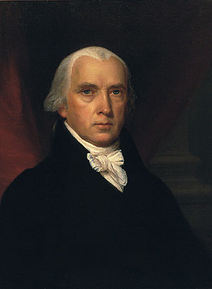
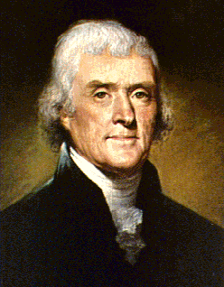
Key Players continued
James Madison
Thomas Jefferson

Slide 6
Marbury versus Madison
Midnight Judge William Marbury sues James Madison so he will deliver the letter of appointment.
Madison refuses.
The case goes to the Supreme Court.
John Marshall (Chief Justice of the Supreme Court) said the Judiciary Act of 1789, was unconstitutional because it gave the Supreme Court authority that was denied by the Constitution.
  The Judiciary Act of 1789 spelled out the practice of delivering commissions for judges

Slide 7
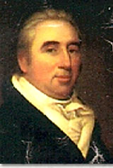
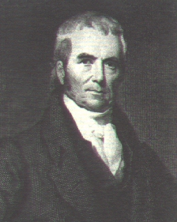
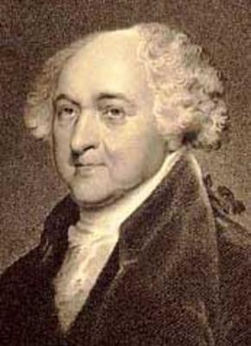
Key Players
John Adams
John Marshall
William Marbury

Slide 8
Marbury versus Madison
Thus, the Judiciary Act of 1789 was illegal.
Significance of the Case: Sets up Judicial Review
What is judicial review? Determining if a law is constitutional or not. If the law is unconstitutional, get rid of the law.
It determines who will be the final authority when there is a need to interpret the Constitution.
Sets up the power for federal courts to void acts of congress in conflict with the Constitution

