Slide 1
COS Standard 4
Describe causes, events and the impact of military involvement of the US in WWI, including mobilization and economic and political changes.

Slide 2
Explaining controversies over the Treaty of Versailles of 1919, Woodrow Wilson’s Fourteen Points and the League of Nations
Chapter 19 Section 3

Slide 3
Fourteen Points
Wilson’s plan to end World War I.
Eliminate the general causes of war through free trade and disarmament, open diplomacy and self determination
Evacuation of Central Powers from all countries invaded during the war
14 points: League of Nations: member nations are to help preserve peace and prevent future wars.

Slide 4
Fourteen Points
January 18,1918, President Woodrow Wilson gives speech to Congress outlying his Fourteen Points for peace to end WWI
  “The War to End All Wars”
President Wilson and America were fighting to bring out lasting peace
  Not lover territory or revge
D

Slide 5
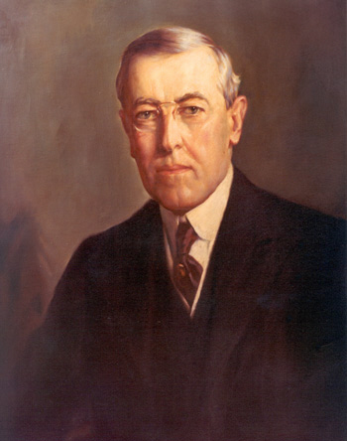
Treaty of Versailles 1919
Weakens Wilson’s 14 points
  Think Wilson is too lenient on Germany
Stripped German of its armed forces and made them pay reparations (war damages), also has to acknowledge guilt for the outbreak and devastation caused by World War I.

Slide 6
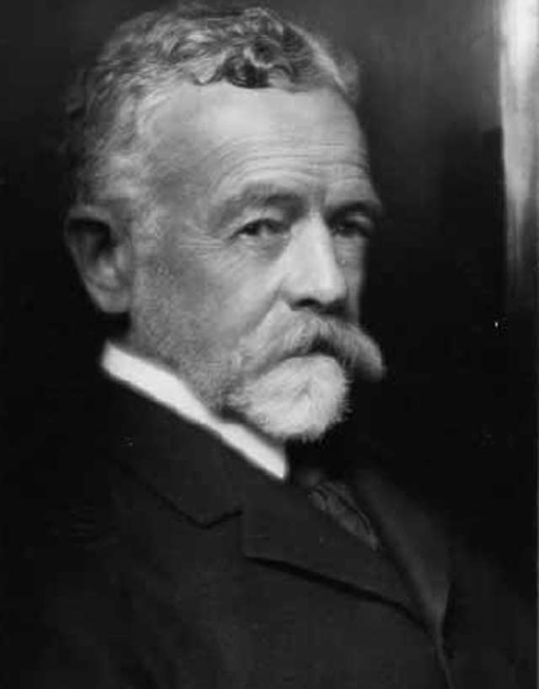
Problems with Peace
Many people do not support Wilson’s plan.
  Henry Cabot Lodge supports League of Nations, but wants add amendments that would preserve the nations freedom to act independently

Slide 7
Problems with Peace continued
Wilson campaigns to pass the 14 Points, but has a stroke and cannot get enough support to pass it.
The US negotiates a separate peace treaty with each of the Central Powers.

Slide 8
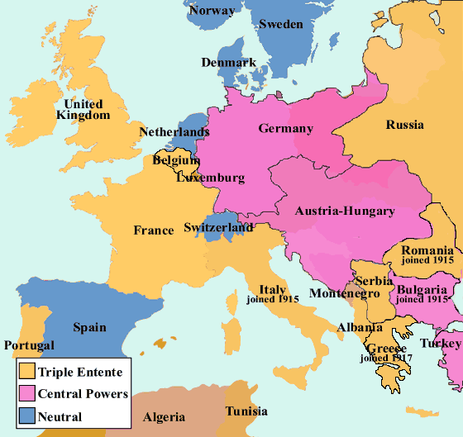
Europe 1914

Slide 9
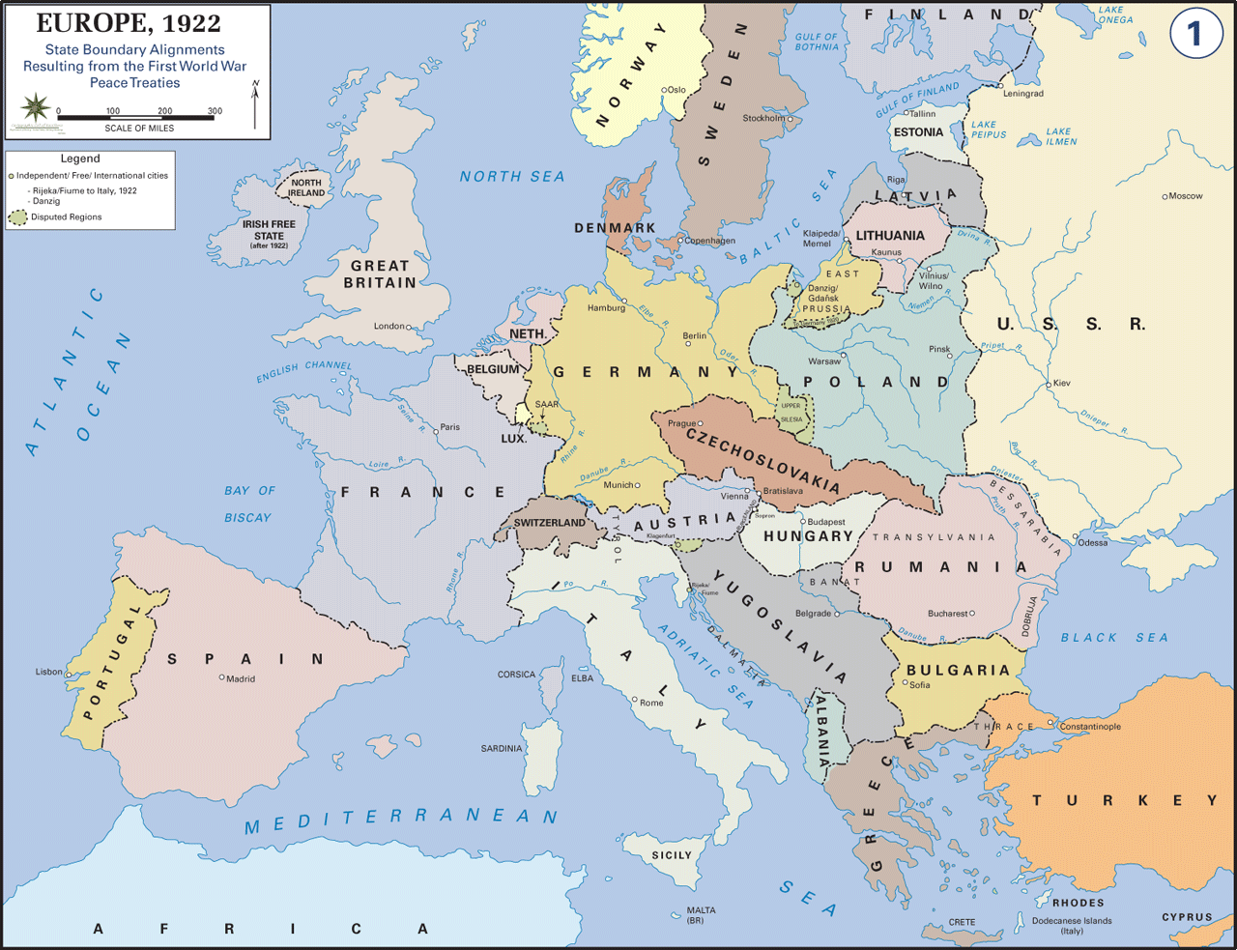
Europe after World War I

