Slide 1
COS Standard 3
Explain the US changing role in the early 20th century as a world power.

Slide 2
Analyzing the involvement of the US in the Hawaiian Islands for economic and imperialists reasons.
Chapter 17-1

Slide 3
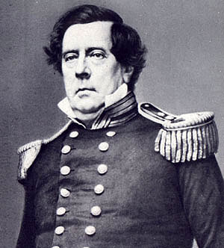
Trade with Asia
America was looking for other countries to trade with when they expanded across the Pacific Ocean.
Trade with Japan or China
Japan did not want to trade with the US
Franklin Pierce sent Commodore Matthew Perry to negotiate a treaty with Japan.
The Japanese were so impressed by American technology and power that they signed a treaty with America.

Slide 4
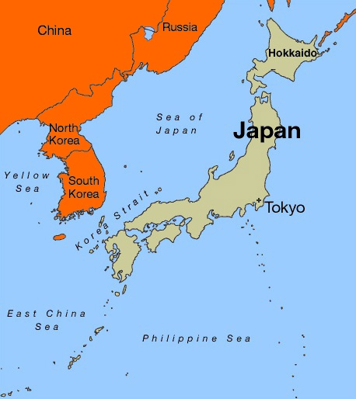
Treaty of Kanagawa
Treaty of Kanagawa- March 31, 1854. Opens the ports of Shimoda and Hakodate to American trade
Eventually, Japan had a powerful navy built its own empire in Asia.

Slide 5
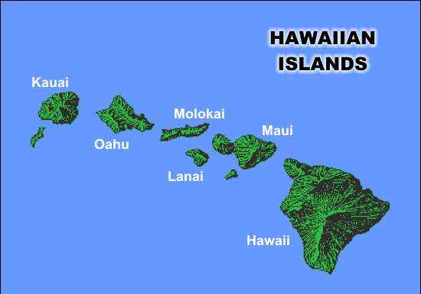
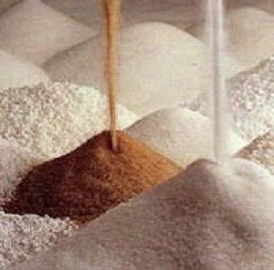
Hawaii
In 1872, there was a recession in Hawaii due to the McKinley Tariff which raised import rates on foreign sugar.
US. Knew if they annexed Hawaii, the tariff problem would disappear.
The next time taxes were due for Hawaii, US asked for a naval base in exchange for no taxes.
  Pearl Harbor
Huge boom in sugar

Slide 6
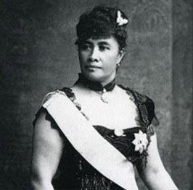
Hawaii continued
The McKinley Tariff of 1890 gave subsidies to sugar producers in the US, which causes the sale of sugar to decline.
Hawaiian economy will decline.
Queen Liliuokalani becomes queen of Hawaii in 1891.
  Unhappy with American influence
US and Hawaiian planters force queen to give up her position.

Slide 7
Hawaii continued
Queen Liliuokalani unsuccessfully tried to impose a new constitution on the Hawaiian people.
The treaty tried to reassert her power as the ruler of Hawaii.
The planters sided with the US and set up a temporary government.
In addition, they asked for the US to annex the islands.

