Slide 1
COS Standard 3
Explain the US changing role in the early 20th century as a world power.

Slide 2
Identifying the role of the Rough Riders on the iconic status of President Theodore Roosevelt and describing consequences of the Spanish-American War, including the Treaty of Paris 1898, insurgency in the Philippines and territorial expansion in the Pacific and Caribbean
Chapter 17 Section 2

Slide 3
Rough Riders
Name given to the First U.S. Volunteer Cavalry under the leadership of Theodore Roosevelt (Teddy)
  Teddy was the Assistant Secretary of the Navy before the war. He resigned in 1898 to organize the Rough Riders.
  Made up of College Athletes, Hunters, Cowboys and Native Americans
Battle of Las Guasimas- June 24th
Battle of San Juan Heights-July 1st
  Kettle Hill-Roosevelt rides his horse, Texas, up and down the hill encouraging his men forward

Slide 4
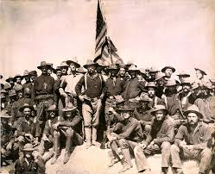
Rough Riders

Slide 5
Buffalo Soilder
Originally formed as an all African American Calvary regiment to help protect American settlers out west.(Indian Wars)
Spanish-American War- only African Americans to see the war against the Spanish
  Played a key role in the Battle of San Juan Hill aiding Roosevelt’s Rough Riders.

Slide 6
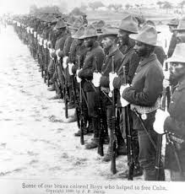
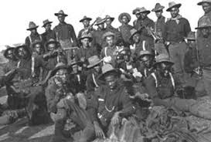
Buffalo Soldiers

Slide 7
Philippines
US Navy attacks Spanish fleet in Philippines.
Pilipino rebels had already started to revolt against Spanish rule in 1896
U.S. Navy Commander George Dewey led the U.S. Asiatic Squadron that destroyed the Spanish fleet at Manilla Bay. (May 1, 1898)-1st battle of war
Spanish are ill-prepared due to them focusing much of their attention on Cuba
McKinley sent troops to secure the Philippines and took Guam as well.

Slide 8
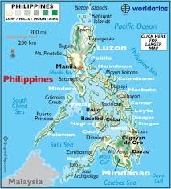
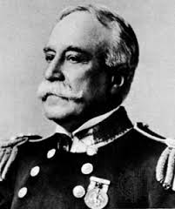
George Dewey and Map of Philippines

Slide 9
The end of the Spanish American War
U.S. War Ships led by Admiral William Sampson destroyed Spanish troops at Santiago
Spain surrenders at Santiago.
  Spain surrenders Cuba to the Americans
August 12, 1898: Armistice signed putting an end to the fighting
  (Armistice= Ceasefire)
  U.S. has little problem defeating the Spanish during this short war)

Slide 10
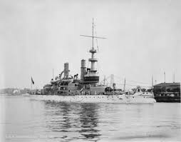
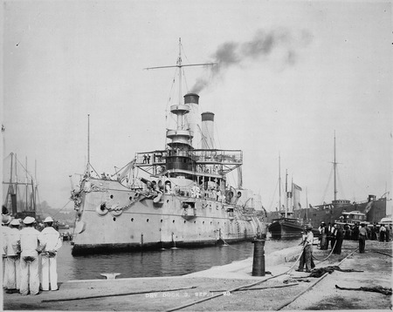
Left: USS Massachussets/ Right: USS Iowa

Slide 11
Treaty of Paris 1898
Signed December 10, 1898
Cuba is an independent country and a U.S. protectorate
US gets Puerto Rico and Guam
US pays $20 million for Philippines
  Pilipino insurgents who were fighting the Spanish now turn their attention towards Americans now
US is now an imperial power.

Slide 12
Controlling Imperial Powers
Philippines tried to revolt on Americans stationed there
Arthur McArthur sets up re-concentration camps killing many.
Taft went to Philippines to reform the less civilized people there. Filipino people eventually become less hostile and resistance will stop.
In 1946, US granted independence to the Philippines.

Slide 13
Controlling Imperial Powers continued
Foraker Act or known as the Organic Act of 1900
  Establishes a civilian government on the island of Puerto Rico
All federal laws of the United States would be in effect on the Island
Self government
1917: granted statutory citizenship of US under the Jones-Shafroth Act

Slide 14
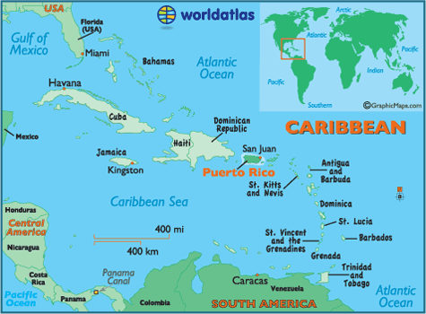
Map of Puerto Rico and Cuba

Slide 15
Controlling Imperial Powers continued
Platt Amendment:
  Cuba cannot make a treaty with another nation that would weaken its power or allow another foreign power to gain territory in Cuba
  Allow US to buy or lease naval stations in Cuba
  Keep debt low to prevent other countries from landing troops there to enforce payment
  US has right to intervene to protect Cuba’s independence and keep order.
Repealed in 1934.

