Slide 1
COS Standard 3
Chapter 4
Trace the chronology of events leading to the American Revolution including the French and Indian War, passage of the Stamp Act, the Boston Tea Party, the Boston Massacre, passage of the Intolerable Acts, the Battles of Lexington and Concord, the publican of Common Sense and the signing of the Declaration of Independence.

Slide 2
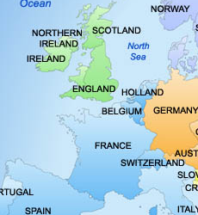
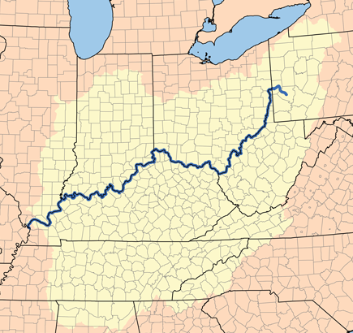
French and Indian War
The fourth war between Great Britain and France for control of North America
Effects on America: common interests of land in Ohio River Valley, build forts to claim land
1754- French build Fort Duquesne in Ohio River Valley
The British ask George Washington to counter by building Fort Necessity 40 miles from Fort Duquesne

Slide 3
French and Indian War continued
The battles at Fort Necessity started the French and Indian War
  Washington retreats in a British loss
Washington gets a chance to redeem himself at Fort Duquesne by helping British General Edward Braddock- loss this battle as well
The British turn to the powerful Iroquois Nation for help
Turning Point of French and Indian War: Battle of Quebec: British launch a surprise night attack catching the French of Guard/ British Victory

Slide 4
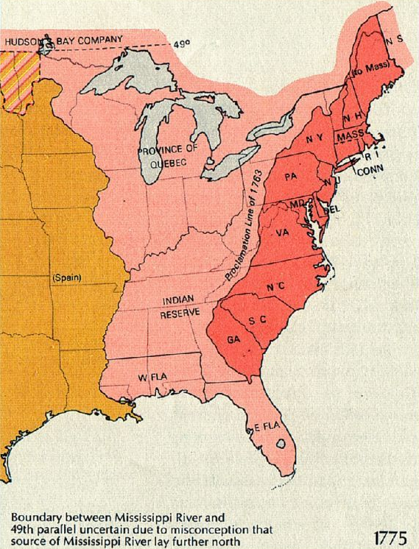
French and Indian War continued
War fought on the frontier became known as the French and Indian War in America.
In Europe, the war goes by a different name: Seven Years’ War.
Treaty of Paris 1763: ends war and eliminates French power in America with Britain claiming all of North America east of the Mississippi including Florida
War makes a lot of debt for England, expects colonies to help pay for war: tax them.
Royal Proclamation of 1763
  Banned all settlement west of the Appalachians to keep from going to war with Native Americans. The ban established a proclamation line that colonists could not cross.

Slide 5
Acts
Navigation Acts of 1660: Parliament requires all goods not produced by mother country, to be shipped only to England or other English colonies
  Tobacco, Cotton, Sugar
Navigation Acts of 1663: Parliament requires all European merchandise in route to the colonies must go through England to be assessed for tariffs and be shipped out on English ships
Leads to colonist smuggling goods.
Smugglers would go to Nova Scotia to be tried for their crimes. Naval officers in Nova Scotia were unsympathetic to smugglers.

Slide 6



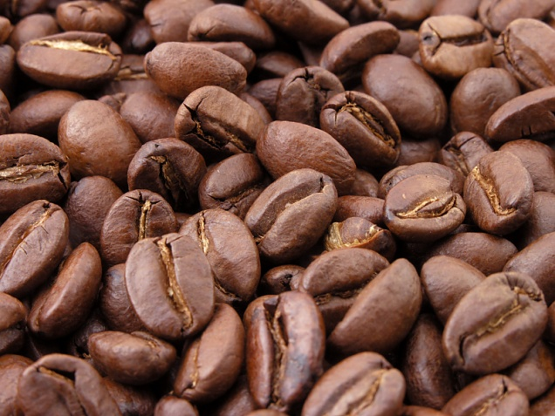
Acts continued
Sugar Act 1764: changed tax on sugar and molasses to help British sugar growers in the West Indies
  placed tax on silk, wine, coffee, pimento and indigo.
  No taxation without representation.
Currency Act of 1764: bans the use of paper money in the colonies, to slow inflation

Slide 7
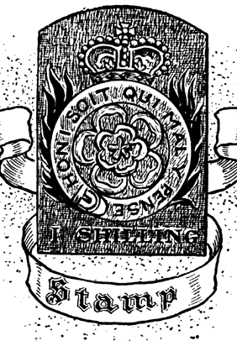

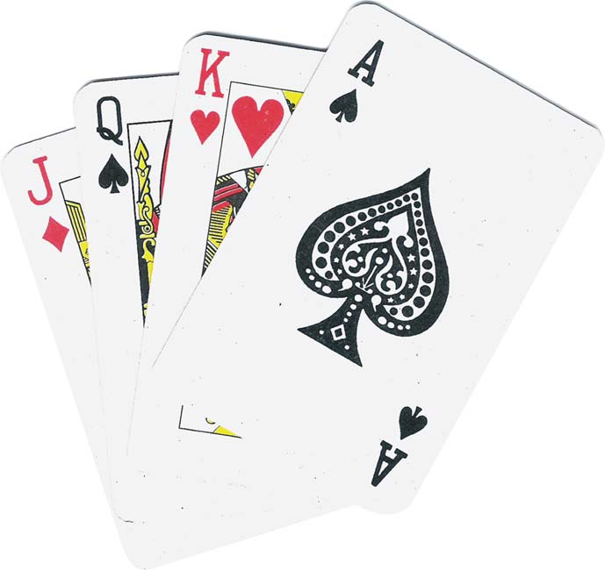
Acts continued
Stamp Act of 1765: 1st direct tax on colonist. Imposed a tax on all paper documents in the colonies
  Legal documents, licenses, newspapers, playing cards
Quartering Act of 1765: forces the colonists to provide a place for British soldiers to stay

Slide 8


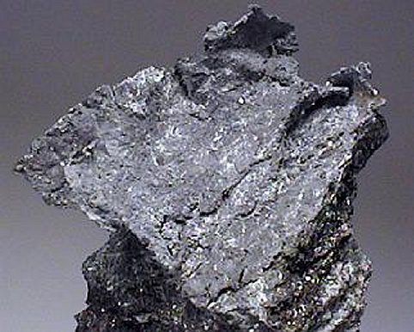

Acts continued
Once the Stamp Act was repealed, British parliament passed the Declaratory Act: gave Parliament the power to make laws for the colonies.
Townshend Act:
  Revenue Act of 1767: new taxes on glass, lead, paper, paint and tea, legalized writs of assistance (gave British soldiers the right to seize property without due process)

Slide 9
Acts continued
Colonist boycott Townshend Acts, finally repeal Townshend Acts after Boston Massacre on everything except tea.
Tea Act of 1773: British East India Company is bankrupt, England tries to save it by forcing cheap tea on colonist. Colonist boycott tea and keep smuggling in tea. Tea Act leads to Boston Tea Party.
Intolerable Acts: Coercive Act and Quebec Act: suspended trial by jury, troops quartered in homes, no exports/imports until tea is paid for, gave more land to Quebec.

Slide 10
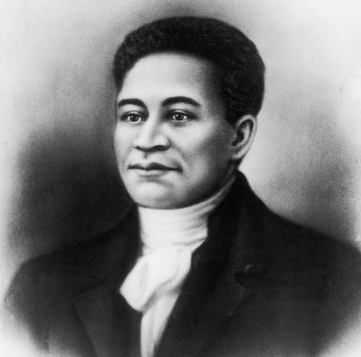
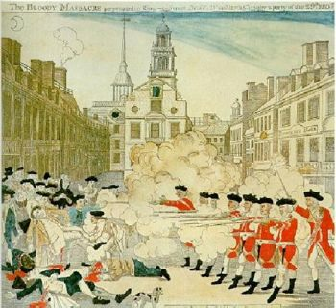
Boston Massacre
March 5, 1770
Bostonians taunt British soldiers by throwing snow covered rocks at them and calling them “lobsterbacks”. British retaliate by firing into the crowd, killing 5 including Crispus Attucks.
  First man to die in the American Revolution

Slide 11
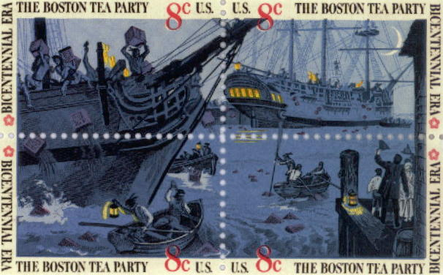
Boston Tea Party
Sons of Liberty (Samuel Adams) encourage boycotts of goods
American patriots disguised as Mohawk Indians boarded a British ship in the Boston Harbor and dumped 342 chests of tea into the harbor
  Protesting: 1) tax on tea, and 2) perceived monopoly of the East India Company
  Leads to Intolerable Acts.

Slide 12
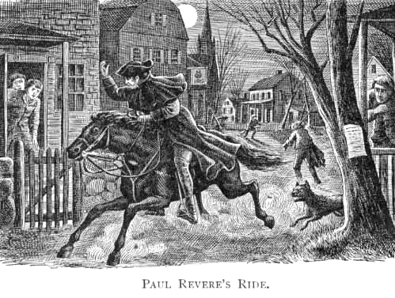
Lexington and Concord
April 18, 1775: British troops sent to seize supply depot at Concord and must pass through Lexington.
Paul Revere and William Dawes warned Lexington that the British were coming. Dr. Samuel Prescott warned Concord.
The British pass through Lexington with little problems, but are forced to retreat at Concord.
  Minuteman- ready at a moments notice

Slide 13
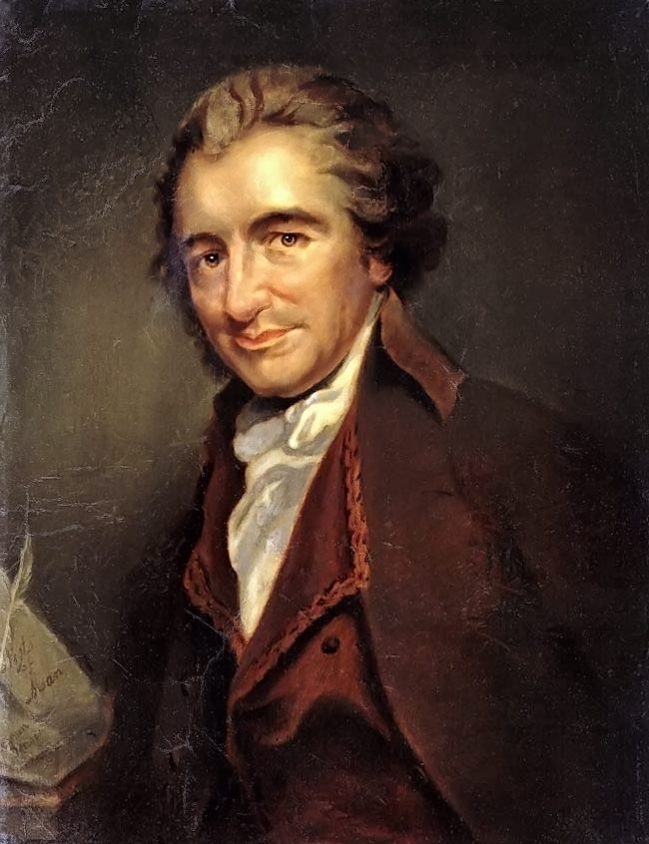
Common Sense
Pamphlet written by Thomas Paine
Lists the reasons why Americans want their independence
Challenged the authority of the British government and royal m0narchy
Leads to writing and signing the Declaration of Independence

Slide 14
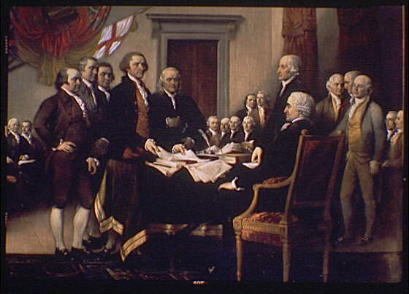

Declaration of Independence
Written by Thomas Jefferson
Used enlightened ideas of Locke, Rousseau and Montesquieu
Declares independence from the king of England
1st signer: John Hancock
Approved and signed on July 4, 1776
Begins American Revolution

