Slide 1
COS Standard 3
Explain the US changing role in the early 20th century as a world power.

Slide 2
Describing causes of the Spanish-American War, including yellow journalism, the sinking of the Battleship USS Maine and economic interests in Cuba
Chapter 17 Section 1 and 2

Slide 3
Imperialism
Imperialism is the policy of extending a country’s power and influence through territorial acquisition, diplomacy, or military force.
  Economic and political domination of a strong nation over a weaker nation.
    Raw materials needed
Americans want to develop overseas markets
  Use Social Darwinism and Spreading “Anglo-Saxonism” to justify expansion

Slide 4
Social Darwinism
Natural Selection, or survival of the fittest.
The application of Darwinism to the study of human society, specifically a theory in sociology that individuals or groups achieve advantage over others as the result of genetic or biological superiority.
  American use this idea to help justify their reasons for expanding their nation.

Slide 5
Cubans Revolt-background
Spain
United States
Owned Cuba along with the Philippines, Guam, and Puerto Rico
Used Cuba for sugar cane cultivation
American’ sympathy went out to the Cuba people
American capitalist wanted to invest in the Cuban sugarcane industry
The U.S offered to by Cuba from Spain, but the Spaniards denied American offers claiming they would rather see Cuba sunk in the Ocean.

Slide 6
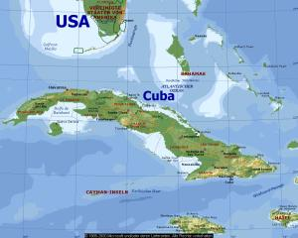
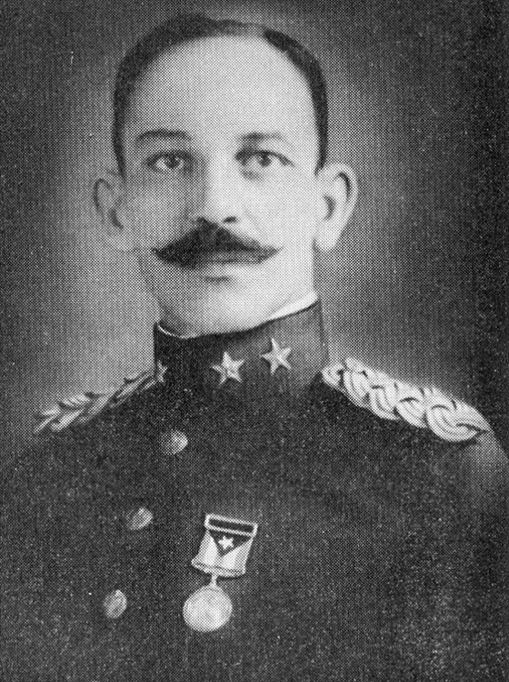
Causes of Spanish American War
Jose Marti
  A Cuban journalist and poet in exile in New York, launches the revolution in 1895
  Marti hopes to provoke American intervention into the war by attacking American owned sugarcane mills and plantations.
  The rebels themselves, gain control of Eastern half of Cuba
    “Cuba Libre”

Slide 7
Yellow Journalism
This is the use of sensationalized and exaggerated reporting by newspapers or magazines to attract readers
American News paper tycoons William Randolph Hearst and Joseph Pulitzer
These two men used yellow journalism to lure the American readers in which deepened American sympathy towards the Cuban Rebels.

Slide 8
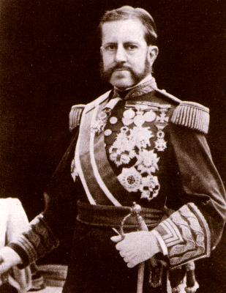
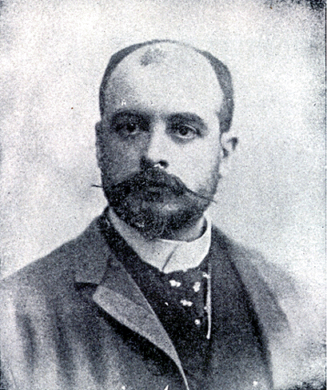
Causes of the Spanish American War continued
Spain invoked harsh punishments on Cuba and appointed Spanish General Valeriano Weyler as governor.
  Uses barbed wire concentration camps to restore order
  Kills many Cubans
The Spanish Minister to United States, Enrique Dupuy de Lome, writes a letter that is intercepted

Slide 9
The De Lome Letter
Stolen by a Cuban rebel from a Havana post office and then leaked to the newspaper.
The letter criticizes President McKinley calling him “weak” and “a bidder for the admiration of the crowd.”
This event embarrassed the Spanish government and they would apologize.
The apology had little effect on Americans being angry that their president had been deeply insulted

Slide 10
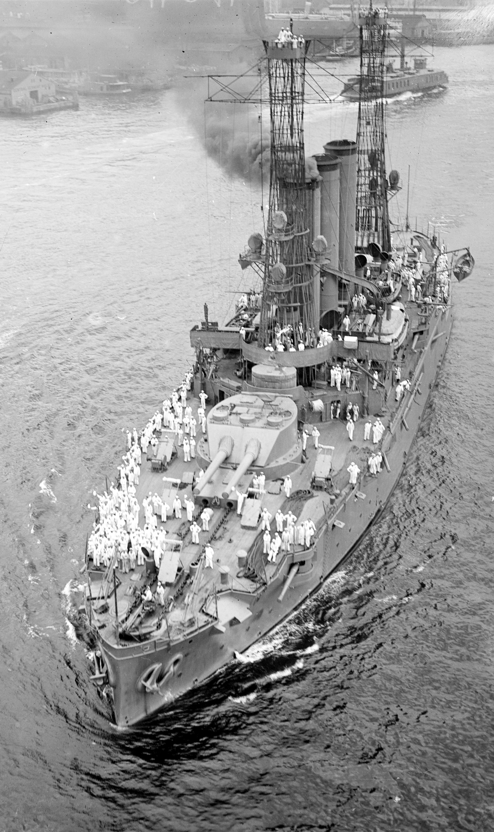
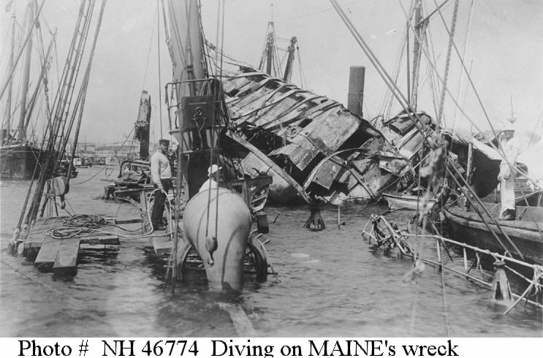
Cause of Spanish American War continued
USS Maine- sent to bring home American citizens in danger of the fighting and to protect American Property
Anchored in Havana, the ship exploded killing some 260 Americans. America blames Spain. No one knows why it exploded really though.

Slide 11
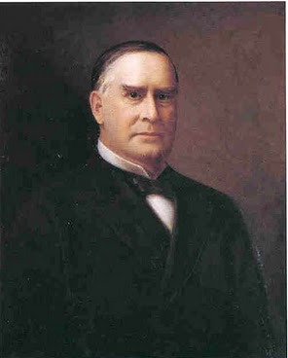
Causes of Spanish American War Continued
1898 McKinley authorizes Congress to declare war on Spain April 21st, 1898.
Splendid little war begins.

