Slide 1
COS Standard 2
Compare regional differences among early New England, Middle and Southern colonies regarding economics, geography, culture, government and American Indian relations.

Slide 2
Compare regional differences among early New England, Middle and Southern colonies regarding economics, geography, culture, government and American Indian relations as well as explaining the significance of the House of Burgesses and New England town meetings in colonial politics.
Chapter 3 as well as 2-3

Slide 3
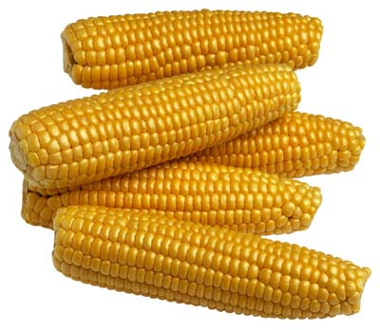
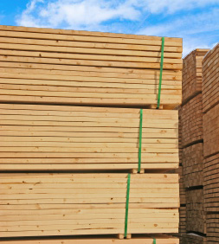
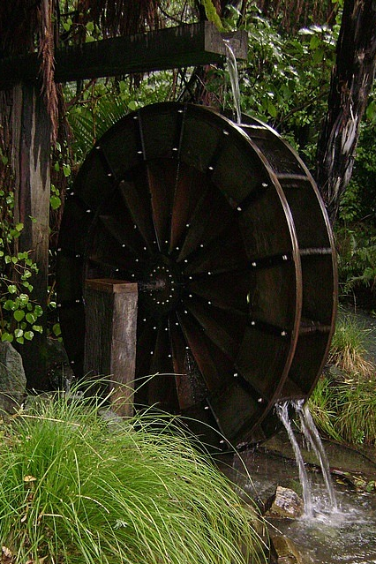
New England
Practiced subsistence farming: planting only for you and your family
Corn
Plankton: good food source for fish and whales
Lumber: furniture, barrels and shipbuilding
Waterfalls: powered mills
Rivers: transported goods

Slide 4
New England Towns
Towns were the heart of the New England society.
Town Meetings: discuss local issues and problems, pass legislation and elect officials
Voting limited to men who own property.
Selectmen: a member of the local government that helps manage town affairs
Felt like they had the right to govern themselves
Set stage for the emergence of democratic government

Slide 5
New England Class System
Upper Class: Wealthy merchants, industry owners, Doctors, Lawyers, some Ministers
Middle Class: Artisans which were skilled workers who knew how to manufacture goods (carpenters, masons) as well as innkeepers, retailers, sailors, ministers
Lower Class: Unskilled workers, slaves, farmers, indentured servants

Slide 6
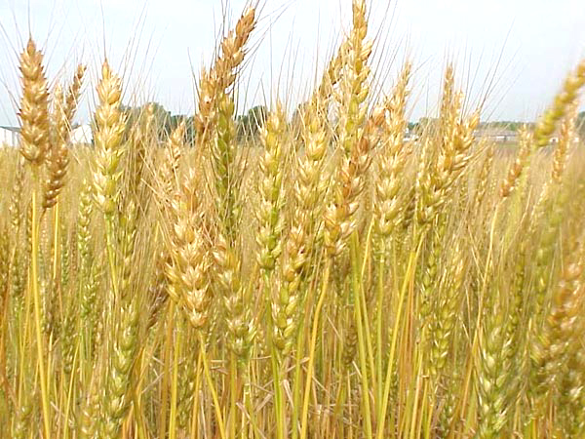
Middle Colonies
Fertile farmland with surplus crops
Wheat
Rivers transport products to ships (smaller ships sail the rivers to exchange European goods for farm goods)
Towns arise at where the rivers empty into the ocean
Very prosperous because of population boom (wheat needed to feed the population)

Slide 7
Middle Colonies Class System
Upper Class: Rich Farmers, Doctors, Lawyers, Mill Owners, Owners of large lands rented to tenant farmers
  Entrepreneurs: risked their capital by buying land, equipment, and supplies and selling them for a profit
  Capitalism: an economic and political system in which a country’s trade and industry are controlled by private owners for profit, rather than by the state
  Capitalist: a wealthy person who uses money to invest in trade and industry
Middle Class: Most farmers, teachers, small business owners
Lower Class: Slaves and Poor tenant farmers

Slide 8
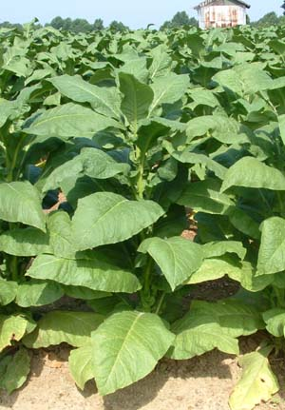
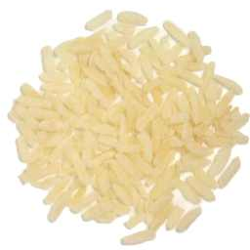

Southern Colonies
Cash Crop:
  North Carolina, Virginia and Maryland: Tobacco
  South Carolina: rice and indigo
Rivers transport crops
Plantations, large workforce, intensive manual labor required
Use indentured servants or slaves to cultivate crops
  Indentured servants work until contract has expired. Supplied passage to America, room, board and clothes

Slide 9
Southern Colonies Class System
Upper Class: Wealthy landowners (planter elite), Doctors, lawyers, business owners
  Influential in politics and economy
  Self sufficient communities
Middle Class= Yeomen farmers, overseers, small shop owners, peddlers, teachers
  Yeomen farmer= owned his own land and family worked
    Practiced subsistence farming
  Peddlers= a person who goes from place to place selling small goods
Lower Class: Slaves, indentured servants, backcountry farmers

Slide 10
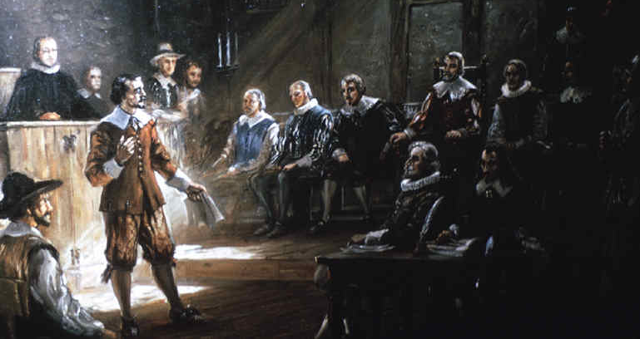
House of Burgesses
First legislative assembly of elected representatives in North America
All free men can vote until Governor Berkeley manipulates House of Burgesses into making only men who own property have the right to vote
Legislative body in Virginia
22 original delegates
1619-1776

Slide 11
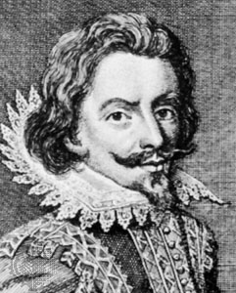
House of Burgesses continued
Bacon’s Rebellion:
  Yeomen farmers want more land, only land left was near Native Americans, thus expanding the colony is a no go;
  A fight breaks out with Native Americans, Berkeley does nothing, upsets yeomen

Slide 12
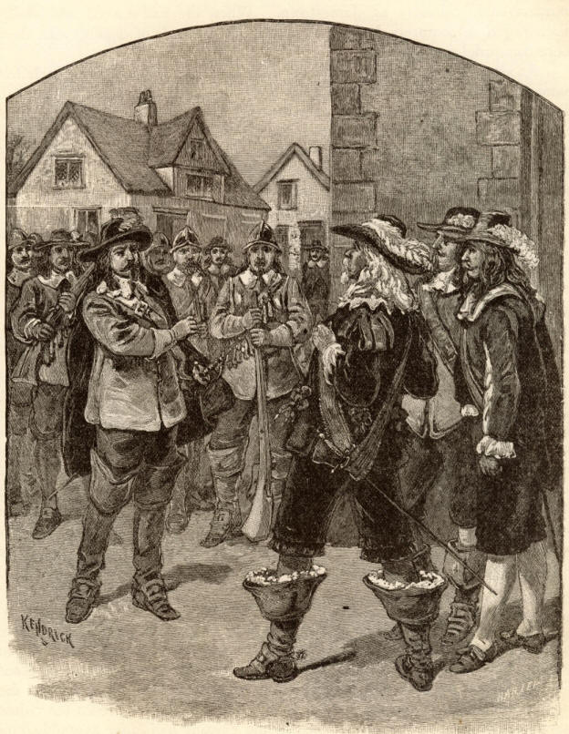
House of Burgesses continued
Bacon’s Rebellion continued…
  Nathaniel Bacon organizes a militia and attacks Native Americans; Berkeley gets the House of Burgesses to address the situation;
  The burgesses allow Bacon to attack Native Americans and restore vote to all free men
  Bacon is upset and seizes control of Jamestown, Berkeley flees and raises own army
  They fight, but it ends quickly because Bacon dies

Slide 13
House of Burgesses continued
Bacon’s Rebellion continued:
  Everyone needs to have land available to them
  Increases purchasing of slaves

