Slide 1
COS Standard 2 Part C
Compare regional differences among early New England, Middle and Southern colonies regarding economics, geography, culture, government and American Indian relations.

Slide 2
Describing the impact of the Great Awakening on colonial society
Chapter 3 Section 4

Slide 3
Salem Witch Trials
The Trials of 1692 caused many people to question the existence of witch-craft and began a mass hysteria of accusations
Tituba- West Indian slave woman accused of practicing witchcraft
Many accusers were poor and brought accusations against richer residents
Court of Oyer
Gallows Hill
Once hysteria ended- 19 persons hung and one man crushed to death

Slide 4
Enlightenment
The colonists were less dedicated to religion as they were when the colonies were founded.
New ideas challenged the church (enlightenment)
Stressed pietism: individual’s devoutness and emotional union with God
Pietism is spread through revivals (large public meetings for preaching and prayer)

Slide 5
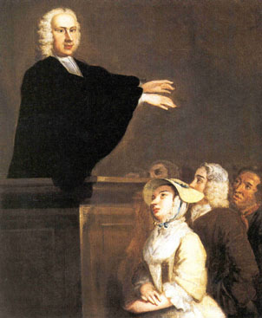
Great Awakening
Massachusetts charter of 1691-forced Puritans to allow freedom of worship and banned the practice of only Puritan church Members could vote
People did so well in the new world in this life, that they paid little attention to the next

Slide 6
Great Awakening Cont…
Puritan merchants developed a taste for material possessions and sensual pleasures the more the prospered
Jonathan Edwards- member of the clergy who sought to revive the intensity and commitment of the original puritan vision
Edwards preached that:
  Church attendance was not enough for Salvation
  People must acknowledge their sinfulness ways and fell God’s love
“Sinners in the Hand of an Angry God”
  Most famous sermon were he vividly describes Gods Mercy

Slide 7
Great Awakening
Lasted from 1730’s to 1740’s
Traveling preachers traveled around holding religious revivals preaching to thousands
Brought many colonists as well as Native Americans and African Americans into organized Christian Churches for the first time

Slide 8
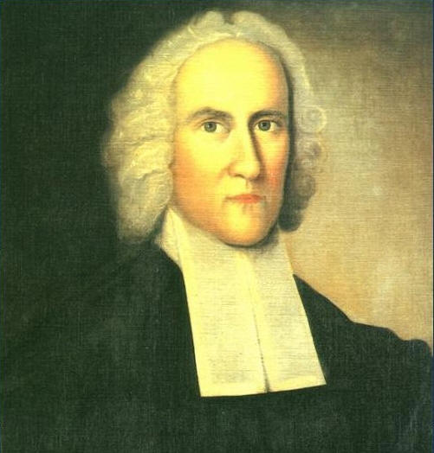
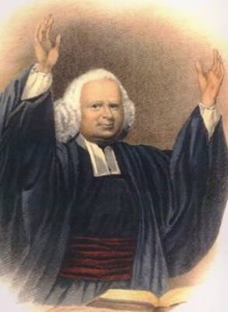
Great Awakening
Jonathan Edwards
  Preached complete dependence on God
  Good works will not save you alone
George Whitefield
  Very powerful preacher of Great Awakening

Slide 9
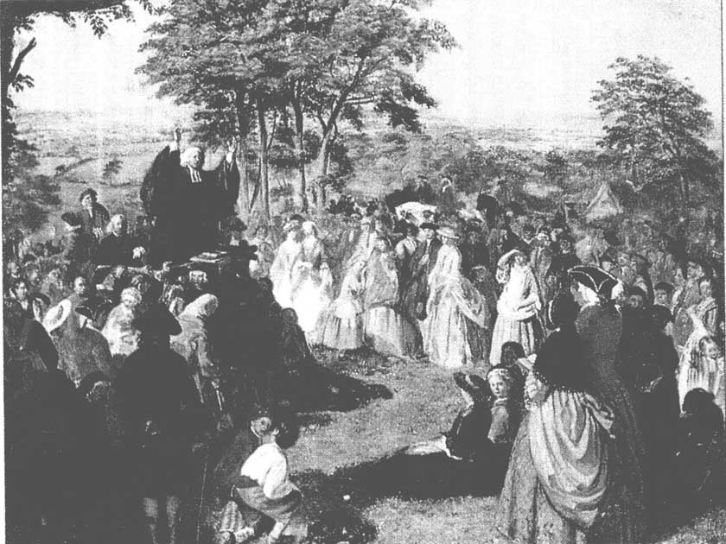
Effects of the Great Awakening
Led to an increase in memberships for Baptists and Methodists
Led to an increase for the desire of higher education
Princeton, Brown, Columbia, Dartmouth
Enlightenment emphasized human reasoning while The Great Awakening deemphasized the role of church authority

