Slide 1
COS Standard 1
Explain the transition of the US from an agrarian society to an industrial nation prior to WWI.

Slide 2
Interpreting the impact of change from workshop to factory on workers’ lives , including the New Industrial Age from 1870-1900, afl-cio, iWW, the pullman strike, the haymarket square riot, and the impact of John d. rockefeller, andrew Carnegie, samuel gompers, eugene v. debs, a. philip randolph and thomas ava edison
Chapter 14

Slide 3
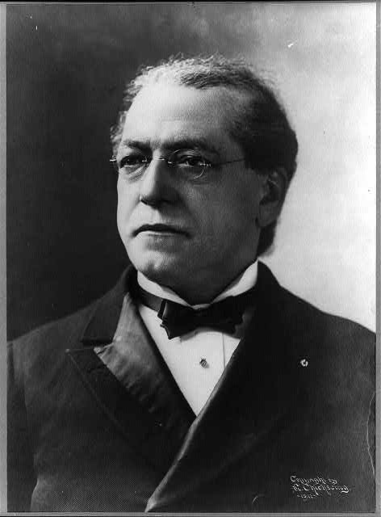
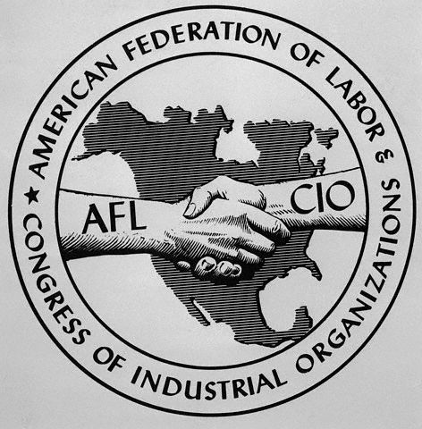
American Federation of Labor-Congress of Industrial Organizations
Group of 20 different trade unions
Leader—Samuel Gompers
  Small gains
  Stay out of politics
3 goals:
  Get companies to recognize unions and agree to collective bargaining
  Push for closed shops (hire only union members)
  Promote 8 hour work day

Slide 4
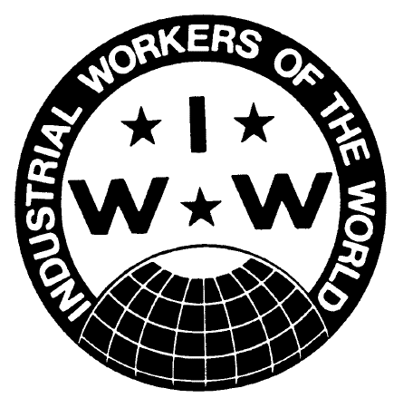
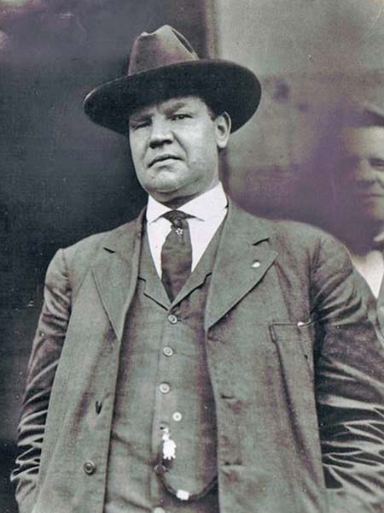
Industrial Workers of the World
Leader: Bill Haywood
Nicknamed the Wobblies
Labor union for skilled and unskilled workers
  Mining and lumber workers
Goal: ultimate destruction of the state and replace it with one big union

Slide 5
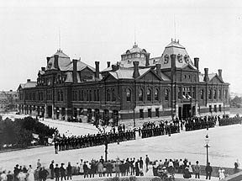
The Pullman Strike
Railroad workers created the America Railway Union; Pullman Palace Car Company.
Recession caused the company to cut wages, people boycott, hurt railroads and economy.
End boycott: US mail cars were attached to Pullman cars.
Result: ends boycott, strike and union.

Slide 6
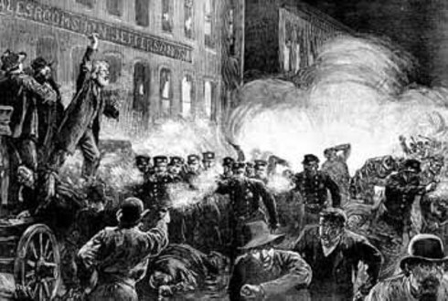
Haymarket Square Riot
Nationwide strike to support 8 hour workday
There is a meeting the next day to protest the killing and a bomb is thrown by an unknown person (suspect is a Knights of Labor member)
Seven police officers and several workers die
Knights of Labor decline

Slide 7
General Information
After the Civil War, industry expands and millions of Americans move to the cities for work.
Water, timber, coal, iron and copper are natural resources that lead the US to industrialize.
Petroleum demands create the oil industry.
Entrepreneurs were people who risked their money to organize and run a business.
American industries grew and were highly competitive. They encourage free trade.

Slide 8
General Information continued
A corporation is an organization owned by many people. They sale stock which are shares of ownership. (Coke)
A monopoly occurs when a company gains control of the entire market. (Microsoft)
A trust merges businesses without violating laws against owning other companies. A trust allows a person to manage another person’s property. (Standard Oil)
A holding company owns the stock of companies that produce goods.

Slide 9
General Information continued
Reasons why Unions formed…
  US experiences deflation
  Deflation caused prices to fall
  Companies cut wages
Improve working environment meant organizing unions.

Slide 10
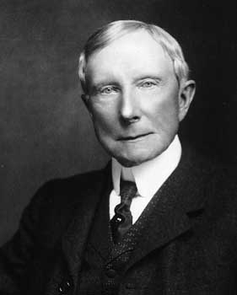
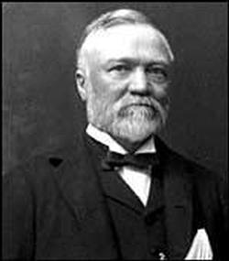
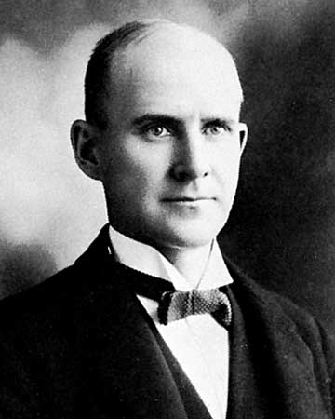
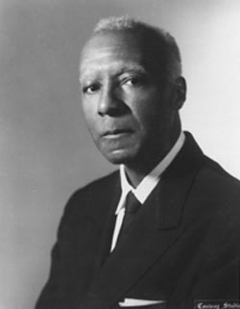
Men to know
John D. Rockefeller: Standard Oil
Andrew Carnegie: US Steel, Bessemer Process, the Gospel of Wealth, philanthropy
Samuel Gompers: leader of AFL
Eugene V. Debs: founder of American Railway Union
A. Philip Randolph: organized March on Washington Movement to end racial discrimination in defense industries

Slide 11
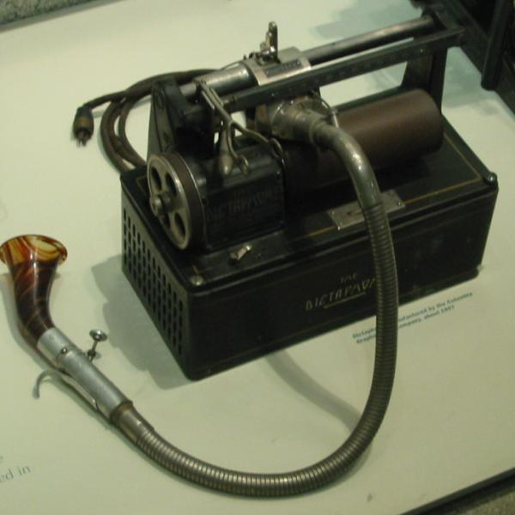
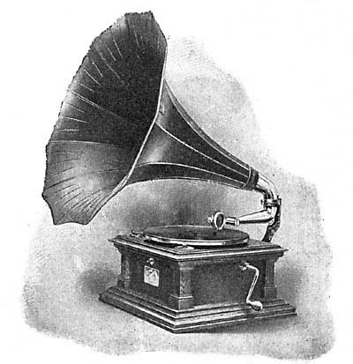
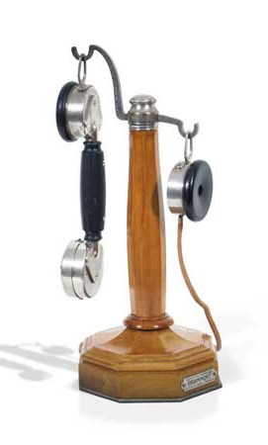

Men to know continued
Alexander Graham Bell: telephone
Thomas Alva Edison: invented/perfected phonograph, light bulb, electric generator, dictaphone and motion picture

