Slide 1
COS Standard 1
Explain the transition of the US from the agrarian society to the industrial nation prior to WWI.

Slide 2


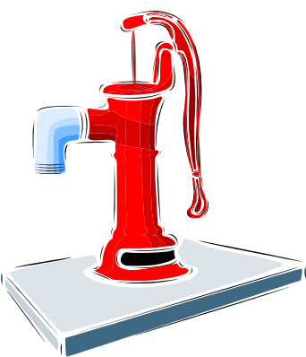
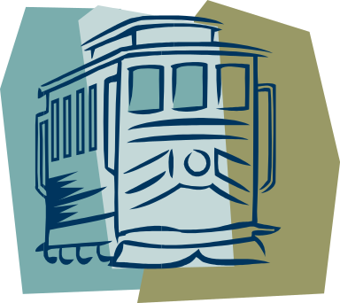


Cities
Farmers migrated to cities.
  Better paying jobs
  Electricity
  Running water
  Plumbing
  Entertainment
Housing and transportation change because the amount of people moving to the cities.
  Skyscrapers
  Electric trolley cars
  Elevated railroads

Slide 3
Classes
Wealthy live in heart of city in elaborate homes.
Middle class lived away from the city.
Most of the lower class lived in tenements (dark, crowded multi-family apartment).

Slide 4

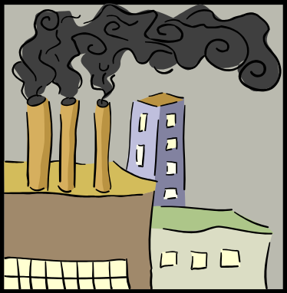
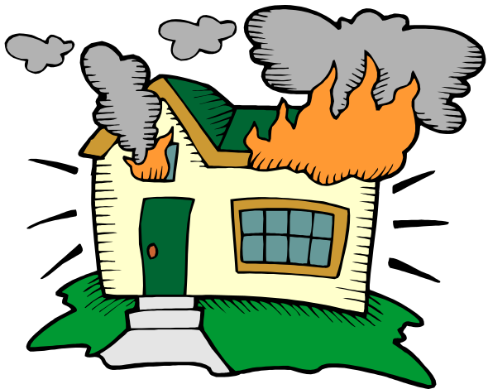
Problems
Crime
Fire
Disease
Pollution

Slide 5
Fixes
The political machines offers help in exchange for votes.
Other organizations offer day cares, gyms, social programs, citizenship training, bible studies, prayer meetings, medical care, English classes, recreation programs and a push for improving living conditions.

