Slide 1
COS Standard 1
Explain the transition of the US from an agrarian society to an industrial nation prior to WWI.

Slide 2
Comparing population percentages, motives and settlement patterns of immigrants from Asia, Africa, Europe and Latin America, including the Chinese Immigration Act regarding immigration quota.
Chapter 15 Section 1

Slide 3


Immigration
Many Europeans came to America by the 1890s.
  European Jews
Reasons to come to America…
  Employment
  Few immigration restrictions
  Avoiding the military
  Religious freedom
  Move up the social ladder

Slide 4
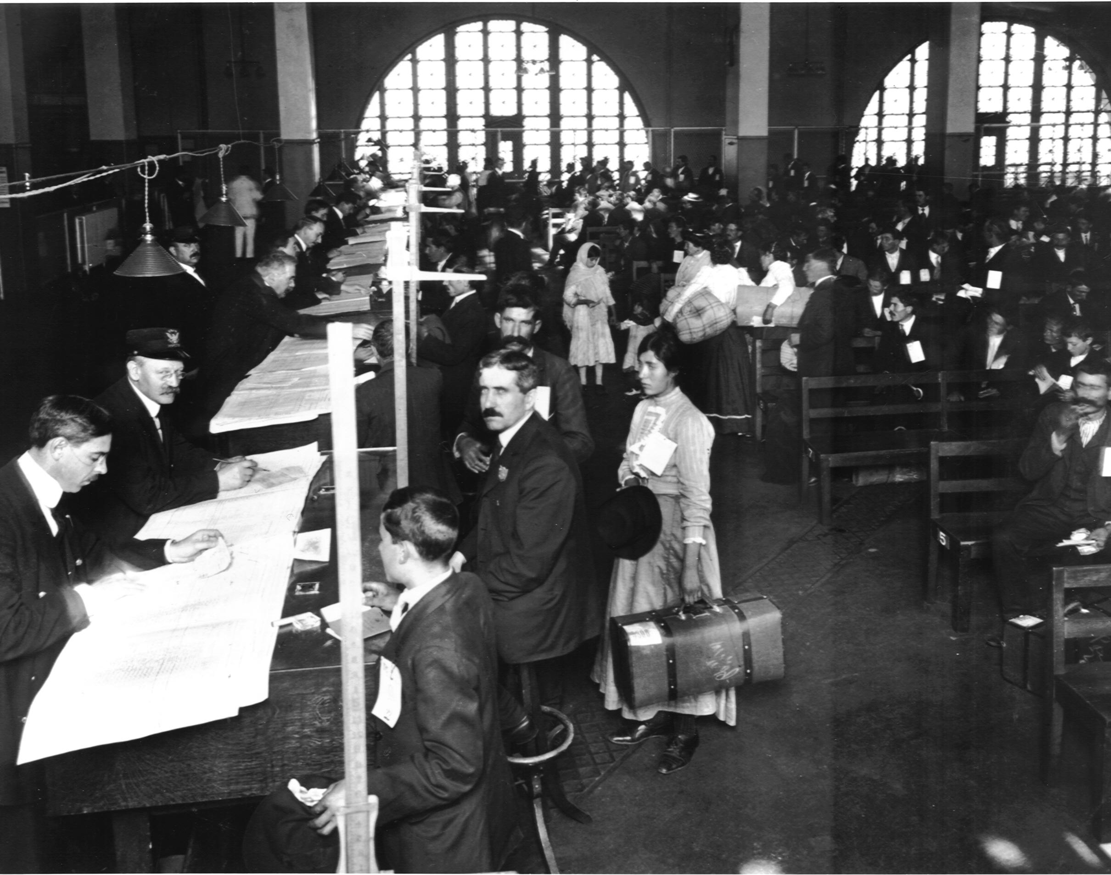
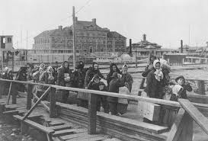
Immigration
Most immigrants came through Ellis Island.
Most settled in cities with people from their homeland.
Those who learned English, adapted to the American culture, had a skill or money, or settled with their ethnic group tended to adjust well to life in America.

Slide 5

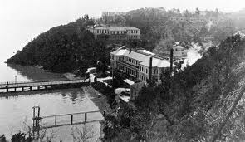


Immigration
People left China for several reasons…
  Unemployment
  Poverty
  Famine
  Discovery of gold in California
  Taiping Rebellion
  Railroad workers
Asian immigrants traveled through Angel Island.

Slide 6
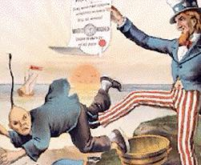
Nativism
Extreme dislike of foreigners by native born people
Desire to limit immigration
Chinese Exclusion Act: barred Chinese immigration and prevented the Chinese who were already in the US from becoming citizens.

