Slide 1
COS Standard 1
Compare effects of economic, geographic, social and political conditions before and after European Exploration of the 15th through 17th centuries on Europeans, American colonists, Africans and indigenous Americans.

Slide 2
Comparing European motives for establishing colonies, including mercantilism, religious persecution, poverty, oppression and new opportunities
Chapter 2-1, 2-2, 2-3, 2-4, 3-3

Slide 3
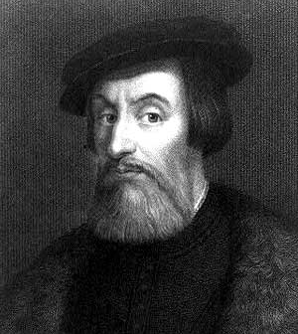
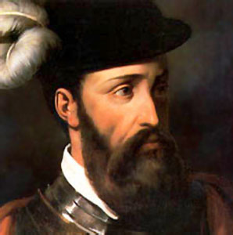
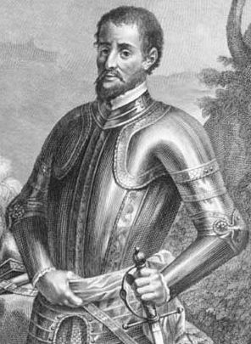
Spanish Conquests
Hernan Cortes: defeated the Aztecs
Francisco Pizarro: conquered the Incan people
Conquistadors: conquerors; God, Gold, Glory
Hernando de Soto: explored area north of Florida
Spanish mined silver and ranched.
St. Augustine was founded to protect the Spanish claim in the region. (Carolina)
  First permanent settlement in America

Slide 4
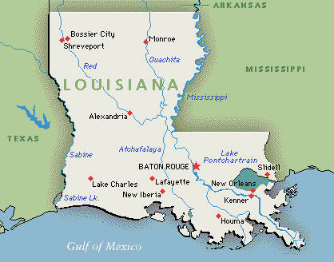
French Conquests
French came to America in search of beaver fur.
  Population grew slowly
  Fur traders lived among the Native Americans with whom they traded.
Louis Joliet and Jacques Marquette explored the Mississippi River.
Rene-Robert Cavelier de La Salle claimed Louisiana for France.

Slide 5
English Conquests
Reasons why England settles America…
  Puritans wanted to purify the Anglican Church of all Catholic elements.
  King James wouldn’t do it and forced many Puritans to leave England.
  Demand for wool increases and landowners convert large estates into sheep farmers, so their tenants were evicted and left unemployed and poor.
  New market for surplus wool

Slide 6
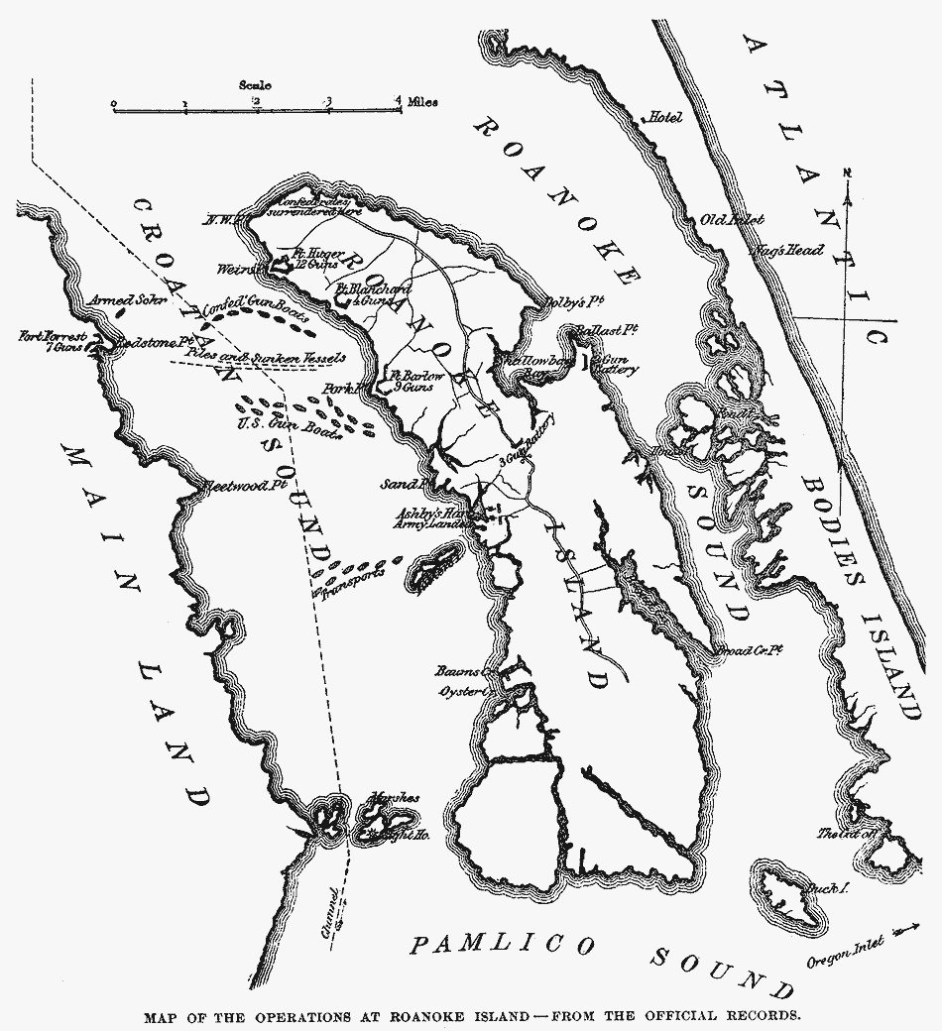
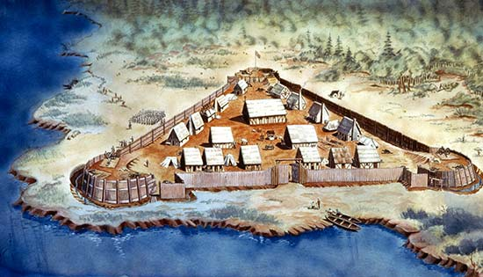
Virginia
Walter Raleigh attempts to settle Roanoke.
Later, another attempt to settle Virginia succeeded at Jamestown.
  Faced problems, but Powhatan Confederacy helped succeed. Later, starving time.
Tobacco
House of Burgesses
Headrights

Slide 7
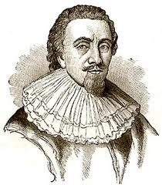
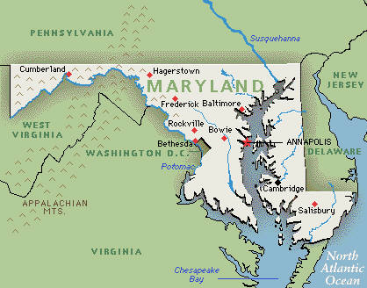
Maryland
Lord Baltimore founded Maryland for Catholics who could practice Catholicism without persecution.

Slide 8
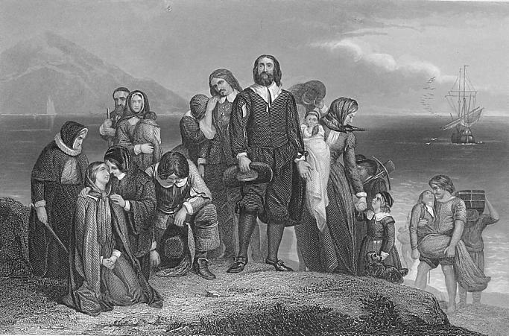
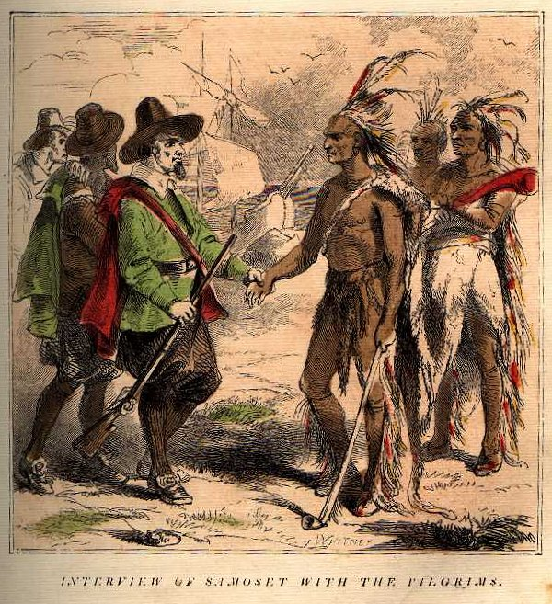
Plymouth
Some Puritans called Separatists broke away from the Anglican Church to make their own colony; these people were known as the Pilgrims.
They first fled to Holland.
In 1620, they sailed to America on the Mayflower and settled near Massachusetts Bay.
William Bradford was their leader.
The Pilgrims survived with the assistance of Squanto, who taught them how to use their environment to meet their needs.

Slide 9
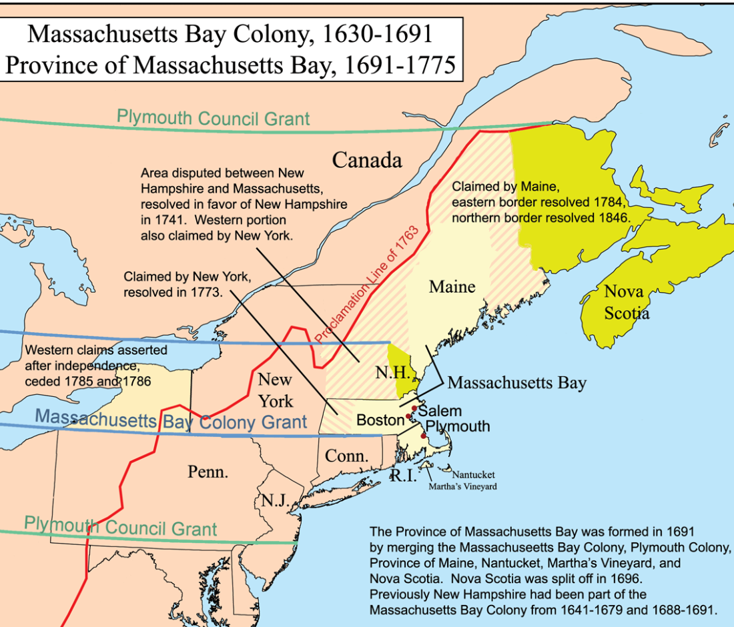
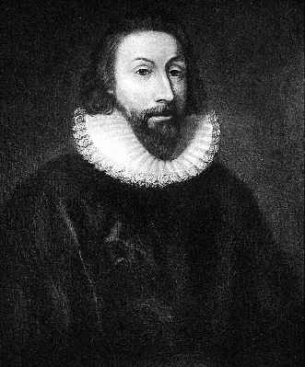
Massachusetts
Bay Company
Other Puritans left England because of persecution and a depression in the wool industry.
John Winthrop started Massachusetts Bay Company as a refuge for Puritans.
Had a General Court and required all colonists to attend church, pay taxes, have good moral behavior.
Intolerant to other religions and heretics were forced to leave.

Slide 10
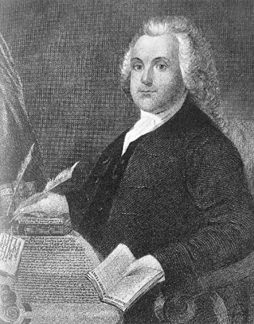
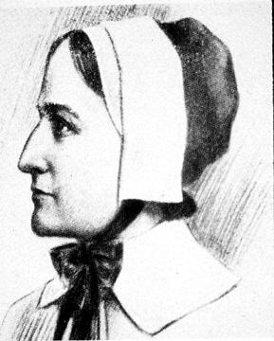
Rhode Island
Roger Williams challenged Puritan authority in Massachusetts and they banned him.
He headed south and founded Providence.
  No authority in religion.
  Religious differences were tolerated.
Anne Hutchinson was declared a heretic and banned as well.
She founded Portsmouth.

Slide 11
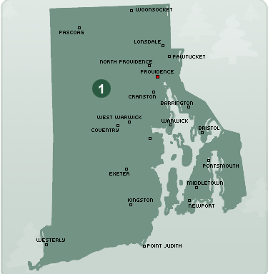
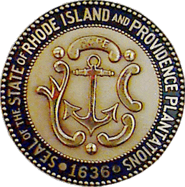
Rhode Island continued
Other heretics were banned as well as and all joined together to become Rhode Island and Providence Plantations.
  Total separation of church and state
  Religious freedom

Slide 12
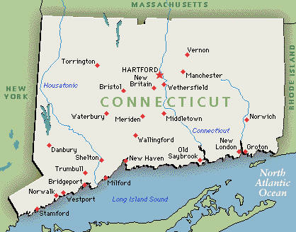
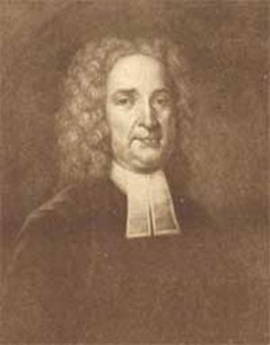
Connecticut
Thomas Hooker opposed the Massachusetts law of only church members could vote.
He created the town of Hartford.
Hartford and two other towns created a General Court and adopted their own Constitution.
  Fundamental Orders of Connecticut

Slide 13
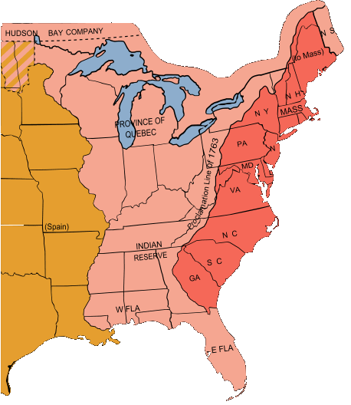
New Hampshire and Maine
New Hampshire became a royal colony
Massachusetts bought Maine.

Slide 14
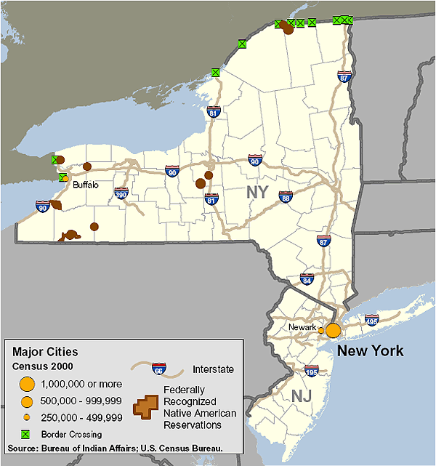
New York and New Jersey
Started by the Dutch, called New Netherland
James seizes New Netherland from the Dutch and renamed it New York
New York was divided into New Jersey
  Land grants
  Religious freedoms
  Elect a legislative assembly

Slide 15
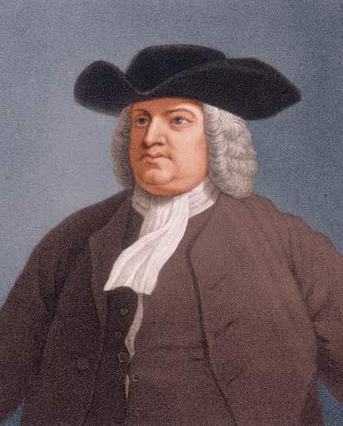
Pennsylvania and Delaware
William Penn received a land grant from Charles II
Quaker refuge
William Penn founded Pennsylvania .
  Legislative assembly
  50 acres of land
  Christian had right to vote
  Practice religion without interference
Penn purchased land south and called it Delaware

Slide 16
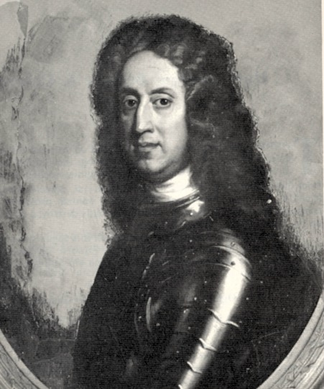
Southern Colonies
North Carolina: population grows slowly, grew tobacco, export naval supplies
South Carolina: Started as a sugarcane colony; didn’t work. Export deerskin and Native Americans as slaves to Caribbean to work on sugarcane plantations
Georgia: James Oglethorpe established as a debtors colony.

