Slide 1
COS Standard 1
Explain the transition of the US from the agrarian society to the industrial nation prior to WWI.

Slide 2
Describe the impact of Manifest Destiny on the economic and technological development of the post-Civil War West, including mining, the cattle industry and the transcontinental railroad.
Chapter 13 Section 1 and Chapter 14 Section 2

Slide 3

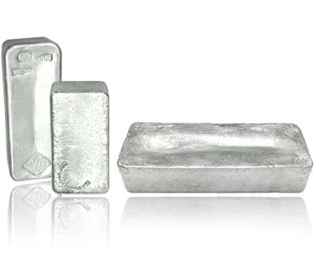
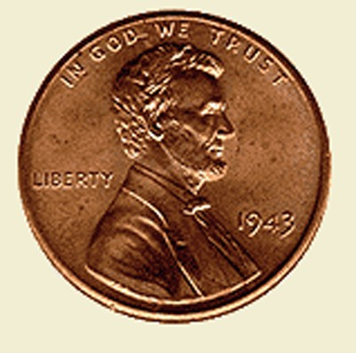
Mining
People in the east needed the resources from the west.
  Gold
  Silver
  Copper
2 ways to mine for resources
  Placer—simple equipment , by hand (picks, shovels, pans)
  Quartz—deep beneath surface with machines

Slide 4
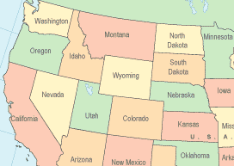
Mining continued
Because of the boom times in mining towns, several places developed.
  Colorado
  The Dakota territory
  Montana
In boom times, crime was a serious problem. Vigilance committees formed to track down and punish wrongdoers.

Slide 5
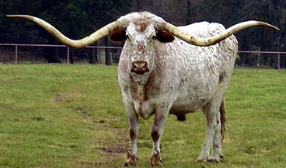
Ranching and Cattle
People began ranching on the Great Plains.
Ranchers began breeding Texas Longhorns because they could withstand the harsh climate on the plains.
Ranching became popular because of the open range.
  Graze herds for free
  No boundaries

Slide 6
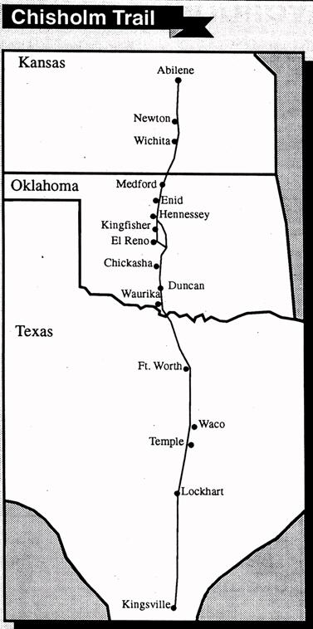
Ranching and Cattle continued
Ranchers started long drives to round up cattle to slaughter.
Long drives proved cattle can be moved to the rail lines and sold for a better price.
The Chisholm Trail was a major route for transporting cattle.
  Texas to Kansas

Slide 7

Ranching and Cattle continued
Long Drives ended for three reasons
  Barbed wire
  Oversupply
  Harsh winter

Slide 8
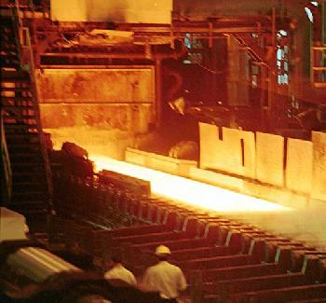
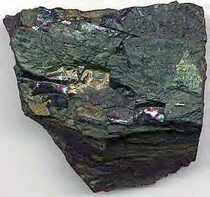

Railroads
The transcontinental railroad started in the 1850s.
Railroads expanded across the US rapidly.
Chinese immigrants built the railroads.
Railroads encouraged the growth of American industry.
  Steel
  Coal
  Timber

Slide 9
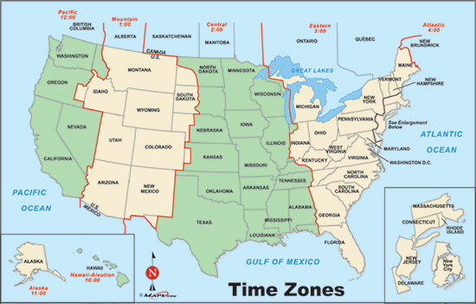
Railroads continued
Over time, railroads became safer and more reliable because of time zones.
Land grants encouraged railroad construction.

Slide 10
Railroads continued
Building railroads were profitable, but people corrupted the railroad system.
  Robber barons
    J.P. Morgan-railroad
    Andrew Carnegie – U.S. Steele

