Slide 1
COS Standard 1 C
Compare effects of economic, geographic, social and political conditions before and after European explorations of the 15th-17th centuries on Europeans, American colonists, Africans and indigenous Americans.

Slide 2
Explaining triangular trade and the development of slavery in the colonies
Chapter 3 Section 2

Slide 3
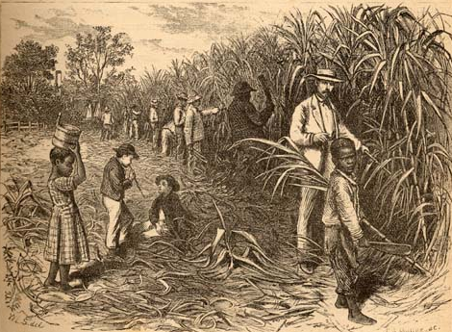
Slavery
European settlers originally forced Native Americans to work
  Hard to enslave
  Knew land better= could run away more easily
Portuguese purchased slaves to work on sugarcane plantations.
The dark skin of the African people was seen as inferior to that of their on

Slide 4
Slavery continued
Sugarcane cultivations requires a lot of hard manual labor.
Europeans transported slaves across the Middle Passage.
At first, they were indentured servants.
Maryland was the 1st colony to recognize slavery.
Virginia enacted slave codes.

Slide 5
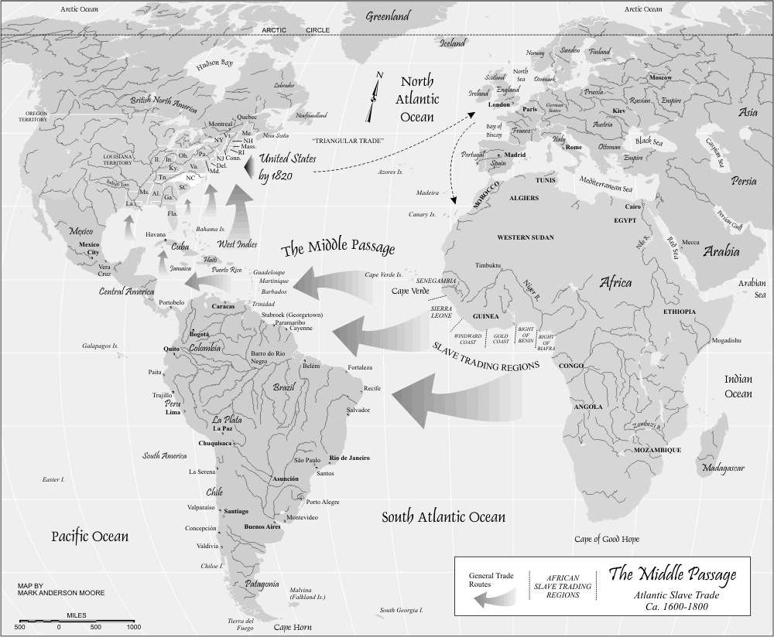
Middle Passage

Slide 6
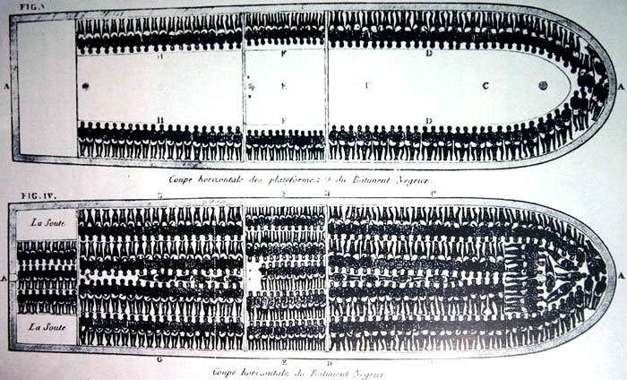
Slavery continued
Slaves were the bottom of the class system
Slavery was essential to plantation society

Slide 7
Triangular Trade
Three way trading process
England did not want all the goods that New England produced.
England produced a lot of goods that New England wanted.
Thus, New England had to find a way to sell their goods so they could get goods England wanted to buy.

Slide 8
Triangular Trade continued
Caribbean wants New England’s fish and lumber
New England gets sugar or bills of exchange
New England merchants would take the bills of exchange back to New England and trade them to English merchants for English manufactured goods.

