Slide 1
COS 2b
Evaluate social and political origins, accomplishments and limitations of Progressivism.

Slide 2
Determining the influence of the Niagra Movement, the NAACP, Booker T. Washington, W. E. B. DuBois, Marcus Garvey and Carter G. Woodson on the Progressive Ear as well as Assessing the significance of the public education movement initiated by Horace Mann

Slide 3
Niagara Movement
Black civil rights organization
WEB DuBois and other African American leaders met at Niagara Falls to demand full political rights and responsibilities for African Americans.
Called for oposistion to racial segregation and disenfranchisement
Led to founding of NAACP

Slide 4
NAACP
National Association for the Advancement of Colored People
1909
African Americans demand full political rights and an end of lynching’s and racial discrimination.
Against segregation
Ensure African Americans their constitutional rights

Slide 5
Booker T. Washington
Believed racism would end once blacks acquired useful labor skills and proved their economic value to society
Headed the Tuskegee Normal and Industrial Institute by 1881
Tuskegee- aimed to equip African Americans with teaching diplomas and useful skills in agricultural, domestic, or mechanical work

Slide 6
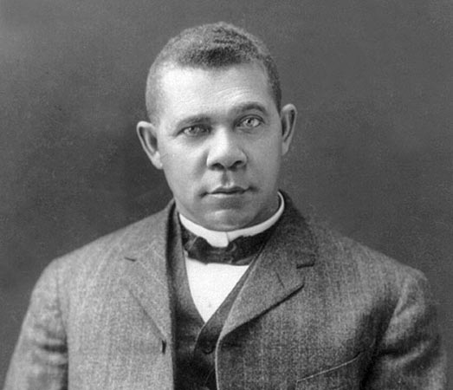
Booker T. Washington
Atlanta Compromise: Achieve Economic goals
  Southern blacks would submit to white political rule, while Southern whites guaranteed that blacks would receive basic education and due process in court

Slide 7
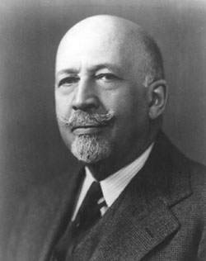
W.E.B. Du Bois
First African American to receive a doctorate from Harvard University
Strongly disagreed with B.T. Washington’s gradual approach
Credited as founder and leader of the Niagara Movement

Slide 8
W.E.B Du Bois
Challenges Atlanta Compromise by insisting that blacks should seek a liberal arts education so that the African American community would have well educated leaders
Later became the editor of the NAACP newspaper
African Americans should Demand rights (voting) to gain full equality

Slide 9
Marcus Garvey
Immigrant from Jamaica who demanded that African Americans should build a separate society
Founded the Universal Negro Improvement Association- 1914
Negro Nationalism: glorifies black culture and traditions
Promotes black pride and unity

Slide 10
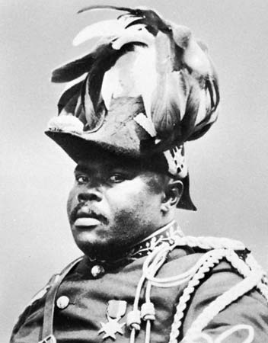
Marcus Garvey
Encourages education to advance yourself economically and politically
Wants to separate and declare independence from whites
Create a settlement in Liberia
Led to a sense of pride and hope in African Americans.

Slide 11
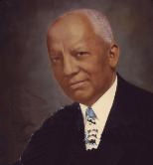
Carter G. Woodson
Father of Black History
Challenged white scholars’ view of African American history as being unworthy to study
1915- founded the Association for the Study of Negro Life and History
Established Negro History week now known as Black History Month

Slide 12
Education
Helped check the child labor abuses
Push for tax funded high schools, free textbooks
Normal Schools: Teacher training schools
Kindergartens formed
Gave a lot of opportunities to children, but not adults
Urban schools better than rural
Literacy rate better

Slide 13
Education
Instill discipline and good work ethic
Americanization
Vocational and technical schools helped students learn a skill
Colleges and Universities multiplied
Women’s education and African American education lagged
Free public libraries opened to help people learn to read

