Slide 1
COS 2 Standard Part C
Evaluate social and political origins, accomplishments and limitations of Progressivism.

Slide 2
Comparing the presidential leadership of T. Roosevelt, W. H. Taft, and W. Wilson in obtaining passage of measures regarding trust-busting, the Hepburn At, the Pure Food and Drug Act, the Federal Trade Commission, the Federal Reserve Act and conservation as well as explaining national legislation affecting the Progressive movement, including the Sherman Antitrust Act and the Clayton Antitrust Act
Chapter 18 Section 2 and 16-1

Slide 3

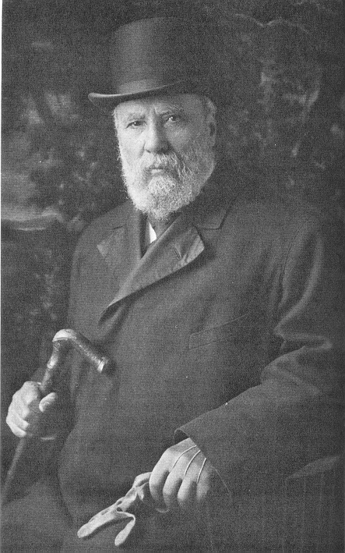
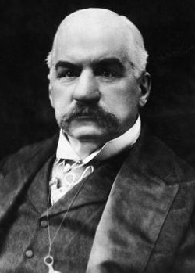
Sherman Antitrust Act
Made trusts illegal
1890
The Sherman Anti-Trust Act was the first Federal act that outlawed monopolistic business practices
The Sherman Act authorized the Federal Government to institute proceedings against trusts in order to dissolve them
The Sherman Act was designed to restore competition

Slide 4
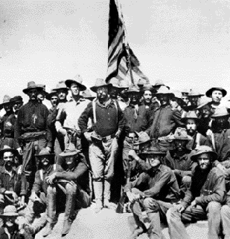
Theodore Roosevelt
Rough Riders-
26th President 1901-1909
Youngest president of the time at 42
Square Deal: balance the needs of all the groups in American society
3 C’s: conservation of natural resources, control of corporations, and consumer protection.
Made executive branch very powerful

Slide 5
United Mine Workers and the Coal Strike of 1902
It was the first labor dispute in which the US federal government intervened as a neutral arbitrator.
Miners struck for higher wages, shorter workdays and the recognition of their union
Union called strike of coal
  Threatened shortage of winter fuel-hard coal
  Let arbitration settle when Roosevelt threatened to send in army to end it.
  Workers Received: 10 % pay raise and shorter work days 9 hours from 10 hours

Slide 6
Controlling Big Business
Department of Commerce and Labor
  concerned with controlling the excesses of big business.
Bureau of Corporations: investigate corporations and issue reports of their actions.
  Sub Department for the Department of Commerce and Labor

Slide 7
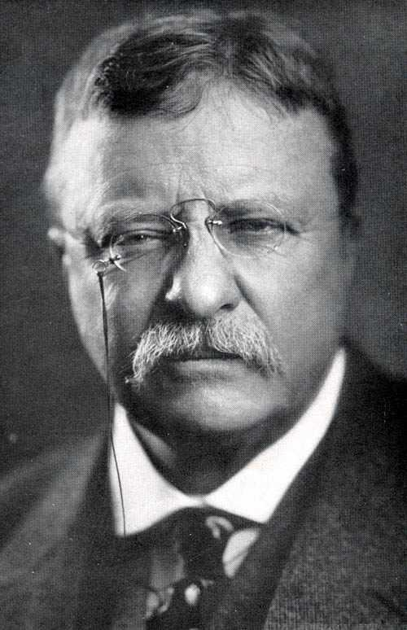
Hepburn Act of 1906
Intended to strengthen Interstate Commerce Commission allowing them to set maximum railroad rates
Limited the distribution of free railroad passes (Bribery)
Boosted governments power to regulate railroads

Slide 8
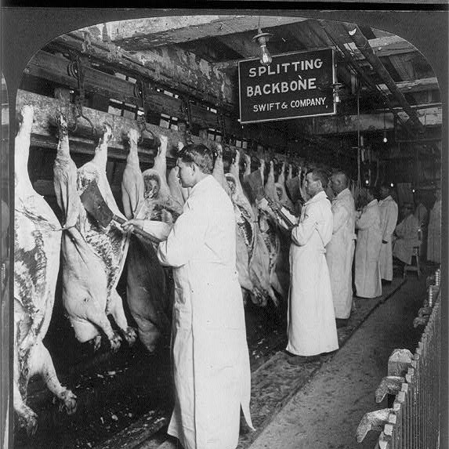
Meat Inspection Act
Upton Sinclair: The Jungle, meatpacking industry
Meat Inspection Act: dictated strict cleanliness requirements for meatpackers and created the program of federal meat inspections

Slide 9
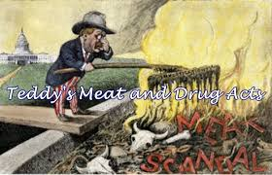
Pure Food and Drug Act
Pure Food and Drug Act: prohibited the manufacture, sale or shipment of impure or falsely labeled food or medicines

Slide 10
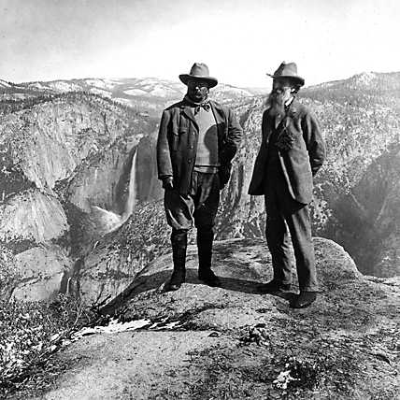
Conservation
Conserve natural resources
Supported the passage of the Newlands Reclamation Act: use federal funds to pay for irrigation and land development projects
Gifford Pinchot: US Forest Service Head, manage timber resources

