Slide 1

The Unusual Baker

Slide 2
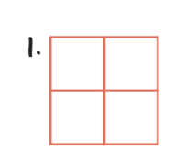
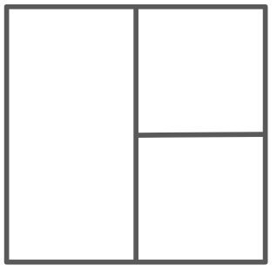
Monday
Tuesday

Slide 3
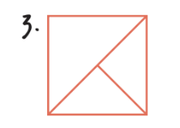

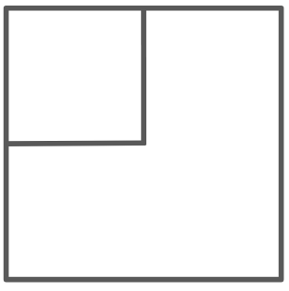
Wednesday
Thursday

Slide 4
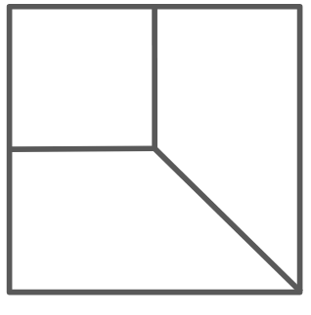
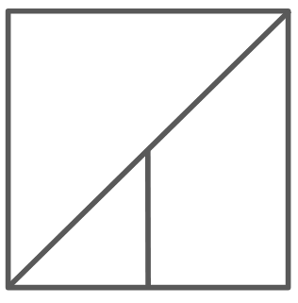
Friday
Saturday

Slide 5

Sunday

Slide 6
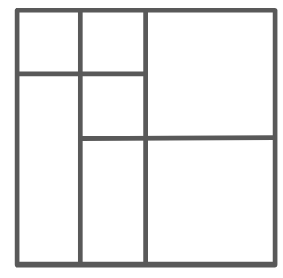
Monday

Slide 7

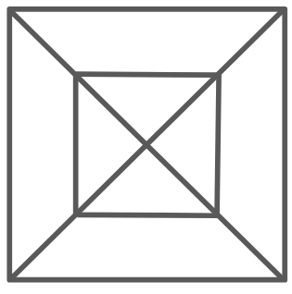
Tuesday
Wednesday

Slide 8
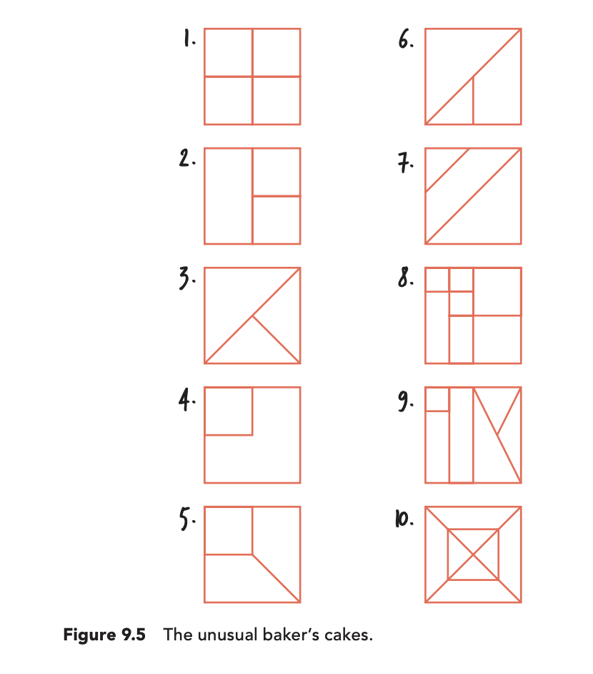
Thin Slicing Example: The Unusual Bakers Task

Slide 9
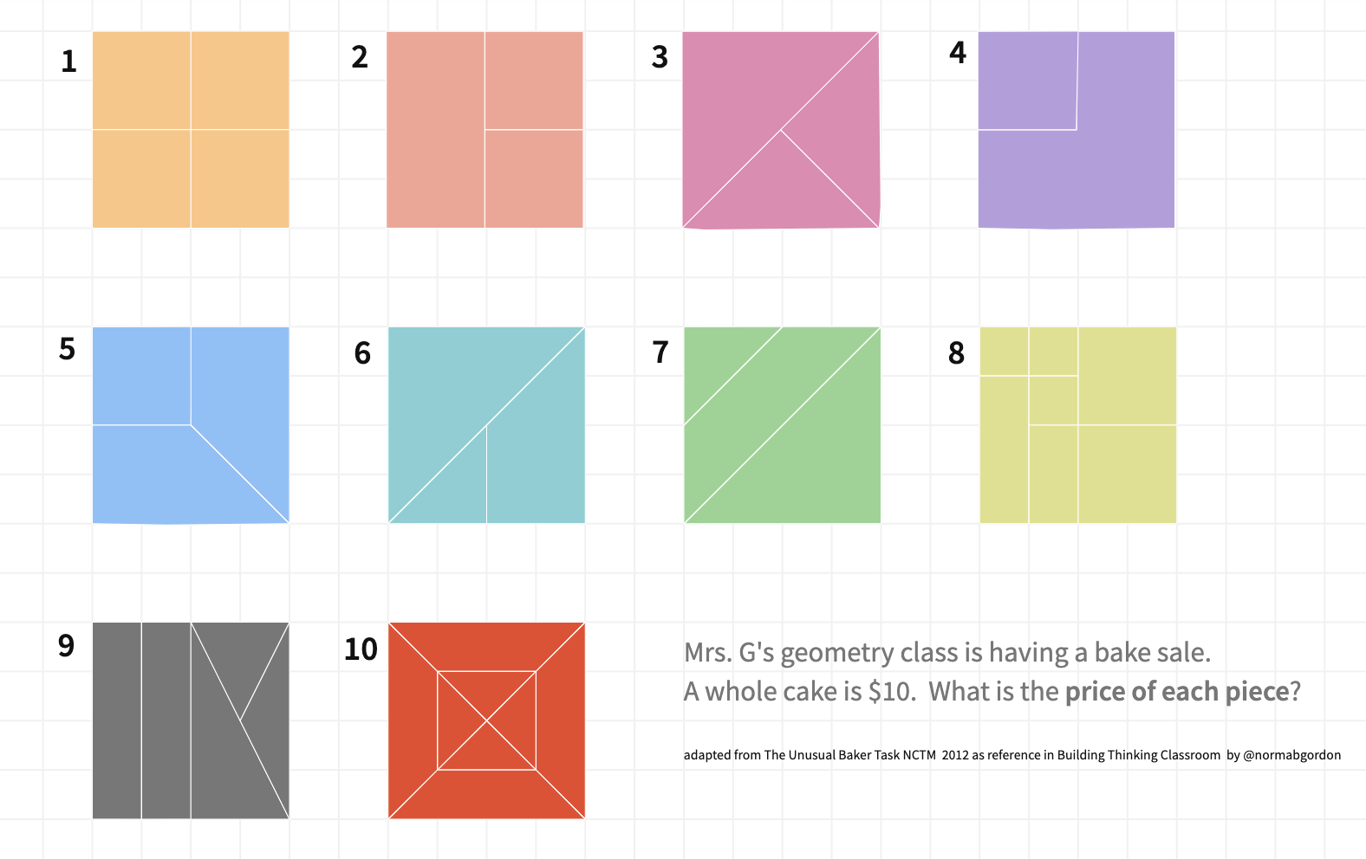
Notes:
Virtual version
https://mathigon.org/polypad/6PVWchX2xEUCKw?fbclid=IwAR3N-LVGh9zvWRl5p2N5fvPSEKTK5GwcD0UMW7uun3UBVosphBKYPMFDK_A
Also found in Desmos: https://teacher.desmos.com/activitybuilder/custom/5c083444d223ec0b2dd370a8?collections=5ebae3af69d6a00caab6e614

Slide 10
1/4
1/4
1/4
1/4

Slide 11
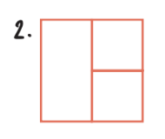
1/4
2/4 1/2
1/4
Notes:
Most common error will be that each piece is ⅓.
Hint: If pieces need to be equal in size to be named the same way, how is the piece on the left different than each piece on the right?

Slide 12
1/2 2/4
1/4
1/4
Notes:
Hint: How is this similar to the previous cake? How is it different? What line could you draw to prove it?

Slide 13
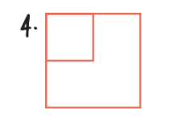
1/4
3/4
Notes:
Hint: How many of these smaller squares could fit inside the bigger square? What lines could you add that might make this clearly seen?

Slide 14
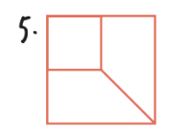
1/4
3/8
3/8
Notes:
Hint: What do you already know about this cake that you learned from a previous cake? What lines could you add to help you see what fraction of the cake each piece is in this cake?

Slide 15
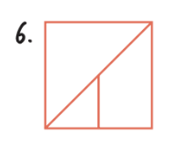
4/8 1/2
3/8
1/8
Notes:
Hint: How does this cake look like a previous cake? What sized piece does this cake have that is the same as a previous cake? What lines might you add to see equal sized parts? How many small triangles fit in the entire cake?

Slide 16
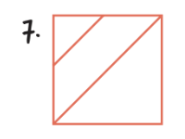
1/8
3/8
4/8 1/2
Notes:
Hint: IF you traced a triangle, how many of these could you fit inside this cake?
Where can you add lines to make equal parts easier to visualize? What lines did you use in previous cakes that you could draw on this image?

Slide 17
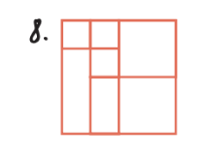
1/16
1/16
4/16 2/8 1/4
1/16
3/16
2/16
1/8
4/16 2/8 1/4
Notes:
Hint: Which cake does this most resemble? What lines have been added? How does that affect the size of each piece? What lines could you add to help you see how many small squares might fit inside each big square or rectangle?

Slide 18

1/16
⅛ or 2/16
4/16
2/8
⅛ or 2/16
3/16
1/4
1/4
Notes:
Hint: Where can you add lines to make equal parts easier to visualize? What lines did you use in previous cakes that you could draw on this image?

Slide 19
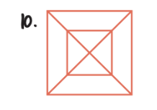
3/16
1/16
3/16
1/16
1/16
3/16
1/16
3/16
Notes:
Hint:
IF you traced a triangle, how many of these could you fit inside this cake?
Where can you add lines to make equal parts easier to visualize? What lines did you use in previous cakes that you could draw on this image?

Slide 20
Task(s) that caused us the most frustration:
Why? What did you think about that helped?
Strategies that helped us find new fractions of the cake:
Strategies other groups used that I want to remember:
Common equivalent fractions, decimals, percents to remember:
Notes:
Possible Notes to Future forgetful self

Slide 21
Alternative Launch (see speaker notes in the next slide)

Slide 22
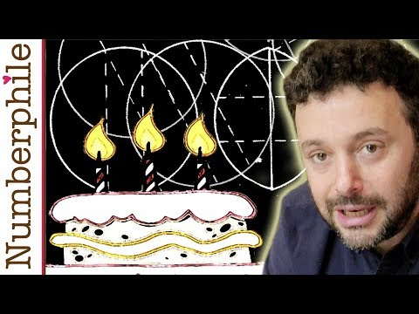
Notes:
Alternate launch (this will take more time than the image of the round cake.
Consider playing this portion of the video and asking students to think about how they might slice this cake to keep as much of the cake as possible moist and NOT dried out for the next day’s slice.
What could the next question be? How can we move from this to the questions in the Unusual Baker’s task?

Slide 23
Notes:
This portion of the video reveals the “best way” to slice a round cake.

Slide 24
Notes:
Virtual version
https://mathigon.org/polypad/6PVWchX2xEUCKw?fbclid=IwAR3N-LVGh9zvWRl5p2N5fvPSEKTK5GwcD0UMW7uun3UBVosphBKYPMFDK_A
Also found in Desmos: https://teacher.desmos.com/activitybuilder/custom/5c083444d223ec0b2dd370a8?collections=5ebae3af69d6a00caab6e614

