Slide 1
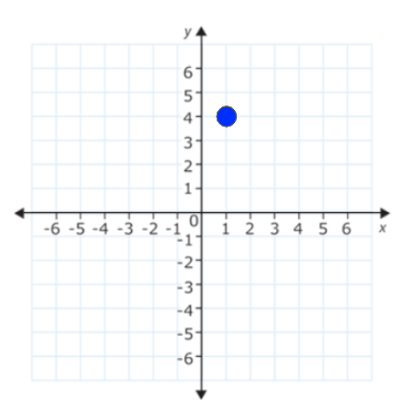
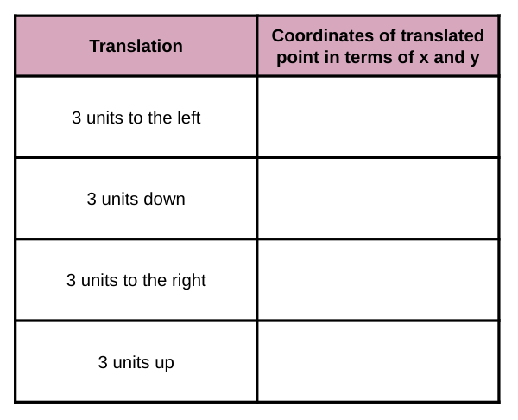
Translating Points on a Coordinate Plane
Tape your transparency over the coordinate plane.
Perform each translation in the table below.
Record the coordinates of each translated point in terms of x and y, also called algebraically.
Think It Out
What information did the words UP, DOWN, LEFT, and RIGHT provide in the context of the translations? Make sure ALL members of your group can explain.
Slide 1

Slide 2
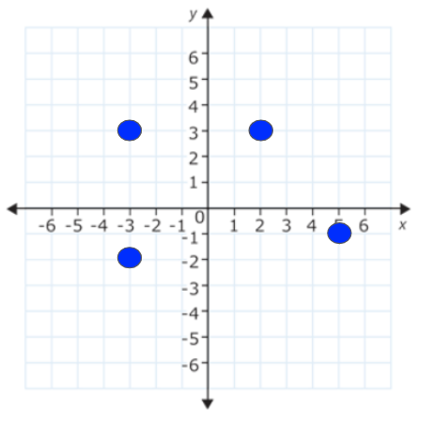
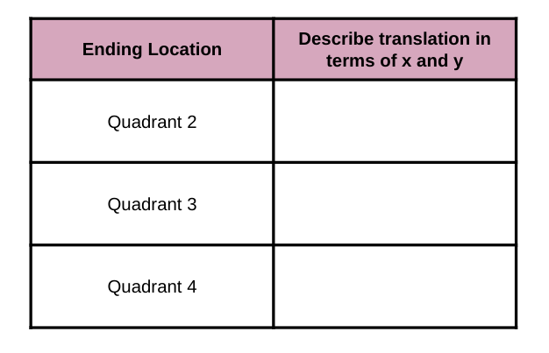
Translating Points on a Coordinate Plane
Tape your transparency over the coordinate plane.
Starting with the point in Quadrant I, complete a translation that ends at each of the other points on the coordinate plane.
In the table below, describe each translation in terms of x and y.
Think It Out
What words did you use to describe each translation?
Slide 2

Slide 3
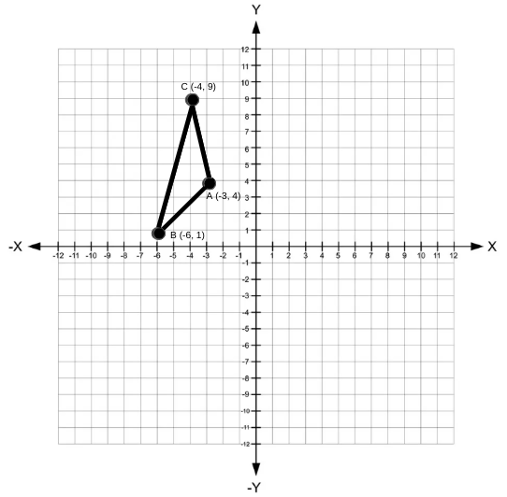
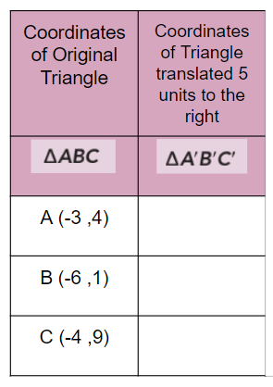
Translating Shapes on a Coordinate Plane
Use the transparency to translate triangle ABC
Translate triangle ABC, 5 units to the right to create triangle A’B’C’
List the coordinates of triangle A’B’C’ in the table
Write the algebraic rule for the translation. EX: (x,y) → (x + ___ , y + ___ )
RULE:
Slide 3

Slide 4
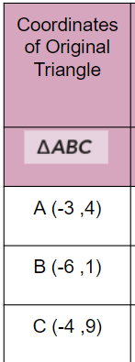
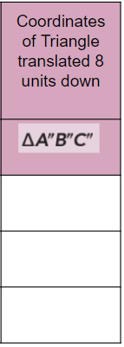
Translating Shapes on a Coordinate Plane
Use the transparency to translate triangle ABC
Translate triangle ABC, 8 units down to create triangle A’’B’’C’’
List the coordinates of triangle A’’B’’C’’ in the table
Write the algebraic rule for the translation. EX: (x,y) → (x + ___ , y + ___ )
RULE:
Slide 4

Slide 5
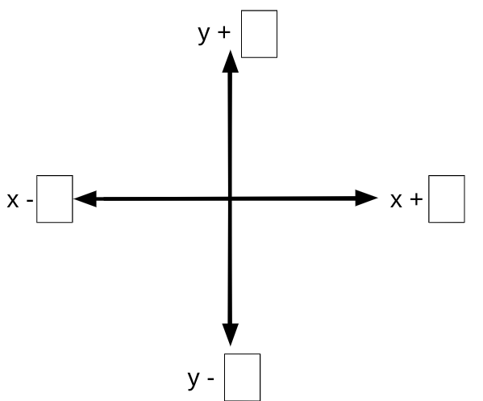
Trapezoid WXYZ was translated 7 units down and 3 units left to create the trapezoid W’X’Y’Z’. Write the algebraic rule that describes this translation. EX: (x,y) → (x + ___ , y + ___ )
Graphic Organizer
RULE:
Think It Out
Discuss with your group which words helped you identify the movement of the translation and how those words helped write the algebraic rule. Make sure all members of your group can explain.
Slide 5

Slide 6
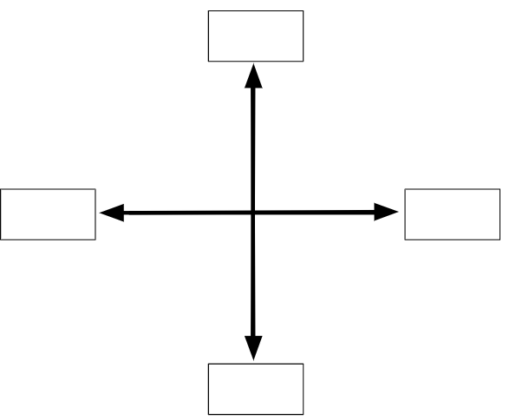
Triangle PQR was translated 5 units right and 7 units down to create the triangle P’Q’R’. Write the algebraic rule that describes this translation. EX: (x,y) → (x + ___ , y + ___ )
Graphic Organizer
RULE:
Think It Out
Discuss with your group which words helped you identify the movement of the translation and how those words helped write the algebraic rule. Make sure all members of your group can explain.
Slide 6

Slide 7
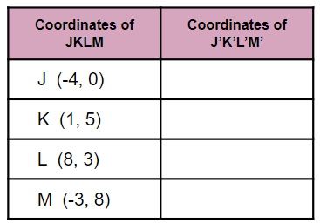
Quadrilateral JKLM is graphed on a coordinate grid with vertices at J(-4,0), K(1,5), L(8,3), and M(-3,-8).
Quadrilateral JKLM is translated down 4 spaces and to the right 6 spaces to create quadrilateral J’K’L’M’.
Write the algebraic rule that describes this translation. EX: (x,y) → (x + ___ , y + ___ )
Record the new coordinates of quadrilateral J’K’L’M’ in the table below.
Graphic Organizer
RULE:
Think It Out
Discuss with your group which words helped you identify the movement of the translation and how those words helped write the algebraic rule. Make sure all members of your group can explain.
Slide 7

Slide 8
Triangle ABC is graphed on a coordinate grid with vertices at A(2,3), B(4,7), and C(8,2).
Triangle ABC was translated to the coordinates A’ (2,1), B’ (4,5), and C’ (8,0) to create triangle A’B’C’.
Write the algebraic rule that describes this translation. EX: (x,y) → (x + ___ , y + ___ )
Graphic Organizer
RULE:
Think It Out
DIscuss with your group how you were able to write a rule with 2 sets of coordinates, instead of a verbal description of the translation.
Slide 8

