Slide 1
Name: Madupu Saikrishna prasad
Course: CSCI_524
CWID: 50158799 http://krishh782.wix.com/mysite
Reason to take this course: I am interested in computer hardware and basically want to learn all the courses that are as part of my course work.
Expectations for this course: Want to be good in this course by learning all the different kinds of software design that are included. I want to learn more in detail analysis of systems under your guidance of you.
Personal Background: I am from Electrical Engineering in my undergraduate and I am pursuing my Master’s in Computational science and have experience with computer science course which am dealing as part of my masters
Goals after graduation :I want to be good programmer with database as my specialization.

Slide 2
JOB TITTLE & DESCRIPTION
Software developer: Becoming a software developer, It plays a key role in the design, installation, testing and maintenance of software systems. The programs we create are likely to help businesses be more efficient and provide a better service.

Slide 3
software design :description is a written description of a software product, that a software designer writes in order to give asoftware development team overall guidance to the architecture of the softwareproject.
Software construction :Is a software engineering discipline. It is the detailed creation of working meaningful software through a combination of coding, verification, unit testing, integration testing, and debugging. It is linked to all the other software engineering disciplines, most strongly to software design and software testing.
software engineering: a software development methodology (also known as a system development methodology, software development life cycle, software development process, software process) is splitting of software development work into distinct phases (or stages) containing activities with the intent of better planning and management. It is often considered a subset of the systems development life cycle. The methodology may include the pre-definition of specific deliverables and artifacts that are created and completed by a project team to develop or maintain an application.

Slide 4
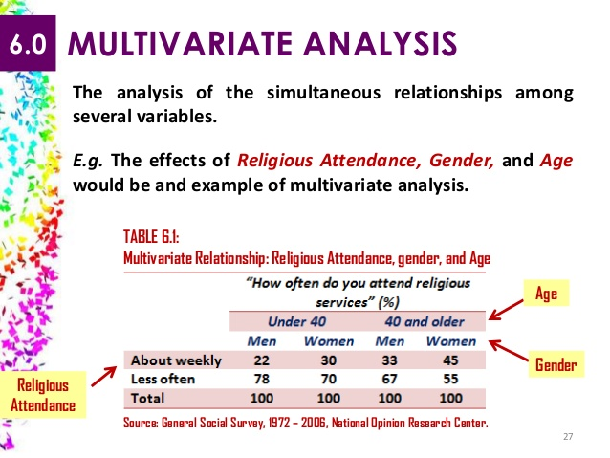
Multivariabla Analysis

Slide 5
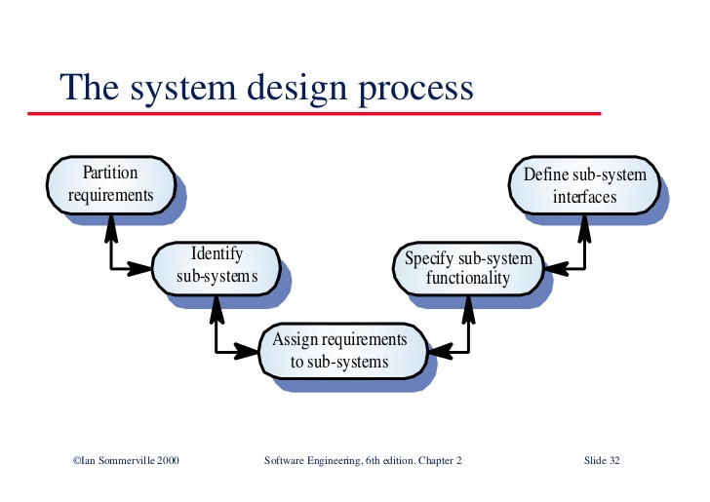
Design

Slide 6
CONCLUSION
To simulate the operating conditions of our mechanism, we created a prototype that would perform using water. The prototype operates by allowing a specific height of water to accumulate above the plug, creating a liquid seal that would prevent air from entering the lower section of the device. At a certain water level, the plug actuates. The system reaches an equilibrium when the liquid flow rate into the prototype matches the flow rate out of the sealing mechanism.
`

