Slide 1
Properties of Matter
Section 2.1

Slide 2
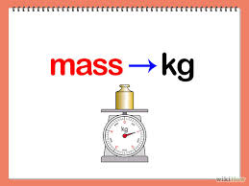
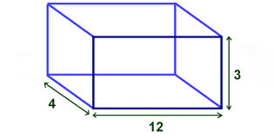
Mass vs. Volume
Mass = amount of matter the object contains
Volume = how much space it takes up.

Slide 3
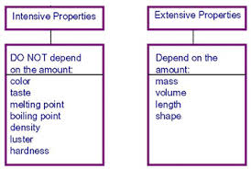
Extensive Properties
A property that depends on the amount of matter in a sample.

Slide 4
Intensive Properties
Depends on the type of matter in a sample not the amount.

Slide 5
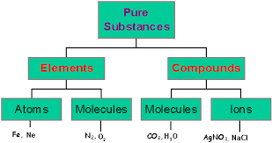
(Pure) Substances
Matter that has a uniform and definite composition is called a substance.
Every sample of a given substance has identical intensive properties because every sample has the same composition.

Slide 6
Physical Property
A quality or condition of a substance that can be observed or measured without changing the substance’s composition.
  Melting point
  Viscosity
  Color
  Size
  Density
  Freezing point

Slide 7
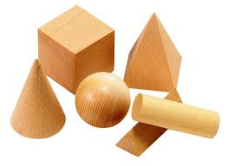
States of Matter
Solids: definite shape and volume

Slide 8
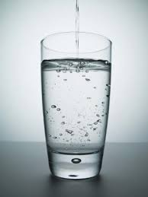
States of Matter
Liquids: Indefinite shape, but fixed volume.

Slide 9
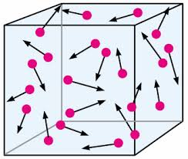
States of Matter
Gases: Takes both the shape and size of its container.

Slide 10
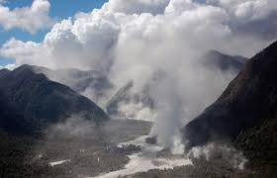
States of Matter
Vapor: gaseous state of a substance that is generally a liquid or solid at room temperature

Slide 11
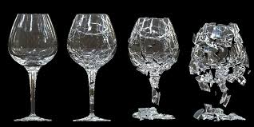
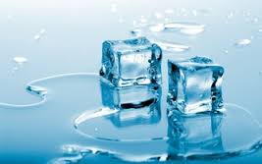

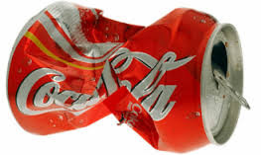
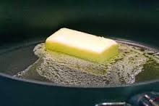
Physical Changes
Some properties of a material change, but the composition of the material does not change.
  Boil, freeze, melt, condense
  Physical changes can be classified as reversible or irreversible.

