Slide 1
Rock Cycle and Types of Rocks

Slide 2
What is a rock?
Rock is a naturally occurring solid mixture of one or more minerals that may also include organic matter.
Rock is always changing.

Slide 3
What processes change rock?
Weathering is the process by which rock is broken down by water, wind, ice, and changes in temperature.
Erosion is the process by which sediment is moved from one place to another.
Rock that is buried can be squeezed by the weight of rock or layers of sediment above it.
At high enough temperature and pressure, buried rock can change into metamorphic rock.
Magma or lava melting or cooling.

Slide 4
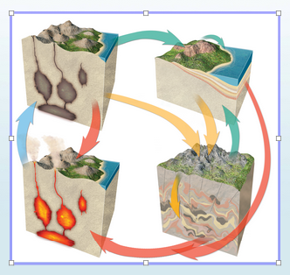
Igneous Sedimentary
Magma Metamorphic

Slide 5
How are rocks classified?
Rocks classified by composition and texture.
composition: the make-up of the minerals of the rock
texture: size, shape, and positions of the grains that make up a rock
  Coarse-grained: large grains
  Fine-grained: small grains

Slide 6
How are rocks classified?
Igneous rock forms when magma cools and hardens. It forms on or beneath Earth’s surface.
Sedimentary rock forms when sediment from older rocks or minerals that form from solutions get pressed and cemented together.
Metamorphic rock forms when pressure, temperature, or chemical processes change existing rock.

