Slide 1
In your group, travel from station to station and write down observations about the mystery material.
  Think about whether these observations could be physical or chemical properties
You will be given a detective’s kit, consisting of:
  Vinegar (an acid)
  pH strips
  Water (in the faucet)
  …and your most valuable resource – your keen intellect!

Slide 2
Physical and Chemical Properties

Slide 3
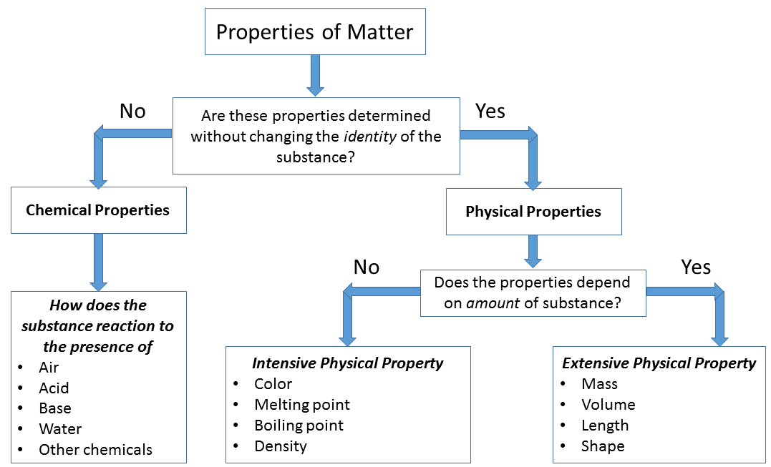

Slide 4
Physical Properties
A PHYSICAL PROPERTY is a property of matter that can be observed or measured without changing the composition.
Examples:
  Copper conducts electricity. Conductivity is a physical property.
  Water is a liquid. States of matter are physical properties.
  Gold has a density of 19.3 g/mL. Density is a physical property.
  What other physical properties can you name?
Notes:
Solubility, senses, melting point, etc.

Slide 5

Take a look at a Twix bar. What are some of the physical properties of the wrapper?
What are some of the physical properties of the candy?

Slide 6
Chemical Properties
A CHEMICAL PROPERTY is a property of matter that can be measured or observed ONLY by changing the composition of the material.
Examples: reactivity, pH, radioactivity
  Hydrochloric acid has a low pH. Hydrochloric acid is…an acid. Go figure.
  Vinegar reacts with baking soda to form CO₂.
  Hydrogen gas is highly flammable.

Slide 7
How can we tell what the chemical properties of materials are?
  BRAINSTORM! What tests could you do to find chemical properties of a substance?
We can examine chemical properties of materials by seeing how they react with other materials.
  In this way, we can actually use chemical properties to determine what something is, even if it is initially unlabeled.

Slide 8

Revisit your observations. With your group, split these observations into physical or chemical properties.
  If an observation was “sinks in water,” what could you determine about its density?
Take a guess at what each mystery solid is!

Slide 9
IN THE JARS:
Chalk
Baking soda
Salt
Sugar
Yeast
Citric acid
Corn starch
Wax
Pepper

Slide 10
Chemical Change
A CHEMICAL CHANGE is a change that alters the composition of the material.
This change means that we no longer have the material we started with – it’s a new chemical!
  Remember: like salt (sodium chloride), the new material may not have any of the properties of the starting materials
Burning paper is an example of a chemical change. The paper combines with oxygen to form ash.
The reaction of baking soda and vinegar changes both ingredients (reactants) into new products.

Slide 11
What are some of the signs that you see that tell you a chemical change is taking place?
  Gas formed (bubbles)
  Solid formed (cloudy)
  Temperature change
  Odor change
  Color change

Slide 12
One important idea to keep in mind with chemical changes is that not all reactions happen spontaneously.
  “Spontaneously” means “without motivation.”
Sometimes, energy is required to get a reaction going.
There are two different kinds of reactions, thermodynamically speaking – ENDOTHERMIC and EXOTHERMIC.
What do you think these terms mean?

Slide 13
An ENDOTHERMIC reaction is one that takes IN energy during the process.
  From the Greek “endo-” for “within”
  Energy is provided as heat.
  Citric acid and baking soda demo

Slide 14
An EXOTHERMIC reaction is one that lets energy OUT during the process.
  From the Greek “exo-” for “outside”
  Energy is released during the reaction, observed as warmth or flame.
  Sodium acetate heating pad demo

Slide 15

Physical Change
A PHYSICAL CHANGE is one that changes the form of the material, but not its composition.
Melting, boiling, tearing, smashing, etc.

