Slide 1
Feeding Rations

Slide 2
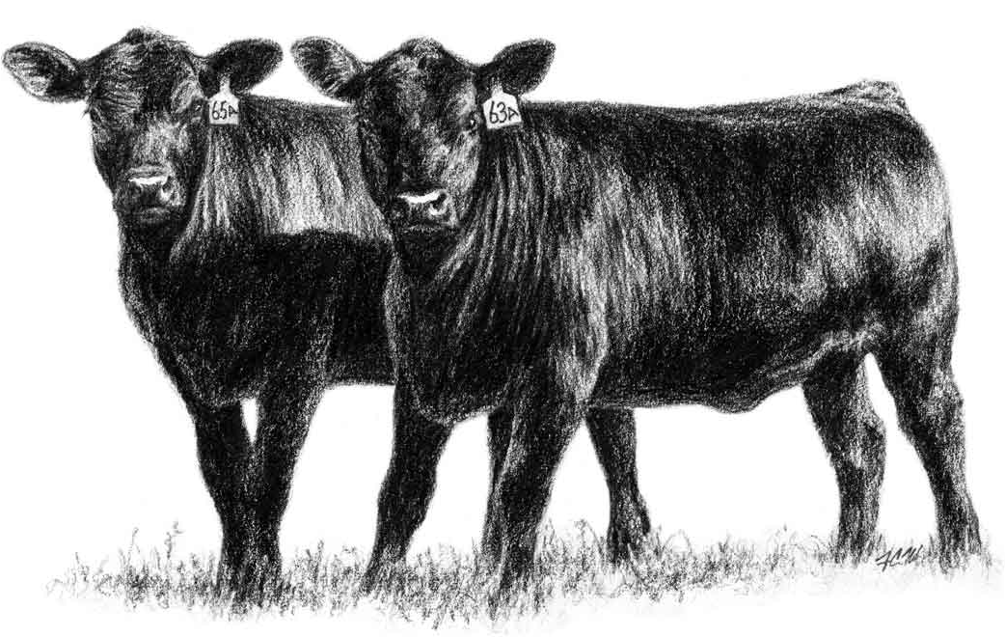
Feeding Rations
Feed costs are the major cost of producing beef.
  Using feed as efficiently as possible is critical for a beef producer to be profitable.
Feeding rations must be properly balanced in order for a producer to be profitable and in order for their animals to be healthy.
  A feeding ration is the amount of feed an animal will receive in a 24 hour period.
  A balanced ration is the amount of feed that will supply the proper amount of nutrients needed for the animal in the proper proportions in order to adequately support growth, lactation,
  maintenance, gestation, or other bodily
  needs.
  Creating balanced rations for beef cattle
  is one of the most important management
  tools that a producer can utilize.
Source: www.angus.org

Slide 3
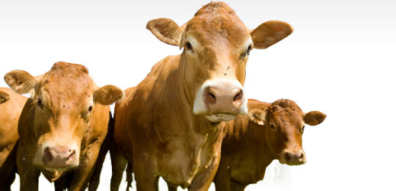
Basic Nutrients
A proper feeding ration is based on balancing the six basic nutrients: water, protein, carbohydrates, fats, minerals, and vitamins.
  The nutrient composition of a feed is the amount of specific nutrients contained in the ration.
  The proportion of each nutrient needed by any given animal depends on many factors including weight, sex, desired rate of growth, stage of production (e.g. gestation, lactation, etc.), etc.
Nutrients will be measured as the percentage of dry matter, or the percent of the total weight of the feed each nutrient comprises after all the water has been removed.
  Because the amount of water in each feed
  can vary (especially with forages), it is
  necessary to focus on the dry weight of the
  feed to reduce variability from ration to ration.
Source: demo.tare2.com

Slide 4
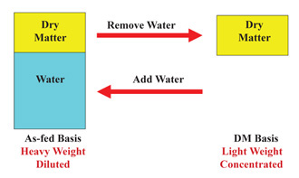
Dry Matter
Nutrient compositions usually focus on dry matter, crude protein, energy, fiber content, and mineral content.
  Dry matter is the portion of the feed left after all water has been removed. Other than water, this is where all the nutrients of the feed can be found.
  As-Fed refers to the feed that includes moisture at the rate that it would when fed to cattle.
Under normal circumstances, dry matter intake represents an amount that can be consumed by cattle.
  Because the amount of dry
  matter in feed can vary, a
  ration should be balanced
  on a dry matter basis and
  then converted to an as-fed
  basis to account for the
  weight of the water content.
Source; www.ianrpubs.unl.edu

Slide 5
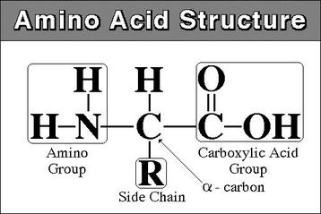
Crude Protein
Crude protein is the determined by measuring the nitrogen content of feed and then multiplying by 6.25
  Proteins typically contain 16% nitrogen; multiplying the nitrogen content by 6.25 is an efficient way to measure an otherwise variable component of the feeding ration.
However, not all nitrogen-containing compounds are protein; these are called nonprotein nitrogen or NPN.
  NPN is valuable because rumen microbes will convert NPN into protein during rumination.
  NPN sources are not as valuable
  as actual protein, especially for
  cattle that have high protein needs
  True sources of protein should
  be used for the majority of crude
  protein in a feeding ration.
Source: sarahssureshots.wikispaces.com

Slide 6
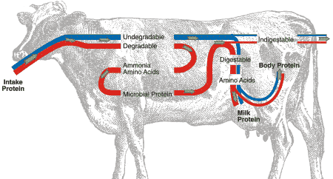
DIP vs. UIP
Crude protein consists of two kinds of actual protein – DIP and UIP.
  DIP, or Degradable Intake Protein, will be broken down in the rumen by microbes.
  UIP, or Undegradable Intake Protein, will bypass the rumen and will be broken down in the small intestine of a cow.
  UIP is also known
  as bypass protein
  for this reason.
  A balance should
  exist between DIP
  and UIP or
  microbial growth
  (or lack thereof)
  will limit the
  digestibility of the
  ration.
farmwest.com

Slide 7
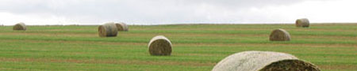
TDN
Energy is not an actual nutrient but a reflection of the calories provided by the carbohydrates, fats, and (to a lesser extent) protein of a ration.
  Total Digestible Nutrients (TDN) is the value most commonly used in ration balancing to determine the energy content of a feed.
  TDN refers to the total amount of digestible fiber, protein, lipid, and carbohydrate components of a ration.
Fiber is a measure of the cellulose content of a feed.
  Because cattle have rumen microbes, fiber provides energy to a ruminant ration that would not be provided to a monogastric.
  However, not all fiber digests equally well to a ruminant.
  For example, both rice hulls and soybean hulls are forms of fiber, rice hulls are a very poor source of ration fiber while soybean hulls are highly digestible.
Source; http://lancaster.unl.edu/ag/images/rural/foragepromox450.jpg

Slide 8
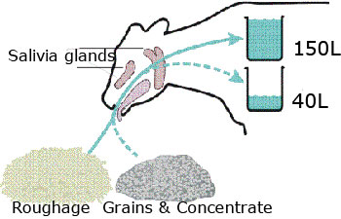
Fiber
In order for the rumen microbes of a cow to remain healthy, fiber is necessary.
  Fiber aids in regulating the rumen pH (preventing it from becoming too acidic) by stimulating saliva production; it is the saliva and not the fiber that maintains the pH level but fiber is necessary to stimulate the production of the saliva.
  For this reason, feeding rations should include at least a minimum level of fiber content rather than consist solely of easily-digestible sources of energy.
The minimum needed for fiber in cattle rations is sometimes called the scratch factor.
  In addition to having sufficient levels of fiber
  to maintain rumen pH, it is also important
  that the particle size of the fiber is not too
  small, or it will digest quickly and stimulate
  less saliva production, resulting in the risk
  for rumen acidity (a disorder known as
  acidosis).
Source: www.milkproduction.com

Slide 9
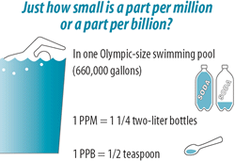
Minerals
Minerals in rations are classified as either macrominerals or microminerals.
  Because macrominerals are needed in larger quantities, they are fed as a percentage of the dry matter of the ration.
  Microminerals, on the other hand, are fed in amounts measured as parts per million (ppm).
  Parts per million (ppm) is a
  measurement that indicates
  the relative abundance of a
  particular substance in a
  solution of other substances
  (such as in water, the
  atmosphere, or an animal’s
  body).
Source: www.abcwua.org

Slide 10
Vitamins
Vitamins in rations are grouped as fat soluble and water soluble.
  This is an important distinction because excess fat soluble vitamins will remain in an animal’s fat.
  If an animal’s feeding ration is too high in fat soluble vitamins, it could lead to toxicity.
The distinction is also important because a cow’s rumen microbes synthesize water soluble vitamins (B and C), meaning they do not need to be included in cattle rations.
  For this reason, fat soluble vitamins are more likely than water soluble vitamins to be deficient in their diet while simultaneously also having a risk for potentially building to a toxic level in a cow’s body if overfed.

Slide 11
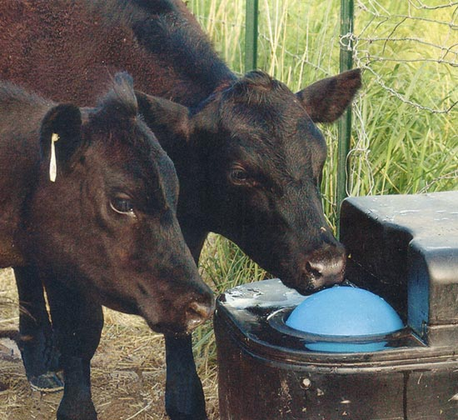
Water
Water is usually not specifically factored into a feeding ration because cattle should have free access to as much clean water as they prefer.
  If water is not freely available to a cow, feed intake will be lowered and performance will be reduced, making it critical to the health of the animal and the profits of a farmer or rancher that all cattle have easy access to clean water.
Water should also be tested for mineral content to prevent the buildup of toxicity in cattle.
  For example, well water with high sulfur
  content could interfere with the absorption
  of copper from a cow’s diet.
  Water should be provided at a rate of 1
  gallon for every 100 lbs. of body weight.
  For example, two 1500 lb. steers would
  need 30 gallons of water per day at
  minimum.
Source: www.motherearthnews.com

Slide 12
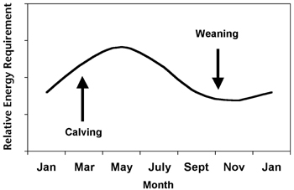
Nutrient Requirements of Cattle
The nutritional requirements of cattle are determined by two main factors: the needs of the animal and the conditions of its environment.
  The needs of the animal are determined by body size and weight, stage of production, growth rate, and whether or not the
  animal is gestating
  (pregnant) or lactating
  (milking).
  Environmental factors
  include temperature
  and humidity among
  other factors.
Source: aces.nmsu.edu

Slide 13
Cattle Groupings
Cattle should be grouped according to similar nutritional requirements. Common groupings of cattle include mature cows, growing weaned calves, first-calf heifers, and mature bulls.
  Growing weaned calves are young animals that are no longer drinking milk but are still immature and have not calved for the first time (if female). Because of their high rate of growth, this group is the most nutritionally-demanding group of cattle. This group can usually be divided further into growing calves and yearlings (animals aged 1-2 years old).
  First-calf heifers are sexually-mature females that are still growing physically and are about to freshen (calve) for the first time; these animals are the second most nutritionally demanding group of cattle.

Slide 14
Cattle Groupings
  Mature cows are female cattle that are fully grown and developed (usually 4 years old or more); the nutritional demands of this group can vary widely depending on whether or not they are lactating and their level of milk production, their body size and body condition (level of body fat), and their stage of production (dry period, early lactation, late lactation, etc.).
  Mature bulls are least nutritionally demanding group of cattle; however, bulls may require extra nutrient supplementation during breeding seasons if a herd’s cows are all bred in a short season (2-3 months).
  If newborn calves are separated from cows after birth (common for dairy cattle but not as much in beef cattle), this group of animals would also have their own nutritional needs.

Slide 15
Nutrient Requirement Table
How a group of similar cattle are fed is determined through the use of a nutrient requirement table.
  A nutrient requirement table is similar to a recipe for feed for a very specific grouping of cattle, except that instead of ingredients, the table describes the specific nutrients needed for a group of cattle.
  These nutrients are listed as specific percentages of the dry weight of the feed given to that group of cattle.
  A nutrient requirement table describes the specific nutrient needs for cattle based on breed, sex, body weight, body condition (body fat), milk yield, ionophores and implants, forage quality, and more.

Slide 16
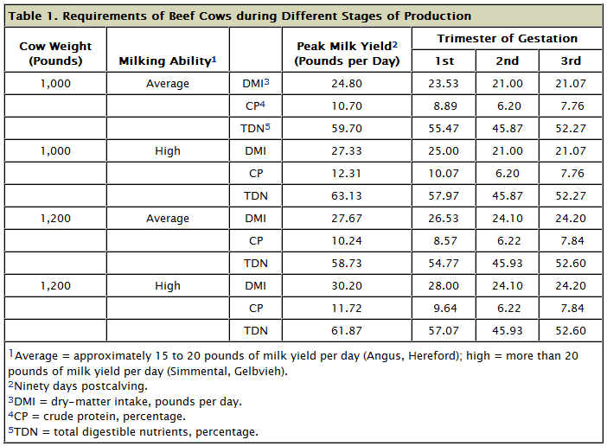
Source: www.noble.org

Slide 17
Ionophores
Ionophores are a type of antimicrobial feed additive that increases the ability of a cow to acquire energy from its food.
  Ionophores increase feed efficiency and the rate of weight gain by while decreasing dry matter intake and methane production, a potent greenhouse gas.
  Ionophores are a type of antibiotic but have no use in human medicine and do not have any effect on antibiotic resistance.

Slide 18
Hormone Implants
Implants are small pellets containing naturally-occurring or synthetic hormones and are implanted between the skin and the cartilage on the back side of the animal’s ear after castration.
  Implants ensure that a steer’s bodily hormone levels are similar to an uncastrated animal.
  This ensures appropriate rate of gain and production, traits that otherwise would be compromised after the animal was castrated.
  The goal is not to raise the animal’s hormone levels to an unnaturally high level; on the contrary, the goal is to maintain the animal’s hormone levels at the point at which they otherwise would occur.

Slide 19
Nutrient Composition of Rations
Once the nutrient needs of a group of cattle are determined, the feeding ration needs to be tested to ensure it has the correct nutrient composition.
  Determining the nutrient composition of a feeding ration can be accomplished in multiple ways.
  Feed composition tables can be used to determine an approximate nutrient composition for a given feeding ration; however, because feed composition tables are based on averages, they will be relatively less accurate than other options.
  A chemical analysis of a feeding ration is a more accurate option and can be performed for a charge by a county University Extension office.

Slide 20
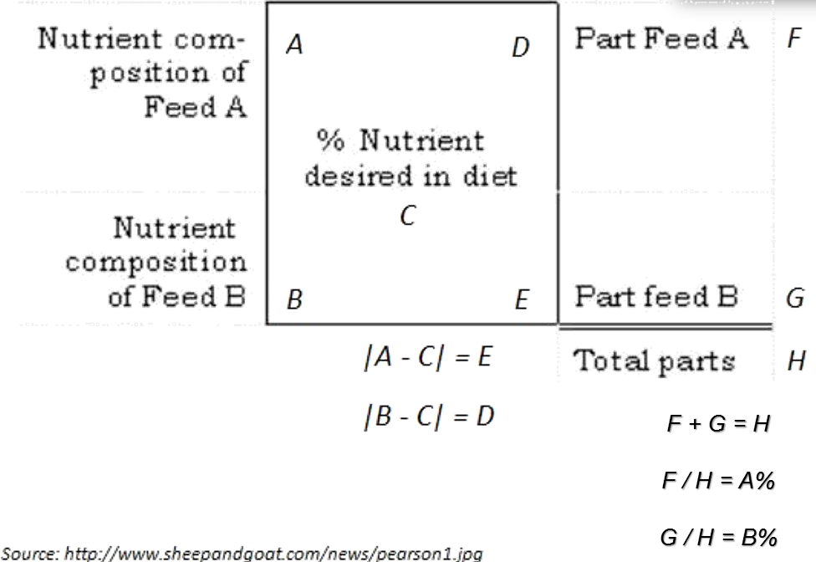
Nutrient Deficiencies
Once the animals have been grouped by similar nutritional needs, the specific nutrient needs have been determined through a nutrient requirement table, and feed has been analyzed using a table or Extension analysis, the final step is to identify and correct any nutrient deficiencies.
  A common method to balance a ration includes the Pearson Square.
The Pearson Square method
is a simple, quick way to
calculate the amounts of feed
necessary to meet a nutrient
requirement of livestock and
other animals.

Slide 21
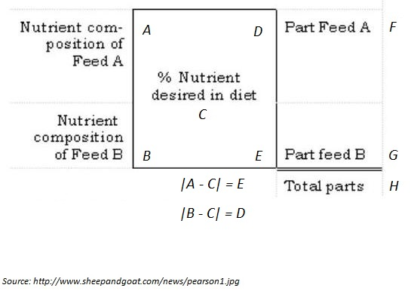
F + G = H
F / H = A%
G / H = B%

Slide 22
Pearson Squares
For example, if a producer were feeding a 500 lb. steer (castrated male) with the intent to have a rate of gain of 2 lbs. per day with a desired final weight of 1200 lbs., nutrient requirement tables show that the animal would need 68% TDN to reach this goal according.
  TDN refers to the total nutrient content of the feed.
  If using a Pearson Square, the vale “68” would be placed in the center of the square.
If the producer were feeding fescue
and shelled corn in their ration, they
would look up the TDN values for
fescue and for corn in the left corners
of the square.
  In this case, fescue has a TDN value of 52
  and shelled corn has a value of 90.
Fescue
52
TDN
68%
90
Shelled Corn

Slide 23
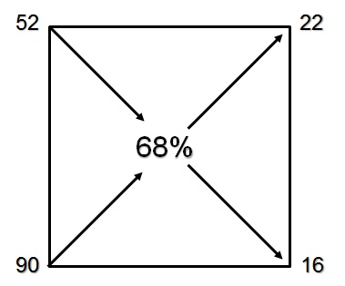
Pearson Squares
The producer would then subtract across the diagonal, subtracting the smaller of the two numbers from the larger.
  This means that if fescue with a value of 52 is in the upper left, the producer would subtract 52 from 68 to get 16. The producer would record 16 in the lower right.
  Shelled corn has a TDN value of 90; the producer would subtract 68 from 90 to get a value of 22, which would be recorded in the upper right.
The producer then adds the values on the right (22 and 16) to get 38.
  Dividing 38 by each number indicates the
  preliminary percentage of fescue and corn
  that should be in the ration.
  In this case, 58% of the preliminary ration
  should be fescue (22/38 = 0.58) and 42%
  should be corn (16/38 = 0.42).
  Remember: all the numbers should be positive
  and the final percentages should always be
  less than 1.0.
Fescue
22 / 38 = 58%
16 / 38 = 42%
Shelled Corn
22 + 16 = 38

Slide 24
Pearson Squares
Once the preliminary ration has been determined, the producer must next determine if this ration provides the required crude protein needed by the animal.
  If the crude protein requirement is met or exceeded by this ration, the ration is balanced and can be fed as is.
  However, if the crude protein requirement is not met by this ration, it will need to be supplemented by additional sources of protein.

Slide 25
Pearson Squares
The crude protein content of a ration can be determined by multiplying the percentage of each ingredient in the mix by the percentage of crude protein it contains.
  In our example, fescue comprised 58% of the ration and has 10% crude protein.
  Shelled corn was 42% of the ration and has 9.8% crude protein.
To determine the amount of crude protein, multiply the percent each ingredient comprises of the ration by the percent crude protein that the ingredient contains.
  In this case, we would use the following formula:
  [0.58 x 10.0] + [0.42 x 9.8] = 9.9%
  This indicates that the crude protein content of this ration is 9.9%.
  The animal we described earlier requires 12.9% protein, meaning that protein supplementation is needed for this ration to be balanced.

Slide 26
Pearson Squares
If protein supplementation is necessary, the Pearson Square can be used for this as well.
  Place 12.9 in the center of the square and place 9.9 in the upper left of the square.
  Place the percent protein of the
  supplemental source of protein
  in the lower left.
  For example, if soybean meal
  was to be used for protein
  supplementation, we would
  place 49.9 in the lower left
  because soybean meal is
  49.9% crude protein.
Fescue/Sh. Corn
9.9
CP
12.9%
Soybean Meal
49.9

Slide 27
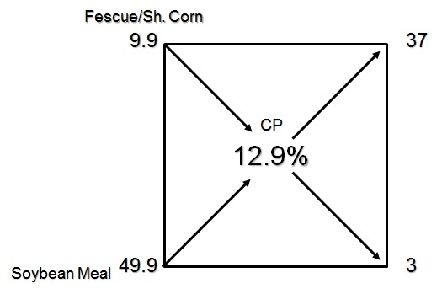
Pearson Squares
Either subtract the left corner number from the center number or vice versa in order to get a positive number on the opposite side of the diagonal; in this case, 12.9 – 9.9 = 3 in the lower right and 49.9 – 12.9 = 37 in the upper left.
  Add the two right side numbers (37 + 3 = 40) and divide each right hand number by this added number.
  In this case, 37/40 = 92.5%
  and 3/40 = 7.5%.
  This indicates that the corn/
  fescue mixture should comprise
  92.5% of the dry weight of the
  ration and soybean meal should
  comprise 7.5% of the dry weight
  of the ration.
37 / 40 =
92.5%
Corn/Fescue
3 / 40 =
7.5%
Soybean
___________
37 + 3 = 40

Slide 28
Works Cited
  Beef Cattle Nutrition Series, University of Arkansas.
  http://www.merckmanuals.com/vet/pharmacology/growth_promotants_and_production_enhancers/antimicrobial_feed_additives.html

