Slide 1
Elements of Satire!
English 12

Slide 2
Elements of Satire
You’ll need the information on the following slides to do well on the first quiz.
You’ll need this information to help you understand our unit text 1984 by George Orwell.
You will be asked to analyze our text and any supplemental reading as satire.

Slide 3
Elements of Satire
Before we get started, what do you think?
  Your definition of satire?
  An example of satire?

Slide 4
Elements of Satire
Formal definitions:
  A self-conscious medium, implying standards of civilized and moral rightness in the mind of the (author) and hence a desire on his or her part to instruct readers so as to reform their moral failings and absurdities.
  Use of irony, sarcasm, ridicule, or the like, in exposing, denouncing, or deriding vice, folly, etc.
  A literary composition, in verse or prose, in which human folly and vice are held up to scorn, derision, or ridicule
  A literary genre comprising of such composition s
  Purpose is for social criticism using wit
  Emphasizes weakness more than the weak person

Slide 5
Elements of Satire
Strict satire 1590-1625
  In the Roman style - attack on social forms and corruptions of the time
    John Donne, Ben Johnson, Alexander Pope, Samuel Johnson
Comedy of Humors / Comedy of Manners 1600-1800:
  Mocks on particular aspect of a person; caricature
  http://www3.dbu.edu/mitchell/comedydi.htm#Comedy%20of%20Humours:
    Ben Johnson, Congreve, Sheridan
Parody and Irony 1600-1750
  Exaggeration, imitation of style, sarcasm, cynicism
    Alexander Pope (The Rape of Lock), Ben Johnson, Congreve, Sheridan

Slide 6
Elements of Satire
Novelistic satire 18th-21st Century
  Peacock, Meredith, Huxley, Orwell, Vonnegut

Slide 7
Techniques of Satire
Exaggeration
  To enlarge, increase, or represent something beyond normal bounds so that it becomes ridiculous and its faults can be seen. (like caricature)
Incongruity
  present things that are out of place or are absurd in relation to its surroundings.

Slide 8
Techniques of Satire
Reversal
  To present the opposite of the normal order (e.g., the order of events, hierarchical order).
Parody
  To imitate the techniques and/or style of some person, place, or thing
Humor
  Exaggeration, burlesque, double entendre, irony

Slide 9
Irony
Verbal
  The actual stated meaning of the statement differs from the intended meaning.
Dramatic
  When the true or intended meaning of the statement or situation is known to the audience but not the character(s) in the play.
Situational:
  The difference between what is expected to happen and what actually happens.

Slide 10
Elements of Satire
Summary
  Self-conscious
  Implied standards of rightness
  Instructional , seeks to reform readers
  May include
    Irony
    Humor
    Parody
    Burlesque

Slide 11
Elements of Satire
Contemporary examples
  The Daily Show
  The Colbert Report
  The Onion
  The Simpsons
  Weird Al

Slide 12
Examples of Sarcasm
The Onion: http://www.theonion.com/video/cias-facebook-program-dramatically-cut-agencys-cos,19753/
The Simpsons
Family Guy
Grouch Marx
“Marriage is the chief cause of divorce.”
“I didn't like the play, but then I saw it under adverse conditions - the curtain was up.”
“I never forget a face, but in your case I'll be glad to make an exception.” http://www.yourdictionary.com/grammar/examples/satire-examples.html

Slide 13
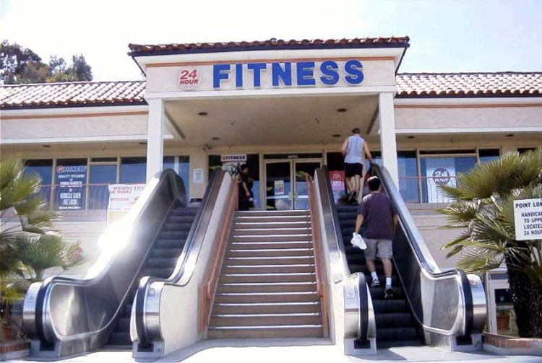
Examples of Irony

Slide 14
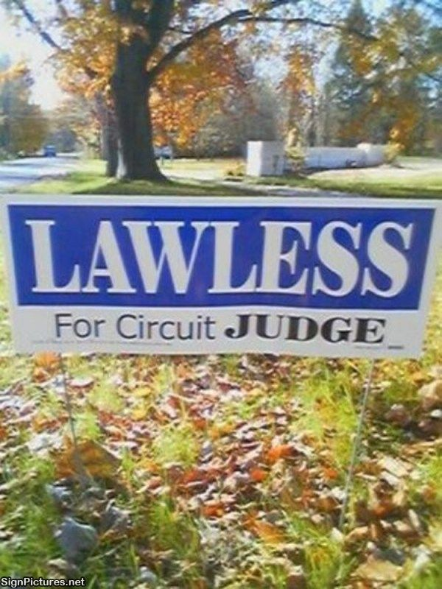
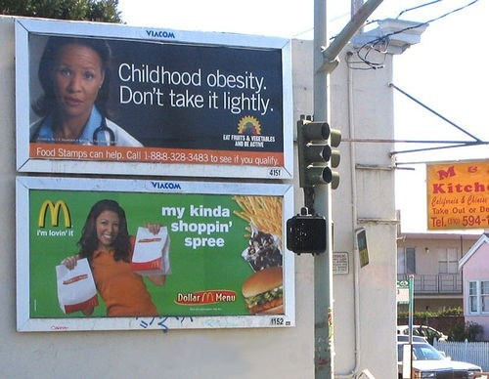

Slide 15
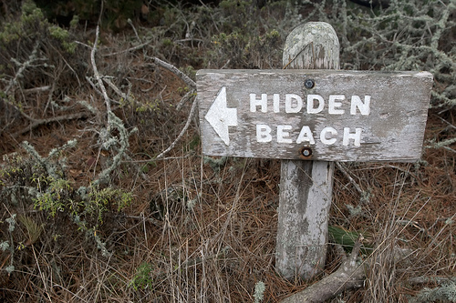
From The Great Debaters: “Tell me the irony in the name Bethlehem Steel Corporation.”
“Bethlehem is the birthplace of Christ, the Prince of Peace and Bethlehem Steel makes weapons of war.”

