Slide 1
WARM UP
f(x) = x² – 3x + 7 g(x) = 3x – 5 h(x) = 3x² – x
f(g(0))
g(f(-3))
h(f(2))
g(h(f(-2)))

Slide 2
Evaluate Composition of Functions

Slide 3
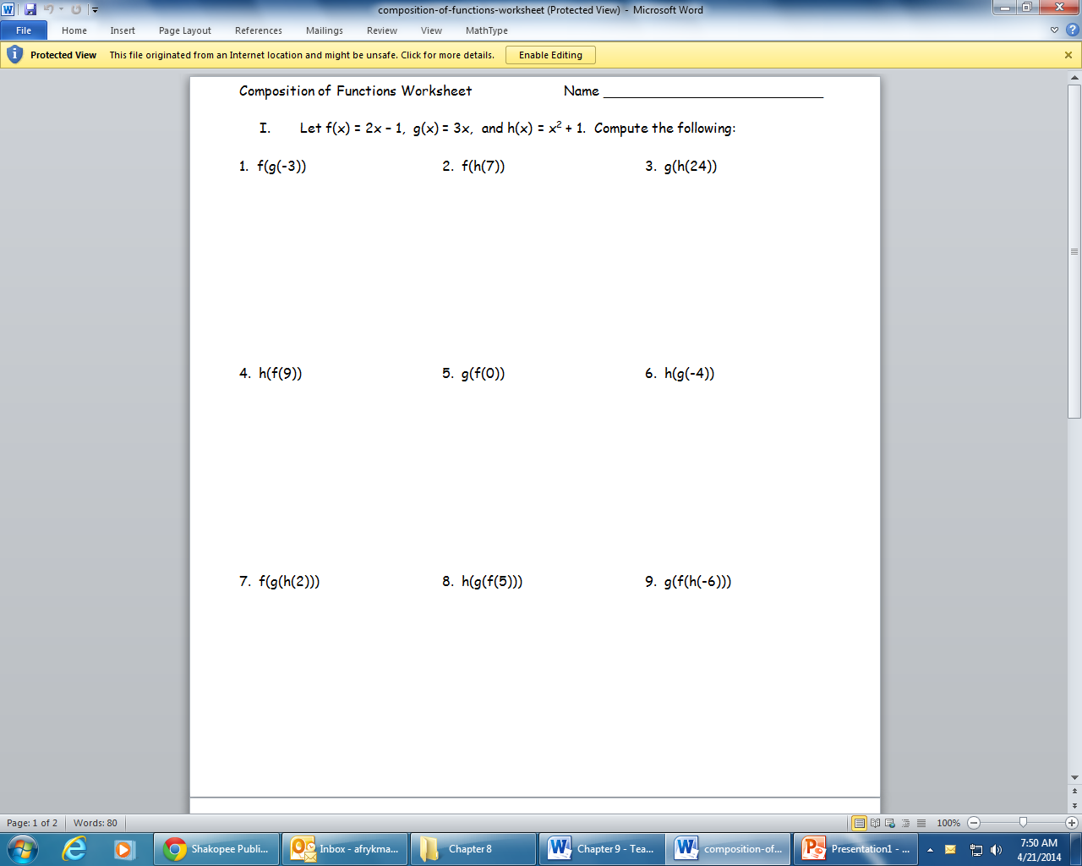

Slide 4
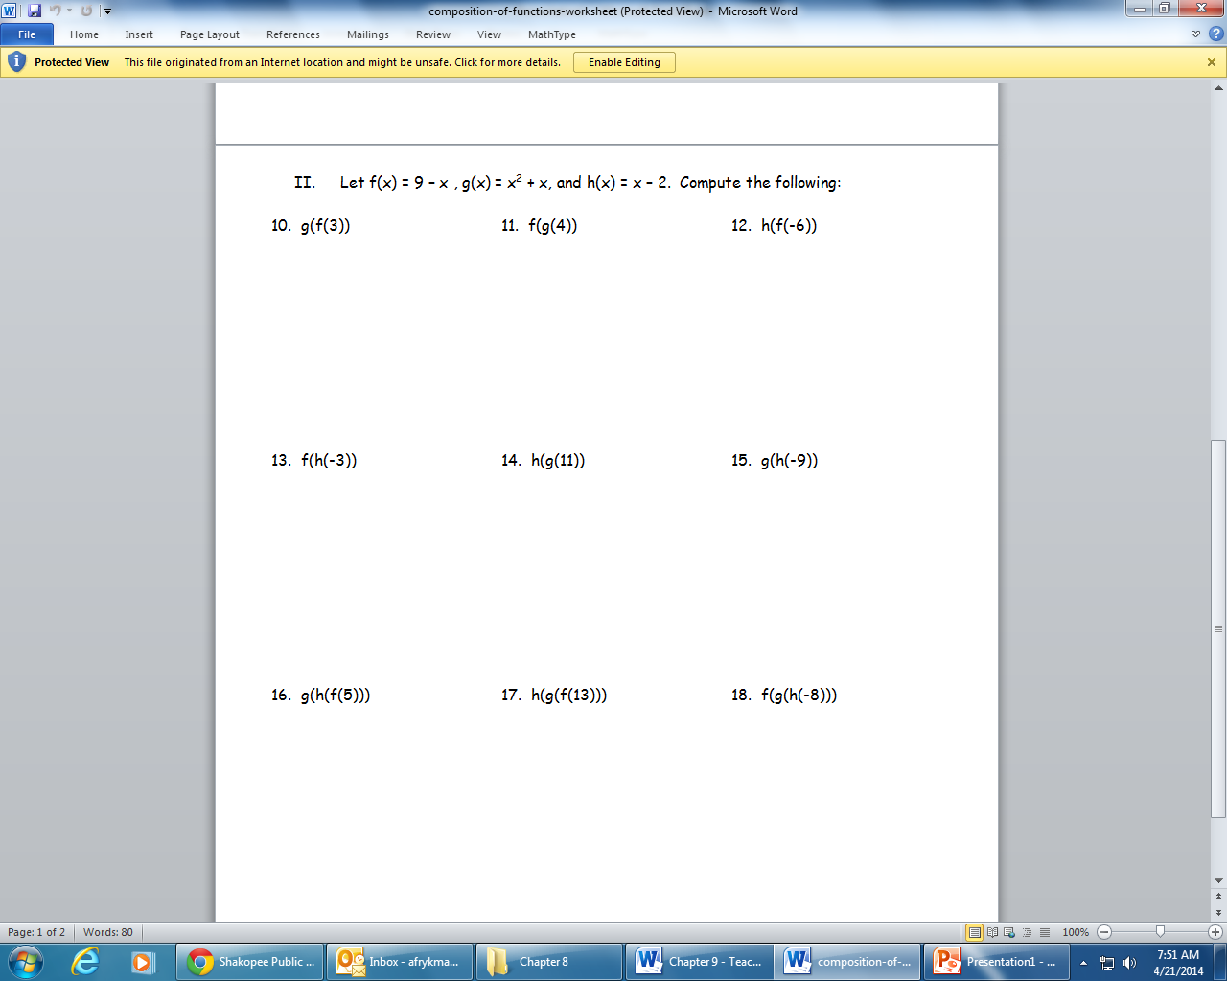

Slide 5
Find f(g(x)) and (gºf)
f(x) = 5x + 8 g(x) = x² – 5

Slide 6
f(x) = x² – 3x + 2 g(x) = x² – 2x
g + f
(g – f)(x)
gf
g/f

Slide 7
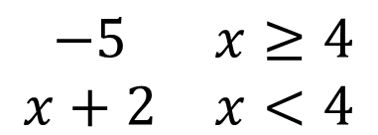
Graph and Evaluate
g(0)
g(-5)
g(4)
g(8)
{
$$\begin{matrix}−5 & x≥4 \\ x+2 & x<4\end{matrix}$$
g(x)

