Slide 1
Chromatography
Applications in Forensic Science
T. Trimpe 2006 http://sciencespot.net/

Slide 2
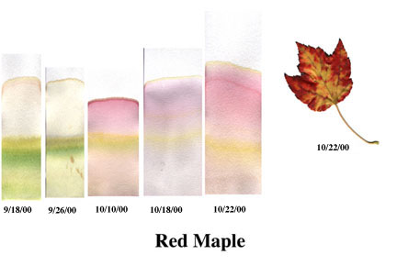
What is chromatography?
From Wikipedia ...
Chromatography (from Greek word for chromos for colour) is the collective term for a family of laboratory techniques for the separation of mixtures. It involves passing a mixture which contains the analyte through a stationary phase, which separates it from other molecules in the mixture and allows it to be isolated.
Which means ...
Chromatography is the physical separation of a mixture into its individual components.
We can use chromatography to separate the components of inks and dyes, such as those found in pens, markers, clothing, and even candy shells. Chromatography can also be used to separate the colored pigments in plants or used to determine the chemical composition of many substances.
http://members.shaw.ca/vict/chemistry_test3.htm

Slide 3
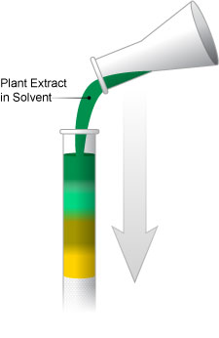
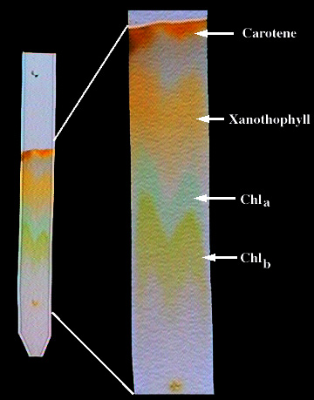
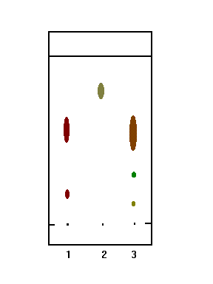
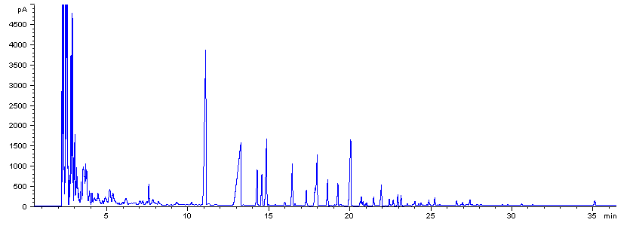
Examples of Chromatography
Liquid Chromatography
Used to identify unknown plant pigments & other compounds.
Thin-Layer Chromatography
Uses thin plastic or glass trays to identify the composition of pigments, chemicals, and other unknown substances.
Gas Chromatography
Used to determine the chemical composition of unknown substances, such as the different compounds in gasoline shown by each separate peak in the graph below.
Paper Chromatography
Can be used to separate the components of inks, dyes, plant compounds (chlorophyll), make-up, and many other substances

Slide 4

Mixtures & Compounds
Mixture – Two or more substances that are mixed together, but not chemically combined.
Examples of mixtures ...
Air – mixture of gases
Bowl of cereal – mixture of cereal and milk
Soda pop – mixture of soda syrup, water, and CO2 gas
Fog –water suspended in air
Kool-Aid – mixture of water, sugar, and flavor crystals
Compounds – Two or more elements that are chemically combined.
Examples of compounds ...
Salt –Sodium and chlorine combined chemically
Water –Hydrogen and oxygen combined chemically
Carbon Dioxide – Carbon and oxygen combined chemically

Slide 5
Solutions
Solutions are mixtures in which one substance is dissolved in another.
Solutions have two parts: solute and solvent
The solute is the substance that is dissolved.
The solvent is the substance that does the dissolving
Identify the solute and solvent in each solution ...
Solution | Solute | Solvent
Lemonade
Soda pop
Ocean water
Solubility - A measure of how much of a given substance will dissolve in a liquid.
A substance that does not dissolve in water is called insoluble.
A substance that does dissolve in water is called soluble.

Slide 6
Paper Chromatography Lab
Obtain the supplies you’ll need.
  1 large beaker (or plastic cup)
  1 small beaker (or plastic cup) filled with water
  4 pieces of filter paper
  4 black markers for testing
  4 small pieces of masking tape
  Pencil (to attach to the top of the filter paper)
  Permanent marker
  Timer
Write the pen number on a piece of masking tape with a permanent marker and place it at the top of the strip.
Choose one of the testing markers and draw a thick line near the bottom of the filter paper - about ¼ inch from the bottom.
Pour a small amount of water into the large cup and then hang the paper strip in the cup. Make sure the ink line does not touch the water – only the bottom of the filter paper.
Allow the water to move up the paper for 5 minutes and then remove the strip from the water. Hang it on the side of the table to dry.
Follow these directions to test the other pens.
Tape – Label with marker
Pencil
Filter Paper
Ink
Mark

Slide 7
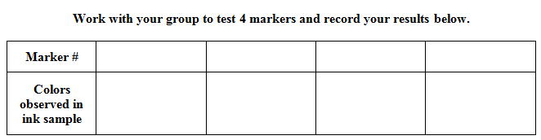
Complete the chart on your worksheet and then answer the questions.
Questions:
What colors did your group observe in each of the black ink samples?
Do the colors occur in the same order on all the samples? Explain.
Did some ink samples not work? Why?

Slide 8
Chromatography Challenge
Work with your group to identify the pens used for each of the “Mystery Marks”.
1st – Test each of the Mystery Mark strips using the procedure from yesterday.
2nd – Compare your strips to the strips hanging in the classroom.
3rd – Write the number of the pen that you think matches each of the mystery marks in the space on your worksheet.
4th – Have your answers checked by the teacher. Keep trying until you are able to identify all 6 pens!
Pen A matches # _____ Pen D matches # _____
Pen B matches # _____ Pen E matches # _____
Pen C matches # _____ Pen F matches # _____

