Slide 1
Jeopardy
Our Planet
Earth 1
Our Planet
Earth 2
Our Planet
Earth 3
Our Planet
Earth 4
Our Planet
Earth 5
$100
$100
$100
$100
$100
$200
$200
$200
$200
$200
$300
$300
$300
$300
$300
$400
$400
$400
$400
$400
$500
$500
$500
$500
$500
Final Jeopardy

Slide 2
1 - $100
What is a mixture of gases that forms a layer around Earth?
The atmosphere is a mixture of gases that forms a layer around Earth.

Slide 3
1 - $200
What Earth system contains all living things?
The biosphere contains all living things.

Slide 4
1 - $300
What water contains less than 0.2 percent dissolved salts?
Freshwater contains less than 0.2 percent dissolved salts.

Slide 5
1 - $400
What is the solid part of the earth called?
The geosphere is the solid part of the earth.

Slide 6
1 - $500
What is water that is stored in cracks and pores beneath Earth's surface?
Groundwater is water that is stored in cracks and pores beneath Earth's surface.

Slide 7
2 - $100
What is a system that contains all Earth's water?
The hydrosphere contains all of Earth's water.

Slide 8
2 - $200
What is naturally occurring, inorganic solid that has a crystal structure and definite chemical composition?
Minerals are naturally occurring, inorganic solid that has a crystal structure and definite chemical composition.

Slide 9
2 - $300
What is naturally occurring solid composed of minerals and sometimes other materials such as organic matter.
Rock is naturally occurring solid composed of minerals ad sometimes other materials such as organic matter.

Slide 10
2 - $400
What is the average weather pattern for a region over a long period of time?
Climate is the average weather pattern for a region over a long period of time.

Slide 11
2 - $500
What is the process by which a gas changes to a liquid?
Condensation is the process by which a gas changes to a liquid?

Slide 12
3 - $100
What is the process by which a liquid changes into a gas?
Evaporation is the process by which a liquid changes into a gas.

Slide 13
3 - $200
What is moisture that falls from clouds to Earth's surface?
Precipitation is moisture that falls from clouds to Earth's surface.

Slide 14
3 - $300
What is force exerted over an area?
Pressure is force exerted over an area.

Slide 15
3 - $400
What is a natural phenomenon marked by gradual changes that lead toward a particular result?
Process is a natural phenomenon marked by gradual changes that elad toward a particular result.

Slide 16
3 - $500
What is a series of processes that transport and continually change rocks into different forms?
The rock cycle is a series of processes that transport and continually change rocks into different forms.

Slide 17
4 - $100
What is the process by which plants release water vapor through their leaves?
Transpiration is the process by which plants release water vapor through their leaves.

Slide 18
4 - $200
What is continuous movement of water on, above, and below Earth's surface?
The water cycle is continuous movement of water on, above, and below Earth's surface.

Slide 19
4 - $300
What is a state of the atmosphere at a certain time and place?
Weather is a state of the atmosphere at a certain time and place.

Slide 20
4 - $400
what is the process that moves large bodies of Earth materials to higher elevations?
Uplift is the process that moves large bodies of Earth materials to higher elevations.

Slide 21
4 - $500
Rain shadow occurs because of an interaction between Earth's __________and_________.
Rain shadow occur because of an interaction between Earth's atmosphere and geosphere.

Slide 22
5 - $100
Weather occurs in Earth's ________.
Weather occurs in Earth's atmosphere.

Slide 23
5 - $200
True or False: Air is best described as mostly nitrogen, some oxygen, and trace gases.
True.

Slide 24
5 - $300
True or False: Most of the water on Earth is contained in the ocean.
True.

Slide 25
5 - $400
What does Earth's geosphere include?
Earth's geosphere icludes the crust, the mantle, and the core.

Slide 26
5 - $500
True or False: About 3 percent of water on Earth is ocean water.
False.

Slide 27
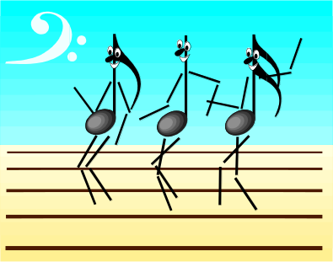
Final Jeopardy
True or False: Ice is the smallest reservoir of freshwater on Earth.
False.

