Slide 1
Chapter I
FOUNDATIONS OF CHEMISTRY
What is chemistry?
Webster's Dictionary, "chem·is·try n., pl. -tries. 1. the science that systematically studies the composition, properties, and activity of organic and inorganic substances and various elementary forms of matter. 2. chemical properties, reactions, phenomena, etc.: the chemistry of carbon. 3. a. sympathetic understanding; rapport. b. sexual attraction. 4. the constituent elements of something; the chemistry of love.
"scientific study of matter, its properties, and interactions with other matter and with energy".

Slide 2
Matter: anything that has mass and takes up space
Energy: it is the capacity to do work or transfer heat
~ All Chemical processes are accompanied by energy changes
These laws allow us to do the calculations needed for Chemistry:
Law of Conservation of Mass
Law of Conservation of Energy
Law of Conservation of Mass-Energy
  Einstein’s Relativity
  E=mc²

Slide 3
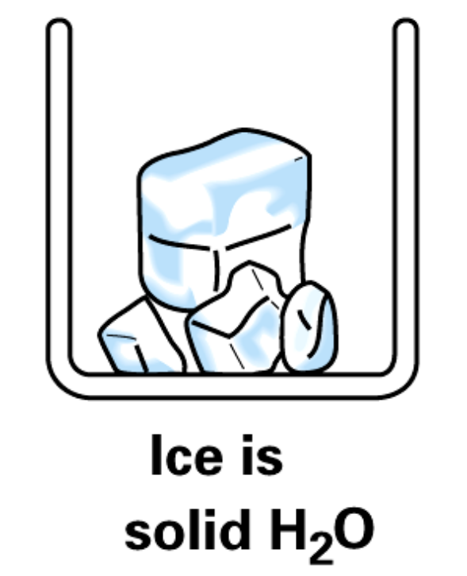
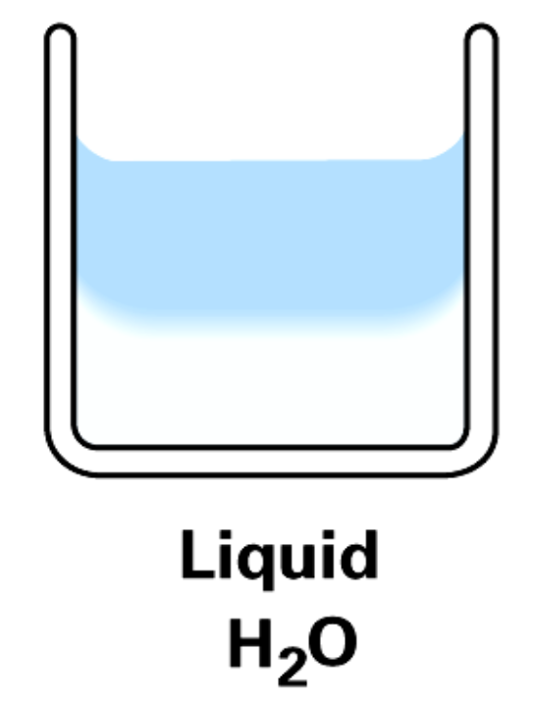
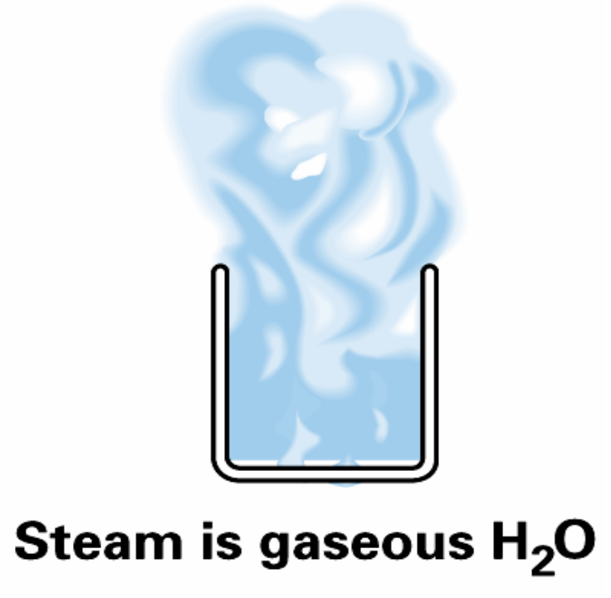
States of Matter

Slide 4
Plasma
http://chemistry.about.com/od/photogalleries/ig/Lightning-and-Plasma-Photos/
Plasma has neither a definite volume nor a definite shape.
Plasma often is seen in ionized gases. Plasma is distinct from a gas because it possesses unique properties. Free electrical charges (not bound to atoms or ions) cause plasma to be electrically conductive. Plasma may be formed by heating and ionizing a gas.
Stars are made of plasma. Lightning is plasma. You can find plasma inside fluorescent lights and neon signs.
Notes:
8
8

Slide 5
Chemical and Physical Properties
Chemical Properties - chemical changes, happens when matter changes composition
  rusting or oxidation (iron reacting with oxygen)
  chemical reactions
Physical Properties - physical changes, no change in composition
  changes of state
  density, color, solubility, hardness, melting and boiling point, conductivity, mass, and volume

Slide 6
Two types of Physical Properties
Extensive Properties - depends on quantity
  Mass, volume
Intensive Properties - do not depend on the amount of material present
  Density, color, temperature, melting and boiling point.

Slide 7
Chemical and Physical Changes
Chemical changes happen when something is being made, something is being used up or energy is being released or absorbed.
  Ex. Sodium in water; burning of a gas;
  5 ways to tell: color change, heat, light, bubbles, and/or a precipitate is formed

Slide 8
Chemical and Physical Changes
Physical change happens with no change in chemical makeup, but energy can be absorbed or released.
  Ex. Melting a metal; light from a light bulb (exothermic); converting water from ice to water to steam (endothermic)
  ~ Exothermic: energy is released to the surroundings
  ~ Endothermic: energy is absorbed from the surroundings

Slide 9
Classification of Matter
Substance
  matter where samples have identical composition and properties
  Mixture ~ composed of two or more substances
  heterogeneous mixtures – can normally see a difference (soil, salt & pepper, sand & water)
  homogeneous mixtures – uniform throughout (solutions ~ salt dissolved in water, brass)

Slide 10
Pure Substances
Compounds
  substances composed of two or more elements in a definite ratio by mass
  can be decomposed into the individual elements that make the compound
    Ex. Water; calcium chloride; methane gas;
Elements
  substances that cannot be decomposed into simpler substances via chemical reactions
Elemental symbols
  found on periodic table

Slide 11
Measurements in Chemistry
length - meter - m
mass - kilogram - kg
time - second - s
current - ampere - A
temperature - Kelvin - K
amt. substance - mole - mol

Slide 12
Units of Measurement
Mass
  measure of the quantity of matter in a body (grams)
Weight
  measure of the gravitational attraction of the earth for a body (weight = force = mass x gravity)
Length
  A measurement of one dimension (how long something is); usually in meters
  1 m = 39.37 inches
  2.54 cm = 1 inch
Volume
  A measure of 3 dimensions (length x width x height)
  1 liter = 1.06 qt
  1 qt = 0.946 liter

Slide 13
mega - M 10⁶
kilo - k 10³
deka - da 10
deci - d 10⁻¹
centi - c 10⁻²
milli - m 10⁻³
micro - μ 10⁻⁶
nano - n 10⁻⁹
pico - p 10⁻¹²
femto - f 10⁻¹⁵

Slide 14
Accuracy
  how closely measured values agree with the correct value
Precision
  how closely individual measurements agree with each other
Think of a dart board

Slide 15
Dimensional Analysis
(factor label, unit factor method, or railroad tracks)
way to change from one unit to another
make unit factors from statements
  1 ft = 12 in becomes 1 ft/12 in or 12in/1 ft
  Ex. 1) Convert 19.37 yards into millimeters.

Slide 16
area is two dimensional
  Ex 2) Transfer 4.8 x 10⁴ square centimeters into square feet
volume is three dimensional
  Ex 3) Express 2.60 cubic feet in cubic centimeters.
You can convert more than one unit at a time
  Ex. 4) 77 miles/hour is how many feet/seconds?
Percentage is the parts per hundred of a sample.
  Ex. 5) A 435 g sample of ore yields 129.5 g of iron. What is the percent of iron in the rock?

Slide 17
Density
density = mass/volume
Different materials usually have different densities, so density is an important concept regarding buoyancy and metal purity
Units for liquids and solids g/mL or g/cm³
  1mL = 1 cm³
Units for gases g/L

Slide 18
  density of water is nearly 1.00 at room Temp, it is dependent on both the temp and phase
  Specific gravity is the ratio of the density of a substance to the density of a given reference material. Specific gravity usually means with respect to water. The term "relative density" is often preferred in modern scientific usage.
  density of substance
  density of water

Slide 19
  Ex. 6) Calculate the density of a substance if 770 grams of it occupies 97.3 cubic centimeters. Would this substance float or sink in water?
  Ex. 7) Suppose you need 122 g of a corrosive liquid for a reaction. What volume do you need? The liquid’s density = 1.42 g/mL What is this liquids specific gravity?
  Ex. 8) A 31.10 gram piece of chromium is dropped into a graduated cylinder that contains 5.00 mL of water. The water level rises to 9.32 mL. What is the specific gravity of chromium?

Slide 20
Ex 9) A concentrated hydrochloric acid solution is 36.31%HCl and 63.69% water by mass. Specific gravity is 1.185. What mass of pure HCl is contained in 175 mL of this solution?

Slide 21
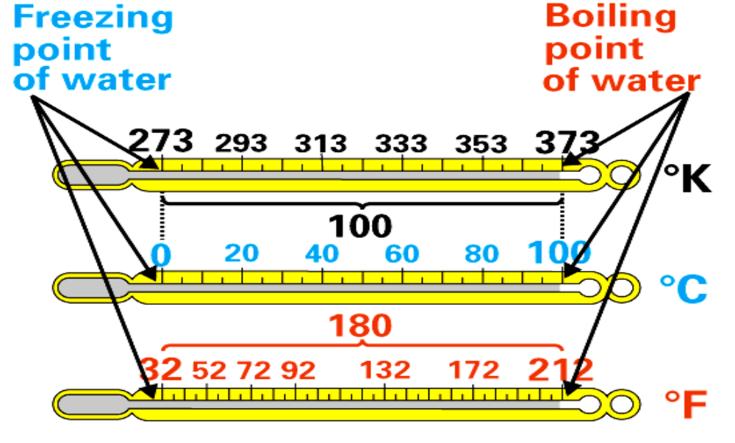
Temperature and heat
heat and T are not the same thing
  T is a measure of the intensity of heat in a body
3 common T scales - all use water as a reference

Slide 22
Temp conversions are at the end of the book
Ex. 10) Convert 211ºF to degrees Celsius.
Ex. 11)Express 548 K in Celsius degrees.

Slide 23
Heat Transfer & The Measurement of Heat
SI unit J (Joule)
calorie 1 calorie = 4.184 J
English unit = BTU (British Thermal Unit)
Specific Heat
  amount of heat required to raise the T of 1g of a substance by 1ºC
    units = J/gºC
Heat capacity
  amount of heat required to raise the T of 1 mole of a substance by 1ºC
    units = J/mol ºC

Slide 24
heat transfer equation
  necessary to calculate amounts of heat
  amount of heat = amount of substance x specific heat x T
  Or… q=mcΔT
  q=amount of heat m=mass
  c=specific heat ΔT=change in temp

Slide 25
Ex. 12)Calculate the amt. of heat needed to raise T of 200.0 g of water from 10.0ºC to 55.0ºC. Specific heat of liquid water is 4.18 J/g ºC
Ex. 13) Calculate the amount of heat needed to raise the temperature of 200.0 grams of mercury from 10.0ºC to 55.0ºC. Specific heat for Hg is 0.138 J/g ºC.
Note: It requires 30.3 times more heat for water than Mercury
Ex. 14) For Mercury, what temperature change would be required in order to use the amount of heat made in Ex. 12?

Slide 26
It has been estimated that 1.0 g of seawater contains 4.0 pg of Au. The total mass of seawater in the oceans is 1.60x10¹² Tg, If all of the gold in the oceans were extracted and spread evenly across the state of Georgia, which has a land area of 58,910 mile², how tall, in feet, would the pile of Gold be?
  Density of Au is 19.3 g/cm³. 1.0 Tg = 10¹²g.

Slide 27
On a typical day, a hurricane expends the energy equivalent to the explosion of two thermonuclear weapons. A thermonuclear weapon has the explosive power of 1.0 Mton of nitroglycerin. Nitroglycerin generates 7.3 kJ of explosive power per gram of nitroglycerin. The hurricane’s energy comes from the evaporation of water that requires 2.3 kJ per gram of water evaporated. How many gallons of water does a hurricane evaporate per day?

