Slide 1

Worthington Schools
February 8, 2016

Slide 2

Worthington students can participate in CC+ :
At a college campus (online or live)
At the high school taught by a Worthington teacher
At the high school taught by a college professor
Students can enroll in a combination of these options.

Slide 3
CC+ Classes taught by Worthington Staff
College Class Name | High School Equivalent | Partner College | College Course Code | High School
Calculus I | AP Calculus AB | COTC | MATH 200 | Both
Calculus II | AP Calculus BC | COTC | MATH 210 | Both
Intro to Programming Logic | Same | CSCC | CSCI 1103 | Both
Pre-Calculus | Same | COTC | Math 150 | Both
Intro to Business | Same | COTC | BUS 105 | WKHS
Personal Finance | Personal Financial Management | CSCC | FMGT 1101 | TWHS
Basic Chemistry | Honors Chemistry | COTC | CHEM 100 | TWHS
General Chemistry I and II | AP Chemistry | COTC | CHEM 110 and 111 | TWHS

Slide 4
CC+ Classes taught by Worthington Staff
The Ohio Department of Higher Education has clarified that Advanced Placement courses are not to be co-seated with CC+ classes. Students will have to choose to take either the AP course or the CC+ course even though the similar content is being covered.
This affects students interested in taking AP Calculus AB, AP Calculus BC, and/or AP Chemistry.

Slide 5
CC+ “Pathway” Anticipated Classes- Taught on the High School Campus (All 1.0 High School credit)
Fall Semester
ENGL 1100 | Composition 1 | 3 college credits
PSY 1100 | Intro to Psychology | 3 college credits
PHIL 1130 | Ethics | 3 college credits
HIST 2223 | African American History to 1877 | 3 college credits
CLAS 1222 | Classical Mythology | 3 college credits
Spring Semester
ENGL 2367 | Composition 2 | 3 college credits
POLS 1100 | Intro to Amer. Gov | 3 college credits
SOC 1101 | Intro to Sociology | 3 college credits
GEOL 1121 | Physical Geology | 4 college credits
HART 1201 | History of Art | 3 college credits
Notes:
Model pathway options will hopefully be available in the home high schools at both TWHS and WKHS – depending on adequate registration – it is possible that these semesters will have to change depending upon registration requests.
- Please note that the course selection sheet at WKHS had a typo – Physical Geology and Art History are both anticipated to be 2nd semester and not 1st as the course selection sheet says.
How these classes were selected
Do not have to take all of the classes – can pick and chose

Slide 6

How student schedules will work
CC+ classes taught by college instructors at the high school will be blocked and only meet on selected days.
For example, periods 1 & 2 could
accommodate a CC+ class from
8:00 to 9:20 that meets on Mondays/ Wednesdays & one that meets at the same time on Tuesdays/ Thursdays.
Notes:
David,
I know you had on here, “CC+ classes will follow the college’s schedule. Such as start dates, drop dates, & withdrawal dates.” As Andrea and I were looking at it we think that might create more questions than it solves. All of the CC+ classes taught by our teachers are following Worthington’s schedule. All of the CSCC instructors who are here have also agreed to go with Worthington’s breaks (like Spring Break) rather than the college’s. I just think that putting it in writing in the presentation will create more questions than it solves. We also thought we should still point out that the classes don’t meet every day.

Slide 7

Scheduling for classes at your high school
Though you have until April 1 to submit your “Intent to Participate Form”, it is preferred that you choose your CC+ class(es) you plan to take at the high school prior to the scheduling window being closed (TWHS closes 2/11/16. WKHS closes on 2/10/16).
The reason is so that your high school will know the number of students requesting a CC+ class as soon as possible and to ensure that the CC+ course(s) will be offered.
For CC+ classes at the high school, build your schedule with the requested CC+ classes assuming they will be offered. If there is a conflict, your counselor will add you to the required course at your home high school.
For CC+ classes at the college (or online), please consult with your counselor as early as possible before making your final decisions. Choose your high school classes as though you will take everything at the high school. Once your college schedule is set, your counselor will look at adjusting your high school schedule within the confines of the master schedule.

Slide 8

When can I participate?
Students can take classes during the summer, fall, and spring semesters provided the student does not exceed 30 hours in the academic year (which starts the beginning of the summer term). You must meet all required deadlines in order to participate.

Slide 9
When can I participate?
Remember! One high school credit = 3 college credits. Therefore, consider how many high school credits you will be taking next school yea. Multiply the number of credits x 3. Then subtract from 30 and that will tell you how many college credits you have available for summer, fall, and spring.
For example, next year I am registering for:
AP Physics- 1.0 x 3 = 3. 0
Math 3- 1.0 x 3 = 3. 0
Government & Behavioral Science- 1.0 x 3 = 3. 0
Honors Spanish 4- 1.0 x 3 = 3. 0
In this example, I am taking 12.0 high school hours, which leaves me with 18.0 college credits remaining. If you exceed the 30.0, the family is responsible for payment.

Slide 10
When can I participate?
Continuing with this example of having 18 credit hours remaining, if during the school year I also plan on taking:
Composition 1: 3 hours
Composition 2: 3 hours
Ethics: 3 hours
Physical Geology: 4 hours
That totals 13 hours of college credits. 18 – 13 = 5 credit hours left over. So, this summer, if I would like to go to a local college, I would have 5 credit hours available to use.

Slide 11

Balance
Think carefully about courses you’re selecting. Consider your participation in after school activities. CC+ = 2 semester high school classes per semester
Similar to an AP Class all in 1 semester rather than across a year
High School weighted grade (equal to AP)
Your transcript will report the institution awarding the grade, the class title, and the letter grade.
Notes:
Even on pathway classes – not all or nothing – can pick and choose
Athletic eligibility
Equals 2 high school classes

Slide 12

Next Steps
OSU, CSCC, COTC, Otterbein & CCAD are available to answer questions in the hall following this presentation.
Complete the Intent to Participate Form.
  Return between February 15th and April 1^{st,} 2016 to the School Counseling Office. If you do not submit this form by the deadline, you will not be eligible to participate in CC+. Summer participation requires earlier action!
Follow college criteria for applying.
Spring Compass testing if necessary (or ACT score).
Work with counselor to finalize selections and course planning.

Slide 13
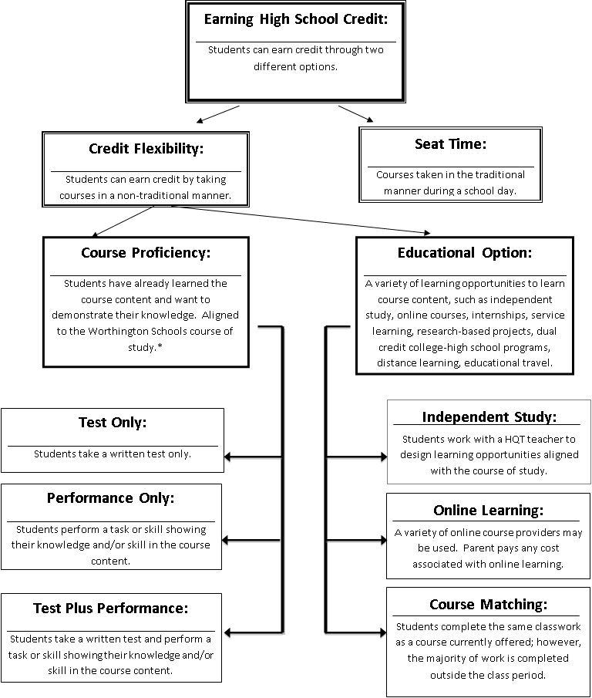
Credit Flexibility
Notes:
Flow chart – This will be the overview of what we are going to talk through tonight

Slide 14
Earning High School Credit
Traditional Seat-Time
Credit Flexibility
Students take courses during regular scheduled day
Instruction by teachers
Earn grades at the end of each semester that is reflected on transcript
Students have flexibility to design instruction based upon individual needs and strengths

Slide 15
Credit Flex Categories
Demonstration of Proficiency
For students who have already learned the course material
Example- Testing out of Spanish 2 to move to Spanish 3.
Educational Options
For students who do not yet know the course material, but want to learn
Examples: student designed courses, online learning, internships, matching

Slide 16
Completing a Credit Flex Application
Students are responsible for completing all steps of the credit flex application and receiving all signatures of approval before coursework can begin
Worthington Schools Credit Flexibility Plan is available at www.worthington.k12.oh.us
  Academics → Credit Flexibility

Slide 17
Thank you for attending!
Worthington Kilbourne:
  www.wkhscounselors.com
Thomas Worthington:
  www.worthington.k12.oh.us/domain/8
Linworth:
  www.linworth.org

Slide 18
Scheduling for classes at your high school
Though you have until April 1 to submit your “Intent to Participate Form”, it is preferred that you choose your CC+ class(es) prior to the scheduling window being closed (TWHS closes 2/11/16. WKHS closes on 2/10/16).
The reason is so that your high school will know the number of students requesting a CC+ class as soon as possible and to ensure that the CC+ course(s) will be offered.
Build your schedule with the requested CC+ classes assuming they will be offered. If there is a conflict, your counselor will add you to the required course at your home high school.

Slide 19
When can I participate?
Students can take classes during the summer, fall, and spring semesters provided the student does not exceed 30 hours in the academic year (which starts the beginning of the summer term). You must meet all required deadlines in order to participate.

Slide 20
When can I participate?
Remember! One high school credit = 3 college credit. Consider how many high school credits you will be taking next school year. Multiply the number of credits x 3. Then subtract from 30 and that will tell you how many credits you have for summer, fall, and spring.
For example, next year I am registering for:
Chemistry- 1.0 x 3 = 3. 0
Math 3- 1.0 x 3 = 3. 0
Government & Economics- 1.0 x 3 = 3. 0
Honors Spanish 4- 1.0 x 3 = 3. 0
In this example, I am taking 12.0 high school hours, which leaves me with 18.0 college credits remaining. If you exceed the 30.0, the family is responsible for payment.

Slide 21

Balance
Think carefully about courses you’re selecting
Similar to an AP Class all in 1 semester rather than across a year
High School weighted grade
Your transcript will report the institution awarding the grade, the class title, and the letter grade.
Notes:
Even on pathway classes – not all or nothing – can pick and choose
Athletic eligibility
Equals 2 high school classes

Slide 22
Next Steps
OSU, CSCC, COTC & Otterbein are available to answer questions in the hall following this presentation.
Complete the Intent to Participate Form.
  Return by April 1^{st,} 2016 to the School Counseling Office. If you do not submit this form by the deadline, you may not be eligible to participate in CC+.
Follow college criteria for applying.
Spring Compass testing if necessary (or ACT score).
Work with counselor to finalize selections and course planning.

Slide 23
Credit Flexibility
Notes:
Flow chart – This will be the overview of what we are going to talk through tonight

Slide 24
Earning High School Credit
Traditional Seat-Time
Credit Flexibility
Students take courses during regular scheduled day
Instruction by teachers
Earn grades at the end of each semester that is reflected on transcript
Students have flexibility to design instruction based upon individual needs and strengths

Slide 25
Credit Flex Categories
Demonstration of Proficiency
For students who have already learned the course material
Example- Testing out of Spanish 2 to move to Spanish 3.
Educational Options
For students who do not yet know the course material, but want to learn
Examples: student designed courses, online learning, internships, matching

Slide 26
Completing a Credit Flex Application
Students are responsible for completing all steps of the credit flex application and receiving all signatures of approval before coursework can begin
Worthington Schools Credit Flexibility Plan is available at www.worthington.k12.oh.us
  Our District → Credit Flexibility

Slide 27
Thank you for attending!
Worthington Kilbourne:
  www.wkhscounselors.com
Thomas Worthington:
  www.worthington.k12.oh.us/domain/8
Linworth:
  www.linworth.org

