Slide 1
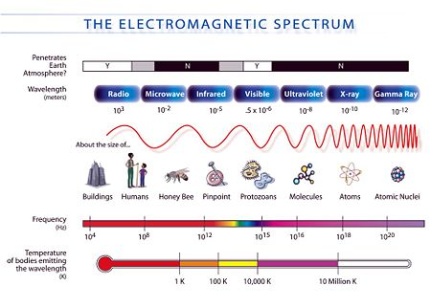
Electromagnetic Spectrum
Scientists use visible light to detect temperature, Radio telescopes to take pictures of distant objects that emit radio waves and x-ray telescopes to detect things like black holes, and supernova explosions.
You may be familiar with UV waves that burn our skin and Infra Red that we detect as heat.

Slide 2
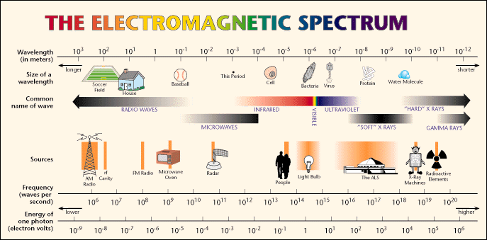

Slide 3
Review
1. Draw a simple picture of the electromagnetic spectrum. Label the main parts.
2. Which end has the most energy? Which has the longest wavelength? Label it on your diagram.

Slide 4
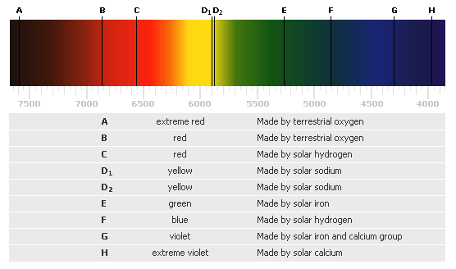
Composition of a Star
Composition- what elements are present in the star
Spectrograph- spreads light from a hot glowing object
Each star has it’s own Spectrum which will determine the elements that are present in the star
Every element absorbs different wavelengths of light as the light from the star passes through it, removing these waves of color from the continuous spectrum of the star. This occurs as the light of the star passes through the Photosphere and different stars may have different elements present in their Photosphere.
The dark lines that show up in a spectrum of a star are called spectral lines, from certain wavelengths of light being absorbed, like that of the sun below.

Slide 5
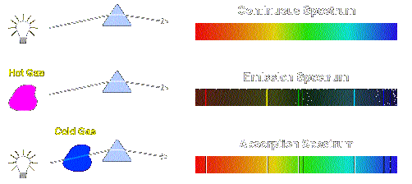
How it works
The below diagram shows the difference between an absorption spectrum and an emission spectrum.

Slide 6
Review
3. Draw a picture showing the difference between emission spectrum and absorption spectrum.

Slide 7
How stars are different
One of the most common differences between spectra is the position of the peak with respect to wavelength, combined with an overall change in steepness
A cooler star will have a lower, flatter peak closer to the red end.
According to the rules governing black body radiation, the spectrum of a hotter star will have a higher, sharper peak closer to the blue end of the spectrum.
Our Sun
Star A is hotter
Star B is cooler
BLUE
RED

Slide 8
PEAK WAVELENGTH
Stars take the color of their peak wavelength. For example the Sun’s peak wavelength is in the yellow region of the visible spectrum, therefore the sun appears to be yellow.
Hotter objects peak on the blue side and cooler objects toward the red
Some objects in the sky are even hotter, and they will have their peaks in the UV, x-ray, or even gamma ray wavelengths.
This is why astronomers want to be able to detect all wavelengths of the electromagnetic spectrum in order to picture as many celestial bodies as possible.

Slide 9
Review
4. Draw a picture showing a hot star and a cool star with the colors labeled.

Slide 10
One Fish, Two Fish, Red Shift, Blue Shift
Sometimes objects in space will move toward or away from Earth.
If it is moving towards earth the waves compress and get shorter making the light look bluer.
If it is moving toward us then the waves get longer making the light look redder.
If the spectrum (emission or absorption) were compared to a known, spectrum for a similar object which is not moving relative to Earth. Then the same features would be there, but would all be shifted towards the blue end of the spectrum.
  Object’s spectrum that is stationary relative to earth
  Same object’s spectrum that is moving rapidly toward earth
  All features basically the same but shifted towards the blue

Slide 11
Review
5. Draw a picture showing the Doppler effect in stars. Label the colors and direction the stars are moving compared to the Earth.

