Slide 1
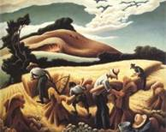
Cradling Wheat, by Thomas Hart Benton, 1938
“I don’t know whether it’s art or not and I don’t care. What I want to show is the energy and rush and confusion of American life.”
-Thomas Hart Benton (1889-1975)

Slide 2
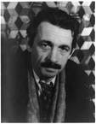
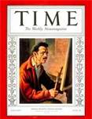
Thomas Hart Benton (1889-1975)
American Regionalism Artist
American Storyteller
and Painter of the People
During the 1930’s, Thomas Hart Benton’s name was practically a household word.

Slide 3
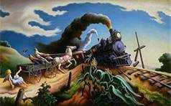
Wreck of the Ole ‘97, 1943, egg tempera
Thomas Hart Benton (1889-1975)
Based on a country music hit, the composition above creates a feeling of tense excitement as a thundering locomotive threatens to collide with a horse drawn wagon.

Slide 4
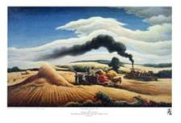
Threshing Wheat, 1938-1939, oil, tempera on canvass
Thomas Hart Benton (1889-1975)
“I have an inner conviction that, for all the contradictory struggles I have gone through, I have finally come to something that is in the image of America.”
-Thomas Hart Benton

Slide 5
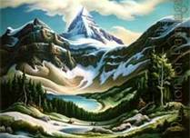
Trail Riders, 1964-1965, oil on canvass
Thomas Hart Benton (1889-1975)
In this mountain scene, the concave curve of the valley at the bottom of the composition contrasts with the soaring, triangular, convex peaks above.

Slide 6
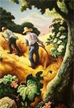
July Hay, 1943, egg tempera and oil
Thomas Hart Benton (1889-1975)
“ America is a land of pioneers and farm folk, and when art reflects this culture, then it is art.”
-Thomas Hart Benton

Slide 7
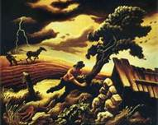
The Hailstorm, 1940, tempera on panel
Thomas Hart Benton (1889-1975)
“ I don’t think an artist can help but express himself. Anything he does automatically expresses his inner character and his mind.”
-Thomas Hart Benton

Slide 8
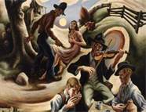
The Ballad of the Jealous Lover of Lone Green Valley, 1934, oil, tempera on canvass
Thomas Hart Benton (1889-1975)
Curving lines form a rhythmic composition that leads the viewer’s eye through this painting. The work suggests the musical flow of a slow, mournful ballad.

