Slide 1
Good Afternoon!

Slide 2
BELL RINGER
How many hours of physical activity do you get per week?
List 3 kinds of physical activity that you participate in.
What is your favorite form of physical activity?
What does FITT stand for?
What does SMART stand for?
What are the components of fitness?

Slide 3
5 Components of Fitness
Cardio-Respiratory Endurance
Flexibility
Muscular Strength
Muscular Endurance
Body Composition

Slide 4
FITNESS PRESENTATIONS
In assigned groups
Each group is responsible for teaching the class about their component of fitness.
You may use your books for information
You must tell us what it is, how to improve it, how it affects your health, exercises that are associated with it, anything else you feel is relevant
You will use your template to create a powerpoint slide that covers your topic

Slide 5
Block 4
Yovanni, Ryan, Devan, Jessica, Katie Wagstaff Cardio Endurance
Ivan, Leila, Morgan, Shawn, Katie Weems Flexibility
Chris, Alex, Brandon, Ana, James Cardio Endurance
Emilie, Matt, Colin L, Lexi Muscular Strength
Chelsea, Brant, Jackson, Morgan Muscular Endurance
Haley, Grant, Maeven, Jo Muscular Endurance
Ernesto, Abby, Olivia, Jared Body Composition
Kayla, Erik, Kyle, Colin V. Body Composition

Slide 6
Groups- Block 7
Jennifer, Patrick, Andrew, Cody- Cardio
Karsyn, James, Jorge, Lauren- Flexibility
Haley, Eileen, Montana, Billy- Flexibility
Rachel, Alex, Bailey, Gabrielle- Muscular Strength
Ben, Gus, Michael, Natalie- Muscular Endurance
Kat, TJ, Preston, Taryn, Abby- Body Composition
Timothy, Josh, Nathan, Kiran, Ashley- Cardio

Slide 7
Groups- Block 8
Moises, Sacha, Emma, Thomas- Cardio
Sarah, Mariela, Adam, Michael, Severn- Muscular Strength
Beau, Anna, Sierra, Cameron- Muscular Endurance
Carina, Kaitlyn H, Roland, Madison- Body Composition
Annie, Corey, Tyler, Lauren- Cardio
Kaitlyn C, Joe, Abby, Walter, Ethan- Flexibility
Joey, Maggie, Max, Kinzy – Muscular Strength

Slide 8
Groups
Group 1- Muscular Strength
Group 2- Flexibility
Group 3- Body Composition
Group 4- Cardiorespiratory Endurance
Group 5- Muscular Endurance

Slide 9
GOOD AFTERNOON!

Slide 10
Bell Ringer
List each of the five components of fitness and one exercise that can be done to help improve this component.

Slide 11
Today
Discussion of the five components
Review
Whole Group Review- if time
****NEXT CLASS****
Test on FITT, SMART, 5 components, Personal Fitness

Slide 12
Cardiorespiratory Endurance
What is it?
  The ability of the circulatory system and respiratory systems to supply oxygen to the rest of the body during sustained physical activity.
What does it do for your health?
  Improves heart and lung function.
  Helps improve metabolic rate
  Helps the body work more efficiently
What are some examples?

Slide 13
Flexibility
What is it?
  The ability to bend and move joints through a full range of motion.
What does it do for you?
  Bend and move easily without pain
  Decreases likelihood of accidents
  Increases mobility throughout life
Exercises that may help with flexibility?

Slide 14
Muscular Strength/Endurance
What is Strength?
  The maximum amount of force a muscle can produce in a single effort
  Aerobic or anaerobic?
What is Endurance?
  The ability of the muscle to continue to perform without fatigue
What do they do for you?
Exercises that increase strength? Endurance?

Slide 15
Body Composition
What is it?
  The ratio of lean body mass to body fat
BMI
  Based only on height and weight- does not take into account body type, muscle mass, etc.
Other ways to determine your body composition
  Skinfold measurements
  Bioelectrical impedance
  Hydrostatic weighing

Slide 16
Videos
http://www.youtube.com/watch?v=8gzsNsWDMyg&feature=related&safety_mode=true&persist_safety_mode=1&safe=active
http://www.youtube.com/watch?v=wqztQryiHSA&safety_mode=true&persist_safety_mode=1&safe=active
http://www.youtube.com/watch?v=QslL-PqOs2s&safety_mode=true&persist_safety_mode=1&safe=active

Slide 17
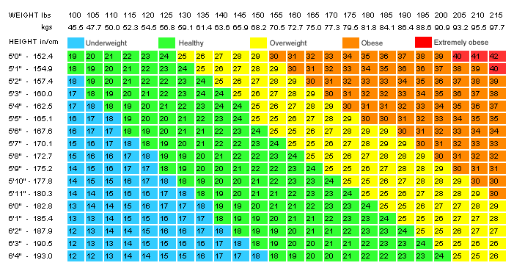
Example BMI Chart

Slide 18
BOOK WORK
Complete the personal fitness review
Work by yourself
REMINDER- 5 COMPONENTS TEST NEXT CLASS!!!!!!!

