Slide 1
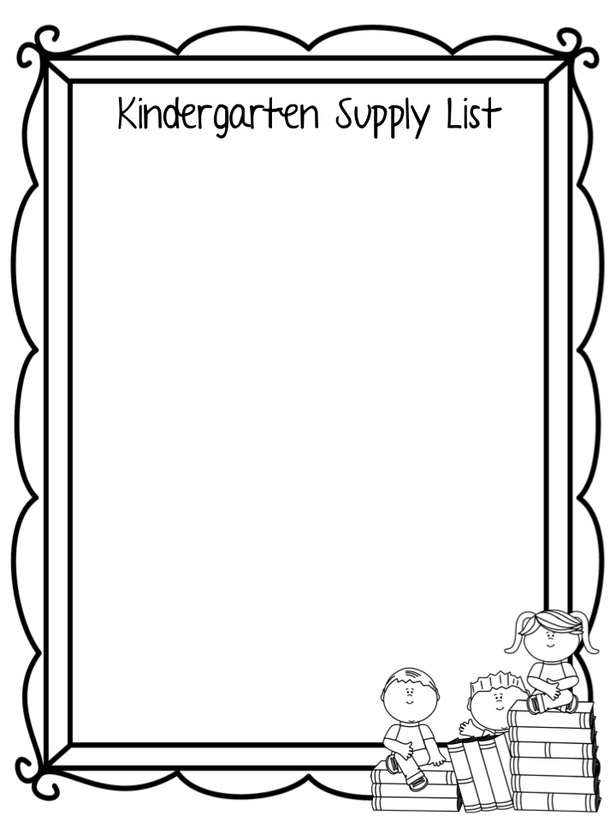
WES- 3rd Grade Supply List
The following supplies should be labeled and will be kept in your child’s desk
__ 1 soft large zippered pencil pouch
__ 8 folders with holes and prongs (please get the following colors: red, orange, yellow, green, blue, purple, white and black)
__ 3 wide ruled composition notebooks (not spiral)
__ 1 pack of markers (only 1 pack please)
__ 2 boxes of crayons (no more than 24 count)
__ 1 pair of scissors
__ 2 pairs of ear buds or headphones to use on the computer/laptops
These do not need to be labeled. They will be kept in the classroom by the teacher and will be given out as needed.
__ 4 packs of 12 or more #2 pencils (Ticonderoga only please and pre-sharpened)
__ 4 Elmer’s glue sticks and 1 bottle of Elmer’s liquid glue
__ 2 tissue boxes
__ 2 highlighters
__ 2 packs of eraser tops
__ 1 roll of paper towels
__ 1 pack of colorful Expo dry erase markers
__ 1 pack of 2 black Sharpies
Girls: 1 box of sandwich size bags and 1 pump bottle of antibacterial hand sanitizer
Boys: 1 container of disinfecting wipes,
and 1 box of gallon bags

