Slide 1
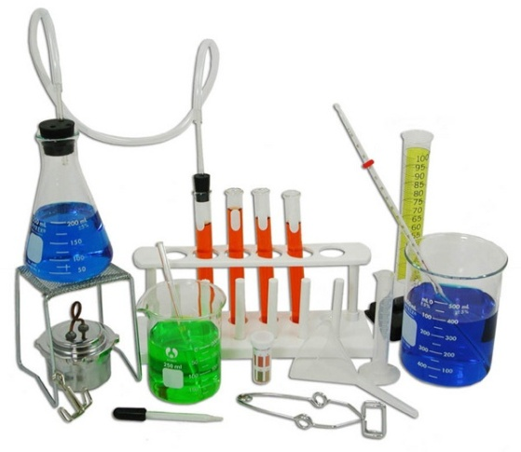
Honors Chemistry
Unit I - Power Point 1d
Introduction to Chemistry
A main challenge of chemistry is to understand the connection between the macroscopic world that we experience and the microscopic world of atoms and molecules.
You must learn to think on the atomic level

Slide 2
Why Study Chemistry?
To be better informed
To be a knowledgeable consumer
To make better decisions for yourself and society
To learn problem-solving skills
To enhance analytical thinking
It will look great on your transcripts, provided you earn a good grade
This class will prepare you for AP Chem and/or College Chem

Slide 3
What is Chemistry?
Chemistry = the study of matter and the transformation it undergoes
What is matter? Matter is anything that has mass and volume. Your book defines it as The material of the universe
EVERYTHING is a CHEMICAL
  Table salt = sodium chloride, NaCl
  Table sugar = sucrose, C₁₂H₂₂O₁₁
  Clothes: Wool, Cotton, Polyester
  Body: lipids, Proteins, Carbohydrates, DNA/RNA
  You name it– it’s a chemical!

Slide 4
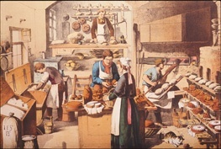
Chemistry in Action: cooking
Cooking is chemistry in action, with the added benefit that you can eat the results.

Slide 5
Chemistry
Chemistry is the driving force behind many “liberal arts”
  Composition of paints? Colors?
  Economies of Industrial Nations
    #1 commercial chemical is sulfuric acid– LOTS of uses!
    All industry involves chemical processes
  Economies of Developing Nations
    Agriculture depends on chemicals as fertilizers, pesticides
  Politics and Natural Resources

Slide 6
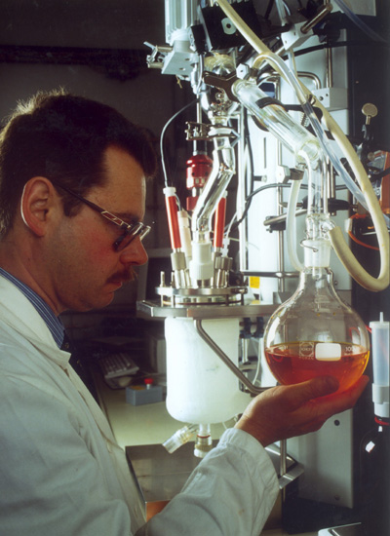
Organic Chemistry
Organic is the study of matter that contains carbon
Organic chemists study the structure, function, synthesis, and identity of carbon compounds
Useful in petroleum industry, pharmaceuticals, polymers
HHS is planning on offering Organic Chemistry next year!!

Slide 7
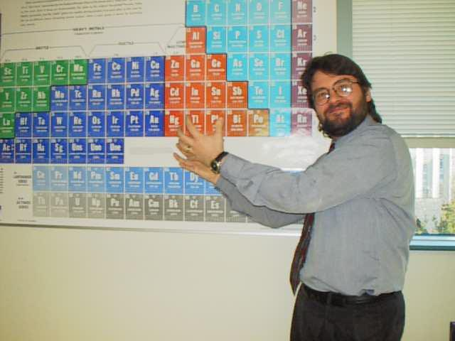
Inorganic Chemistry
Inorganic is the study of matter that does NOT contain carbon
Inorganic chemists study the structure, function, synthesis, and identity of non-carbon compounds
Polymers, Metallurgy

Slide 8
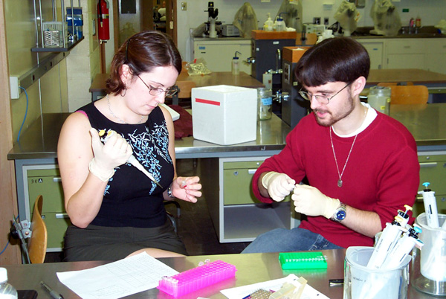
Biochemistry
Biochemistry is the study of chemistry in living things
Cross between biology and chemistry
Pharmaceuticals and genetics

Slide 9
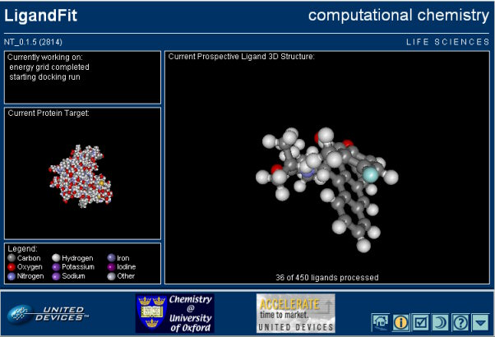
Physical Chemistry
Physical chemistry is the physics of chemistry… the forces of matter
Much of p-chem is computational
Develop theoretical ideas for new compounds

Slide 10
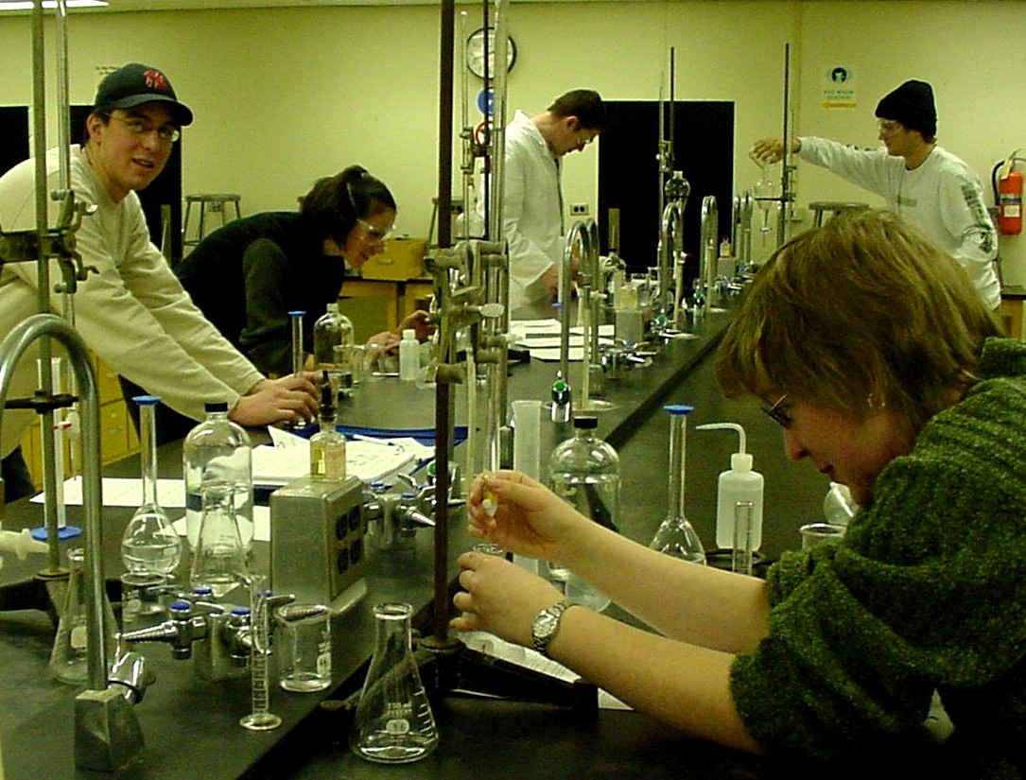
Analytical Chemistry
Analytical chemistry is the study of high precision measurement
Find composition and identity of chemicals
Forensics, quality control, medical tests

Slide 11
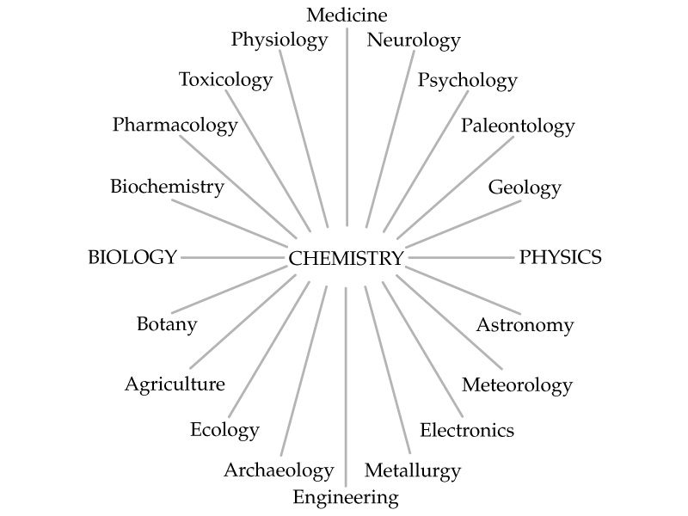
Chemistry as the “Central Science”

Slide 12
Tomorrow’s DQ
What is a flipped classroom?
Why study chemistry?

