Slide 1
Department of Health and Human Services
Presentation for New Legislator Orientation
December 3, 2014
Romaine Gilliland
DHHS Director

Slide 2
DHHS’s Mission
The Department of Health and Human Services (DHHS) promotes the health and well-being of Nevadans through the delivery of essential services to ensure families are strengthened, public health is protected, and individuals achieve their highest level of self-sufficiency.
The department consists of the following divisions: Aging and Disability Services, Child and Family Services, Health Care Financing and Policy, Public and Behavioral Health, Welfare and Supportive Services, and the Public Defender's Office.
Statutory Authority: NRS 232.290-465.
Link to Website: http://dhhs.nv.gov/
Helping People. It’s who we are and what we do.

Slide 3
DHHS Organizational Chart
Public Information Officer
Mary Woods
Romaine Gilliland
Director
Dena Schmidt
Deputy Director - Programs
Ellen Crecelius
Deputy Director – Fiscal
Kareen Masters
Deputy Director – Admin. Services
State Public Defender
Karin Kreizenbeck
Aging and Disability Services
Jane Gruner
Child and Family Services
Amber Howell
Public and Behavioral Health
Richard Whitley
Welfare and Supportive Services
Steve Fisher
Health Care Financing and Policy
Laurie Squartsoff

Slide 4
Topics of Interest
Medicaid Expansion
  Changing Uninsured Population
  Composition of Current Medicaid Population
  Mandatory and Optional Services
Behavioral Health
Medical Marijuana
Other Hot topics
Additional Information
  Bill Draft Requests
  Additional Resources

Slide 5
Medicaid Expansion and the Effect on the
Uninsured Population
Where we Began
  Uninsured
    22.4% of Nevadans (605,000 people)
    National Average is 16%
    Of the Uninsured Nevadans
      23% below poverty
      29% poverty to 200%
      19% 200% to 300%
      7% 300% to 400%
    Children
      Worst in the Nation with 19.3% uninsured
      National Average is 9.7%
    Medicaid Coverage
      Nevada is 11% vs. 20% National Average
      Poor coverage of Mental Health program recipients

Slide 6
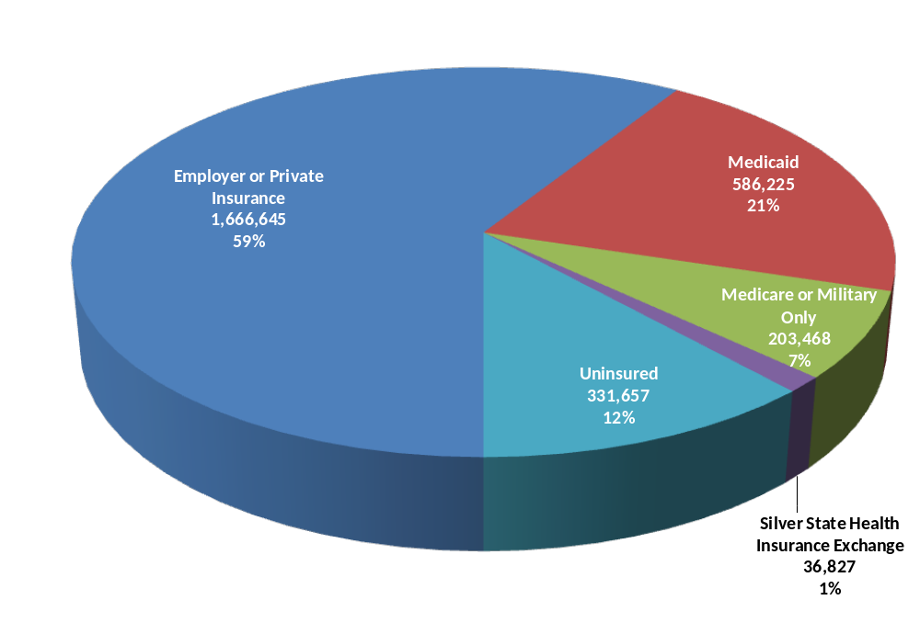
Estimated Insurance Status of All Nevadans as of July 2014
Total Population = 2,824,822
Note: Individuals may have more than one form of insurance, particularly Medicare or Military health care combined with private insurance or Medicaid.

Slide 7
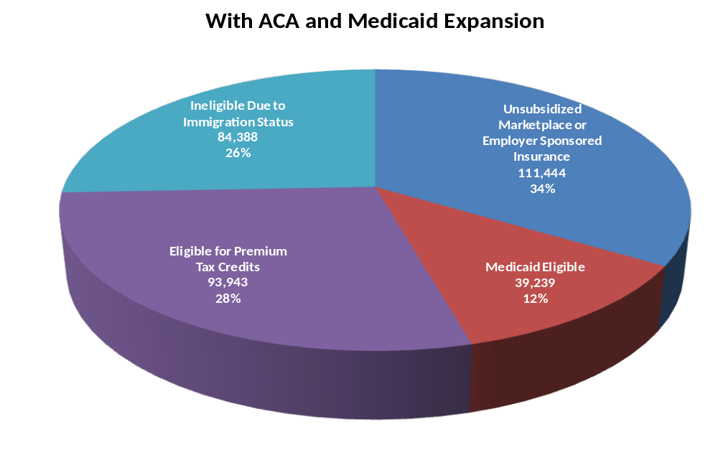
Estimated Eligibility for Coverage among Currently Uninsured Nevadans as of July 2014
329,014 Uninsured
Uninsured Rate
Non-Elderly Nevadans = 13%
All Nevadans = 12%

Slide 8
Composition of the Medicaid Population
Medicaid Recipients October 2014 – 565,935
    Estimated Member Months with Retro Claims – 621,570
Recipients by Type
    Affordable Care Act (ACA) – 164,149
    Adult & Children Medical (TANF Med and CHAP) – 306,960
    Aged Blind Disabled (MAABD) – 49,137
    Seniors (Dual Eligible) – 30,478
    Other including Child Welfare and Waiver – 15,211
    Nevada Checkup – 24,717

Slide 9
Mandatory Medicaid Services
Federal law requires this set of “mandatory services:”
Physician’s services
Hospital Services
Laboratory and x-ray services
Early and periodic screening, diagnostic and treatment services for those under 21
Federally-qualified health center and rural health clinic services
Family planning services and supplies
Pediatric and family nurse practitioner services
Nurse midwife services
Nursing facility services for individuals 21 and older
Home health services
Durable medical equipment
Transportation services

Slide 10
Optional Medicaid Services
Pharmacy
Dental (under 21 except emergency care)
Optometry
Psychologist
Physical, occupational, and speech therapies
Podiatry (under 21)
Chiropractic (under 21)
Intermediate care facility for 65+
Skilled nursing facility (under 21)
Inpatient psychiatric services (21 and under; 65 and older)
Personal care services
Private duty nursing
Adult day health care
Nurse anesthetists
Prosthetics and orthotics
Hospice
Intermediate care facility for individuals with intellectual disabilities

Slide 11
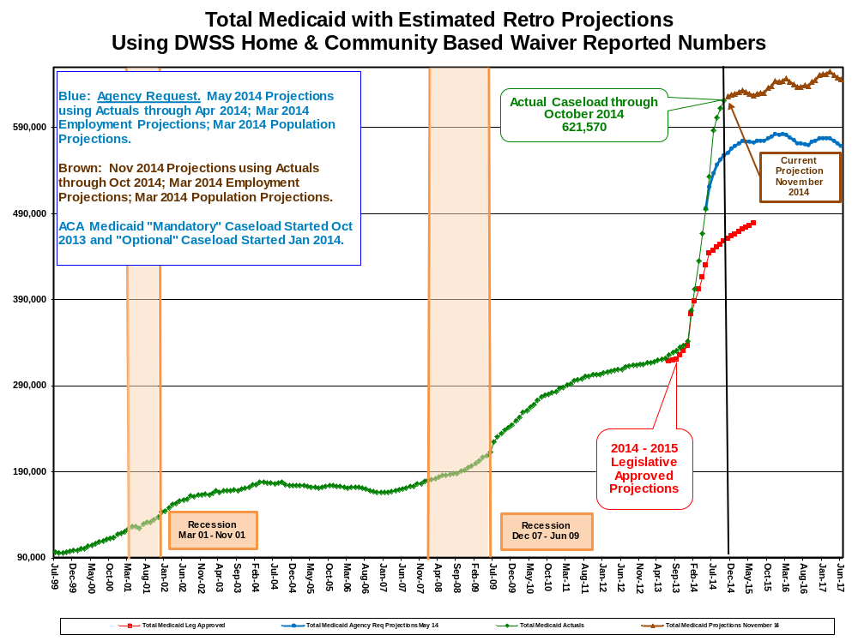

Slide 12
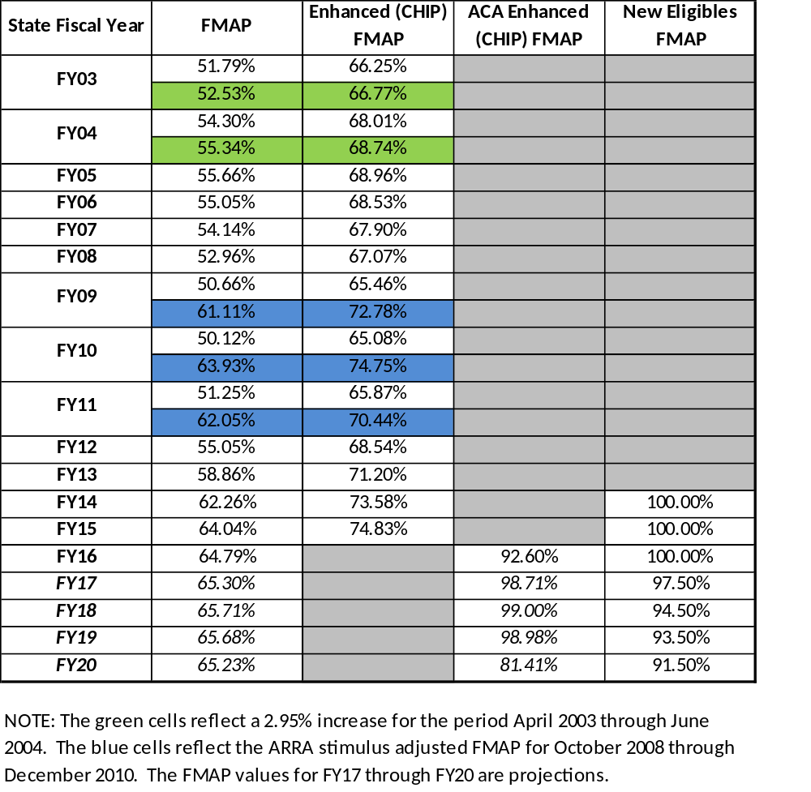
Blended FMAP
Updated September 2014

Slide 13
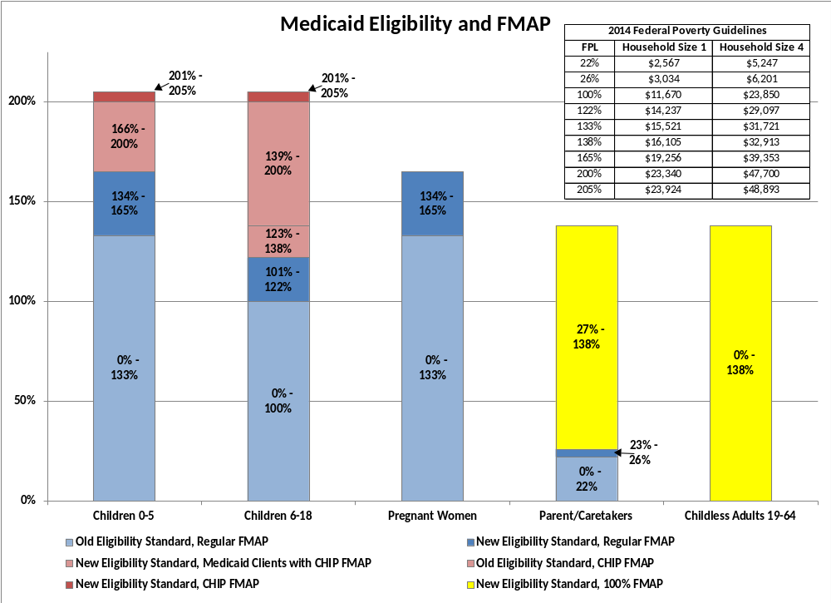

Slide 14
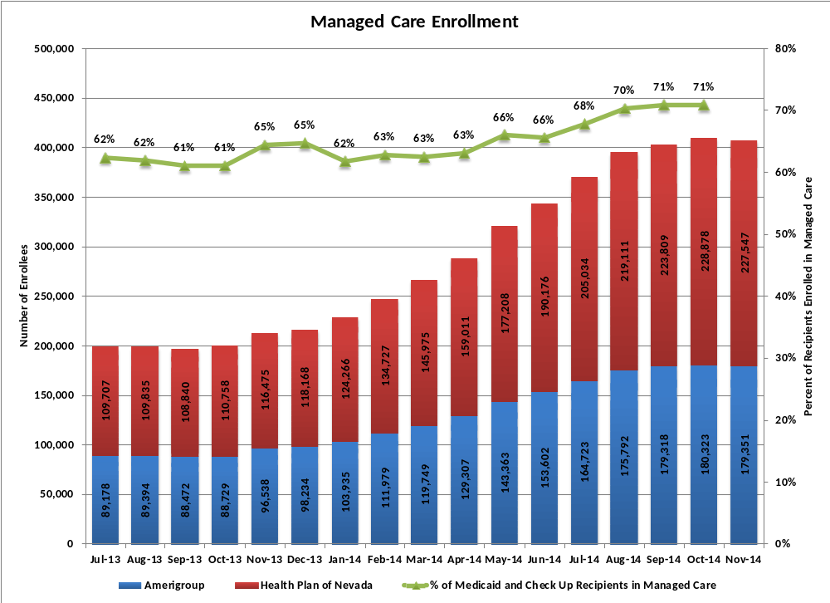

Slide 15
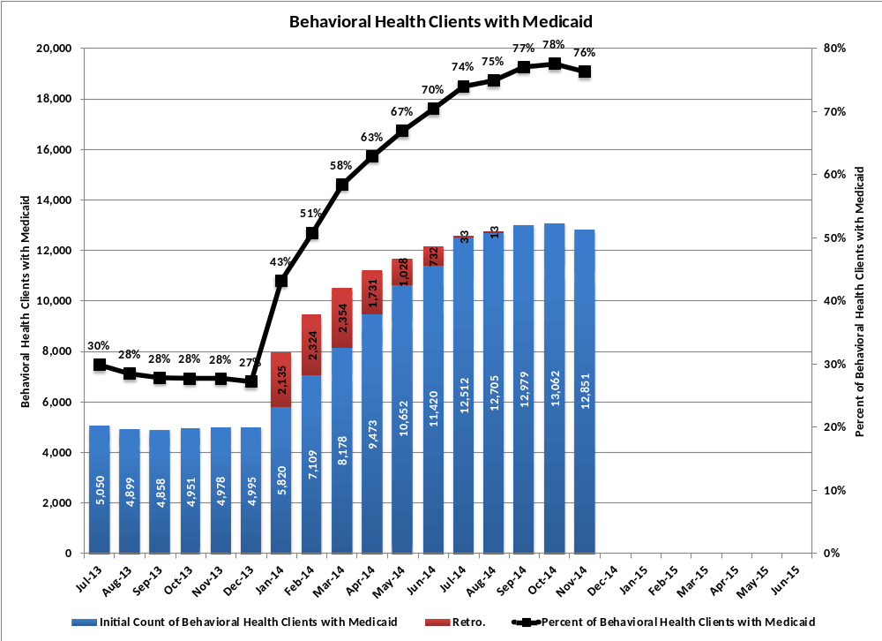

Slide 16
Public and Behavioral Health
Governor's Behavioral Health and Wellness Council
    Implemented Recommendations
      Home Visitation Program
      Assisted Outpatient Treatment (AOT)
      Housing Support Reentry
      Mobile Outreach Safety Team (MOST)
      Mobile Crises for Kids
      Community Triage Center (CTC)
      Mental Health Courts – Transitional Housing
      Increased Psychiatric Reimbursements
        Inpatient Acute Care Hospital Rate – Increased from$460 to $944
        In-Lieu of Rate for Stand Alone Facilities
        Managed Care (MCO) Rate for Rawson Neal
    Anticipated December 3, 2014 Recommendations Will Address
      Children
      Seniors
      Governance
Civil and Forensic Hospital Occupancy

Slide 17
Medical Marijuana
Medical Marijuana Program Groups:
  Medical Marijuana Cardholders
  Medical Marijuana Establishments (MME)
Establishment Applications Received -- 519
  Percentages by Establishment Type
  Dispensaries: 38%
  Cultivation: 35%
  Production: 23%
  Laboratories: 3%
Provisional Dispensary Licenses Issued by County
  Carson City 2
  Churchill 1
  Clark 40
  Nye 1
  Story 1
  Washoe 10
Link to Frequently Asked Questions

Slide 18
Other Hot Topics
Food Security
  The Office of Food Security (and, along with that, the Food Security Strategist) was elevated out of the Grants Management Unit to establish a more direct connection with DHHS Divisions and other Departments.
  The Grants Management Unit’s second competitive solicitation for grants intended to relieve hunger in Nevada will be published in late January with a proposed increase in funding.
Aging and Disability Services
  Growth in the incidence of Alzheimer’s Disease and Dementia
  1 in 9 people over age 65 have Alzheimer’s Disease
  1/3 of people aged 85 and older have Alzheimer’s Disease
Persons with Intellectual Disabilities
  Over 75% of people with ID live with families, and more than 25% of family care providers are over the age of 60 years and another 38% are between 41-59 years
  Service system impacts come by way of both the aging person and their aging family caregivers.
Growth in the demand for services for children with Autism Spectrum Disorder (ASD)
  1 in 68 children is diagnosed with autism.
  In Nevada, over 6,000 children have a diagnosis of autism.
  Early diagnosis and treatment are critical to long term outcomes

Slide 19
Other Hot Topics
Medicaid
  Access to Care
  Health Care Guidance Program for Fee for Service Patients
  Applied Behavior Analysis
  Medicaid Management Information System improvements
  Home and Community Based Services (HCBS)
Welfare and Supportive Services
  TANF -- Caseload Growth
      NEON - WPR Compliance Plan Activities
      Workforce Innovation Opportunity Act (WIOA) in Collaboration with DETR
  SNAP -- Caseload Growth
      Timeliness Corrective Plan
      Accuracy error rate
      SNAP Employment & Training – Pilot grant application
      Investigation & Recovery SNAP trafficking grant application

Slide 20
DHHS Bill Draft Requests

Slide 21
DHHS Budget Bill Draft Requests (BDR)
DOA BDR # | Division | NRS | Description
406-1045 | DPBH | 449.0153, 449.001, 449.0151, 449.089, 449.0301, 449.119, 449.174, 449.194, 200.5093, 427A.175, 632.472 | Community Health Worker Pool (CHW): Required to implement the CHW model in Nevada, including oversight and certification of workforce. CHW's are commonly characterized as lay health workers. CHW is considered an evidence-based model to improve access to health care, increase education and awareness, prevent disease and improve select health outcomes among the populations in which they reside.
403-1077 | DHCFP | 422.4025 | Medicaid Preferred Drug List (PDL): Elimination of the sunset/expiration date to enable Medicaid to continue to collect rebates on certain drugs.
406-1042 | DPBH | 449, NAC 449 | Peer Support Recovery Organizations (PSRO): Creates Peer Support Recovery Organization as a facility type to employ trained Peer Supporters to provide peer support services for individuals with mental illness, addictions or co-occurring disorders. Provides for licensure requirements.
406-1040 | DPBH | 449.00455 | SAPTA: Allows DPBH to license all alcohol and drug abuse facilities that meet the NRS 449.00455 definition.

Slide 22
DHHS Policy BDRs
DOA BDR # | Division | NRS | Description
400-1102 | DO | 439.581 to 439.595 | Statewide Health Information Exchange System: Revisions necessary to address advances in technology and lessons learned during implementation of the "State Health Information Technology Strategic & Operational Plan". Change DDHS to oversight authority rather than administrative authority.
406-1020 | DPBH | 439A, NAC 439A.720 | J-1 Physician Visa Fees: Remove cap for J-1 Physician Visa Waiver application fee to allow for adequate funding for staff processing and program oversight.
402-1043 | ADSD | 435 | Early Intervention and Developmental Services into Aging and Disability Services Division: Complete the integration/realignment of services of EIDS into ADSD as requested in NRS 435.
403-1081 | DHCFP | 422.4035 | Pharmacy and Therapeutic Committee (P&T Comm.): Change of membership requirements so committee may meet regularly.
403-1090 | DHCFP | 689A.430, 689B.300 | Confirmation of Medicaid Payer of Last Resort: Implement trading partner agreements (TPAs) with commercial payers to acquire their monthly eligibility rosters. Ensures Medicaid is payer of last resort.

Slide 23
DHHS Policy BDR’s continued
DOA BDR # | Division | NRS | Description
403-1103 | DHCFP | 428 Indigent Persons | Indigent Accident Funds: This will help with proper and appropriately flexible use of federal/non-federal funds for indigent care. Also abolishes fund & board related to the county match program which is no longer needed.
406-1041 | DPBH | Title 40, 449, Chapter 458 | Alcohol and Drug Abuse Facility Licenses: Seeks to require all alcohol and drug abuse facilities falling under NRS 449.00455 to be licensed by the Division. Changes authority for adoption of regulations from Division to State Board of Health.
406-1054 | 406-1076 | 453A.740 | Medical Marijuana Program - ID Cards: Provides for DPBH to prepare and issue medical marijuana registry cards for cardholders and caregivers.
406-1093 | DPBH | 178.400 | Lake's Commitment Provisions: Clarify fiscal responsibility for individuals committed to Lake's Crossing. Amends long-term commitment provisions of incompetent defendants to include only the most egregious offenses. In reviewing the eligibility of a client for discharge from conditional release, removes the requirement the court find the person no longer has a mental disorder.

Slide 24
DHHS Policy BDR’s continued
DOA BDR # | Division | NRS | Description
406-1099 | DPBH | Title 39, Chapter 433A | Involuntary Commitment/Decertification: Expands the practitioners that may file a petition for involuntary court-ordered admission of a person. Adds licensed physician assistants and nurse practitioners. Adds a new section to allow for decertification of a person who has had a petition initiated for involuntary court-ordered admission.
407-1088 | DWSS | 702.275 | Distribution of LIHEAP Funds: Creates flexibility that's intended to maximize use of low income energy assistance program (LIHEAP) funds and universal energy charge (UEC ) funds to maintain stable year round energy assistance program.
409-1203 | DCFS | 432.100 | Central Registry: Allows access by certain employees of DPBH, a child welfare agency, or with the Division Administrator's approval, to a contracted agency, in order to complete daily business.
406-1060 | DPBH | 457, NAC 457 | NCCR Mammography: The NCCR, in collaboration with the NV Cancer Coalition and healthcare providers are requesting NRS changes to reflect program changes. Also revise fee and penalty requirements.
406-1061 | DPBH | 388 | Youth Risk Behavior Surveillance Survey (YRBS): Standardize parental permission requirements to the use of passive parental permission in all school districts to conduct YRBS. Action is needed to affect response rates for the survey.
406-1076 | DPBH | 453A.740 | Medical Marijuana Program - ID Cards: Provides for DPBH to prepare and issue medical marijuana registry cards for cardholders and caregivers.

Slide 25
Resources – DHHS Website dhhs.nv.gov
Quick Links
  DHHS Quick Facts “Nassir Notes” (Next update December 2014) – Link to document
  Ebola Tool Kit - Link to page
About Us
  Budget Information - Link to page
Reports and Publications
  Reports
    Welfare Fact Book Executive Summary (next update Feb. 2015) - Link to document
    Medicaid Fact Book Executive Summary –Link to document
    Medicaid State Plan - Link to page
  Public Assistance Caseload - Link to page
  Medicaid Chart Pack – Link to document
  Behavioral Health Chart Pack – Link to document
  DHHS Expanded Presentation

