Slide 1
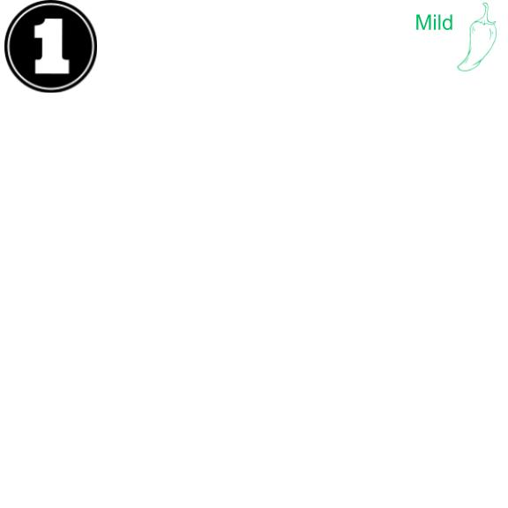
Write “three thousand, four hundred and eighty seven in standard form”.
What is the value of the 8? What is the value of the 4?

Slide 2
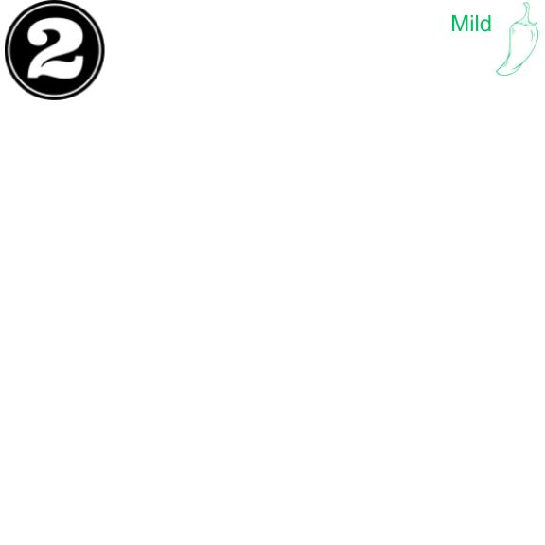
*Draw and label a place value chart up to a million
*Use the digits 9, 8, 7, 3,1, and 0 to create a number between 7 hundred thousand and 9 hundred thousand

Slide 3
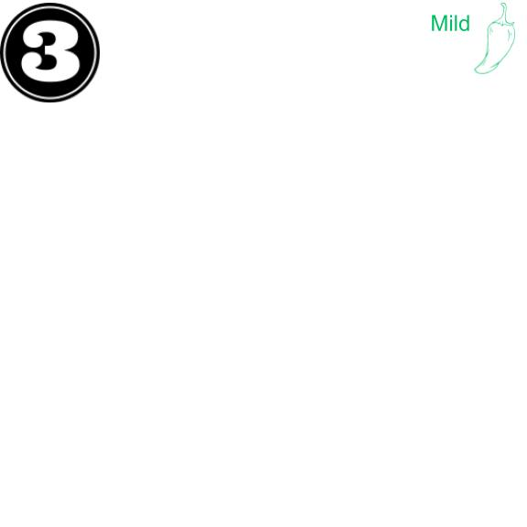
3,010 ____2,040
*Say the standard form to your group
*model each number on a pv chart with DOTS (one chart, separate numbers with a line)
*Which is greater?

Slide 4
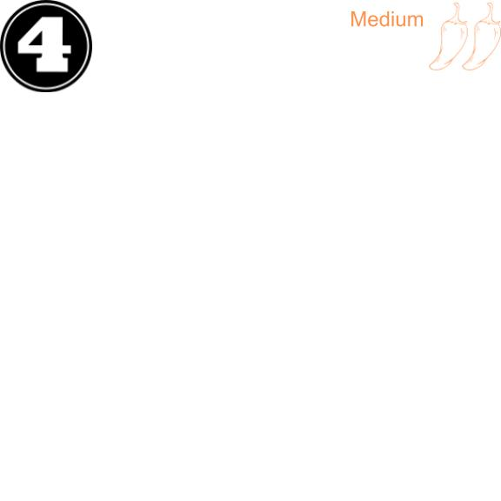
43,021 ____45,302
*Say the standard form to your group
*model each number on a pv chart with DOTS (one chart, separate numbers with a line)
*Which is greater?

Slide 5
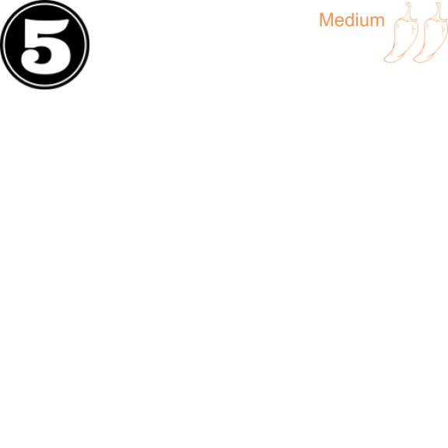
2,305 ____2,530
*Say the standard form to your group
*model each number on a pv chart with DOTS (one chart, separate numbers with a line)
*Which is greater?

Slide 6
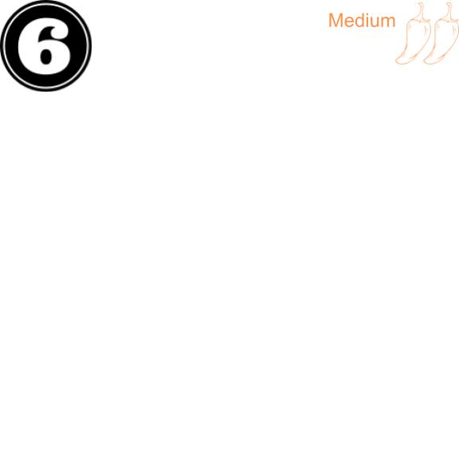
970,461____907,641
*Say the standard form to your group
*model each number on a pv chart with DOTS (one chart, separate numbers with a line)
*Which is greater?

Slide 7
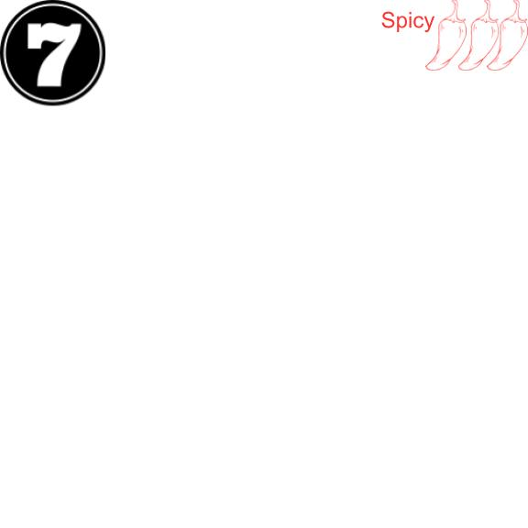
32,434 32,644 32,534
Draw a PV chart. Write the three numbers on the chart.
Below the chart, order the numbers from least to greatest

Slide 8
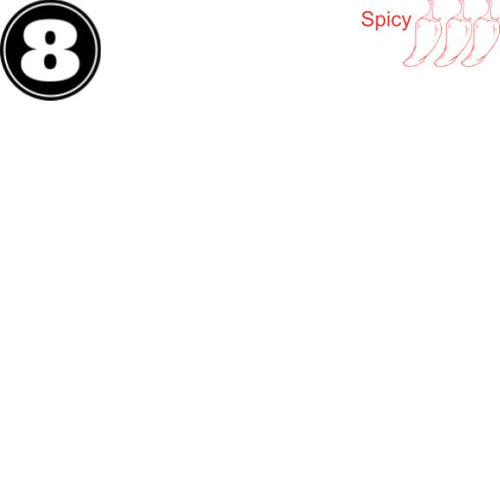
Compare 700,000 + 30,000 + 20 +8 and 735, 008
*write both (in standard form) on a pv chart
compare in a number sentence using <, >, or =

Slide 9
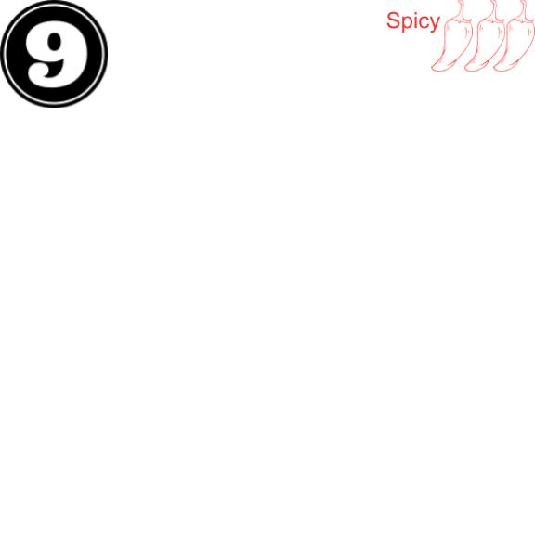
Name of Mountain | Elevation in Feet
Allen Mountain | 4, 340 ft
Mount Marcy | 5,344 ft
Mount Haystack | 4,960 ft
Slide Mountain | 4,240 ft
Order the Mountains from Greatest to Least

Slide 10
