Slide 1

Seniors:
What can I do today to prepare for tomorrow?

Slide 2
Know your School Counselor
Adam Keel, Last Names A-K
  keel.adam@lee.k12.al.us
Veronica Jefferson, Last Names L-Z
jefferson.veronica@lee.k12.al.us
Beth Parkman, Career Coach
parkman.Elizabeth@lee.k12.al.us
Offices are located in the bottom office.
Your counselor addresses your concerns: academic, personal/social, and career
Counselors keep information confidential or on a need to know basis, unless you or someone else is getting hurt.
Remember your counselor is here to HELP!

Slide 3
College Checklist
Make a list of colleges.
  Junior/Senior Workshop: Tuesday, October 21 @ 6
Check your high school grades and courses.

Slide 4
Class of 2015/2016 Diploma Credit Check
for __________________________________
* = Indicates required courses.
Regular | Advanced
English 9 | English 9
English 10 | English 10
English 11 | English 11
English 12 | English 12
Algebra A/Algebra I | Algebra A & B/Algebra I
Algebra B/Geometry | Geometry
Geometry*/Alg Connections | Alg II w/ Trig*
Alg Connections/Alg II w/ Trig | Other:
Biology* | Biology*
Physical* | Chemistry/Physics*
Science: | Science:
Science: | Science:
World History | World History
US History 10 | US History 10
US History 11 | US History 11
Am Gov’t/Econ | Am Gov’t/Econ
LIFE PE | LIFE PE
Health (½) | Health (½)
Comp Apps (½) | Comp Apps (½)
Fine Art (½) | Fine Art (½)
6 ½ Electives | Lang I:
 | Lang II:
 | 4 ½ Electives

Slide 5
College Checklist
Make a list of colleges.
Check your high school grades and courses.
Register to take the ACT and/or SAT.

Slide 6
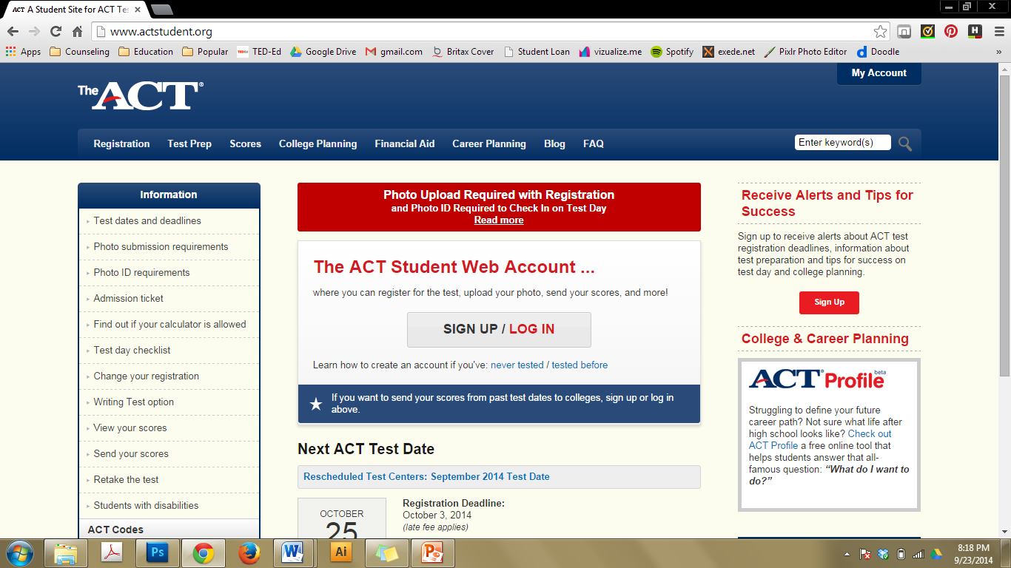

Slide 7
College Checklist
Make a list of colleges.
Check your high school grades and courses.
Register to take the ACT and/or SAT.
Begin filling out your applications as soon as possible.
  http://beulah.lch.schoolinsites.com/?PageName=Guidance&Page=%27DocumentsCategory%27&CategoryID=199768&iSection=Guidance&CorrespondingID=
  Admissions
  CAST: College Application and Scholarship Thursdays starting Thursday, October 23

Slide 8


Slide 9


Slide 10
file:///E:/Beulah%20High%20School%20%20Guidance%20-%20Links.htm

Slide 11
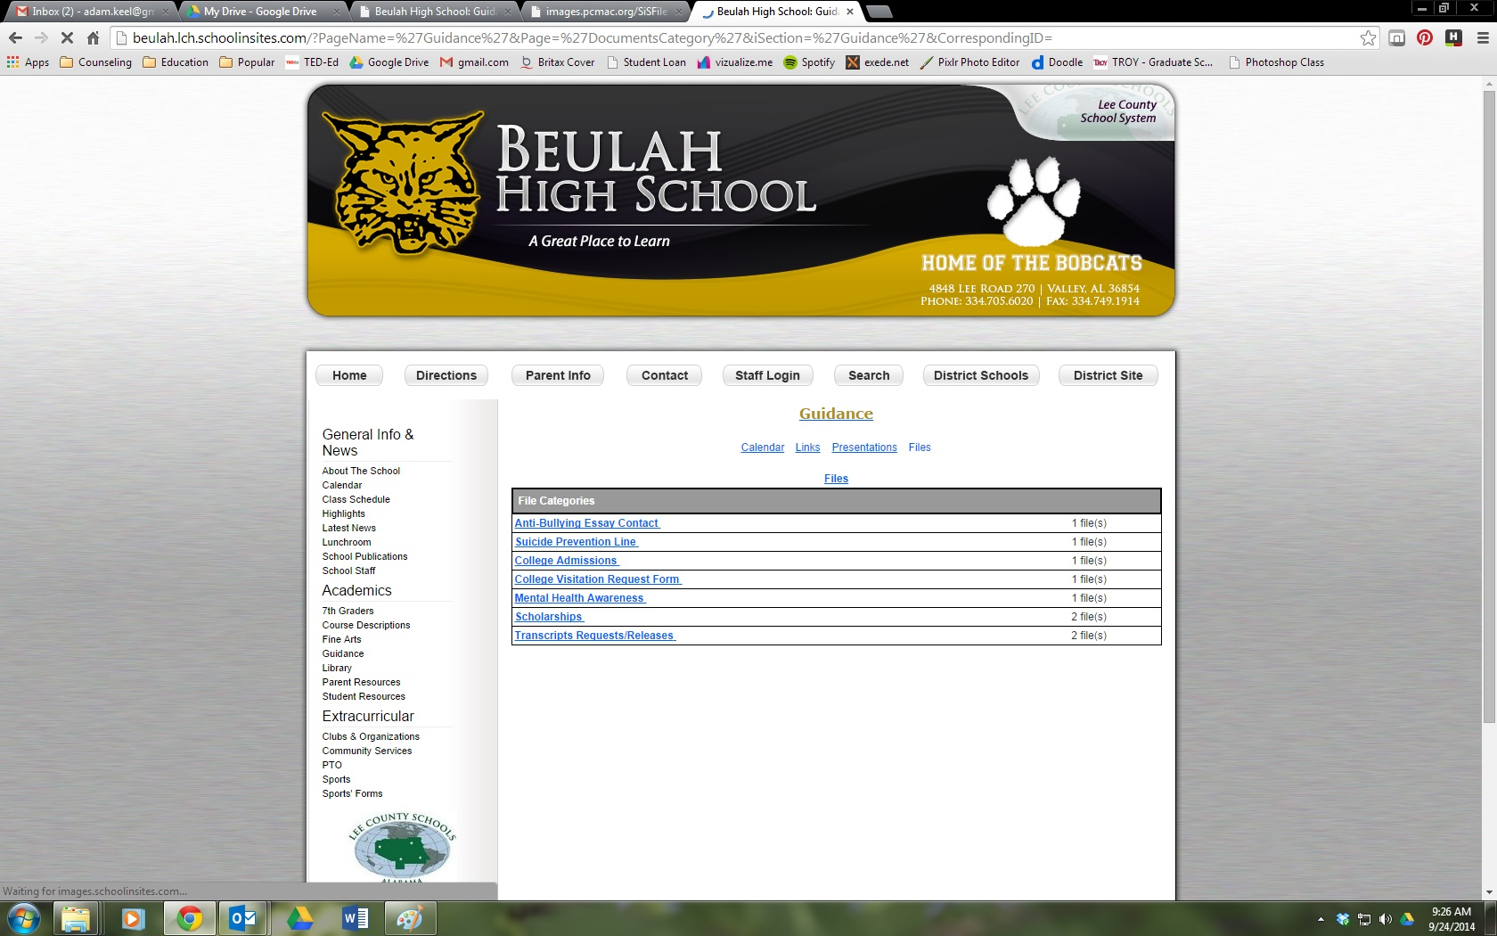

Slide 12
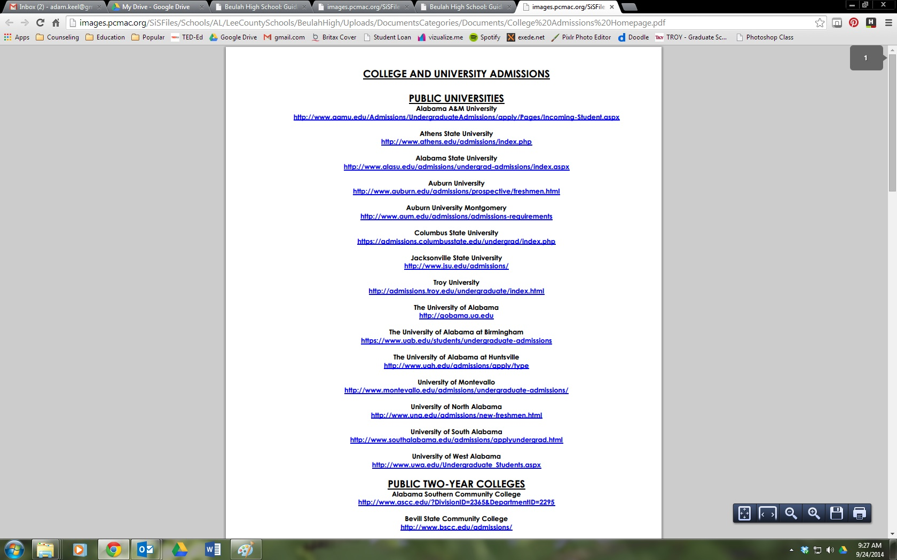

Slide 13


Slide 14
College Checklist
Make a list of colleges.
Check your high school grades and courses.
Register to take the ACT and/or SAT.
Begin filling out your applications as soon as possible.
Request an official transcript and send “official” test scores to the college(s).

Slide 15
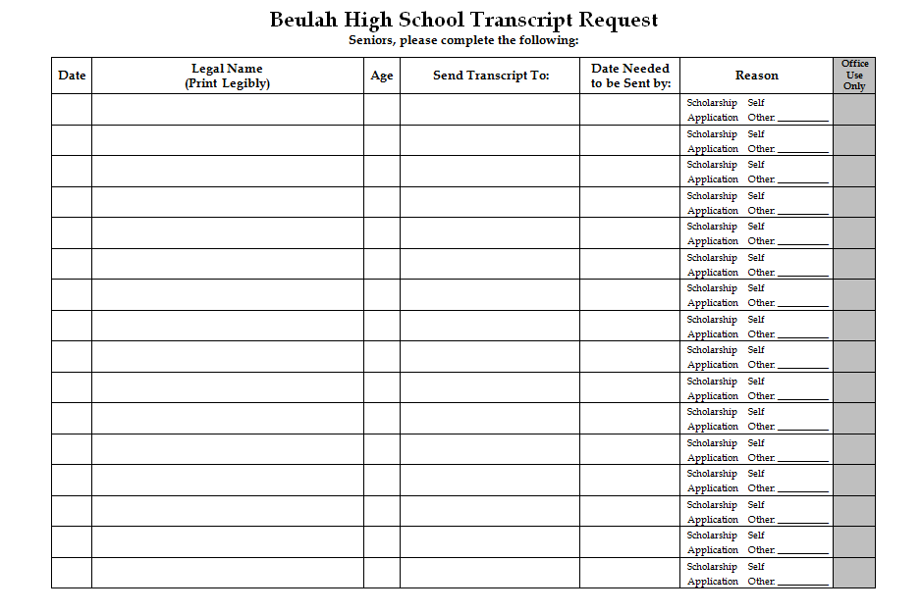
Give our office at least a one week notice when transcripts need to be sent.

Slide 16
College Checklist
Make a list of colleges.
Check your high school grades and courses.
Register to take the ACT and/or SAT.
Begin filling out your applications as soon as possible.
Request an official transcript and send “official” test scores to the college(s).
Have letters of recommendation written.

Slide 17
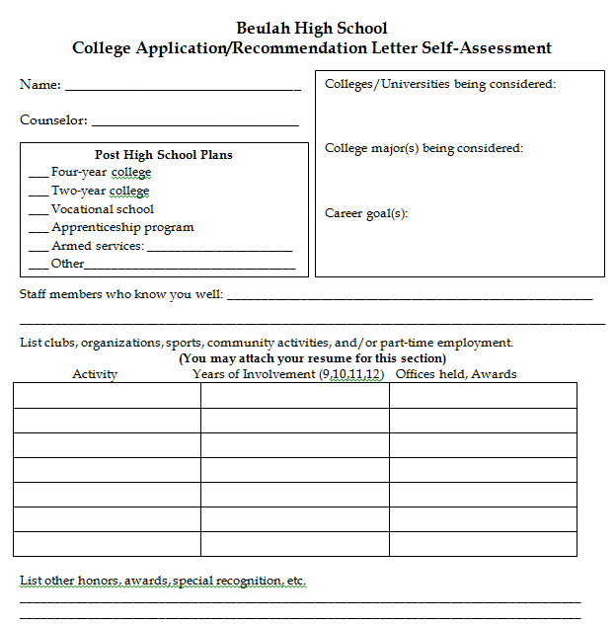
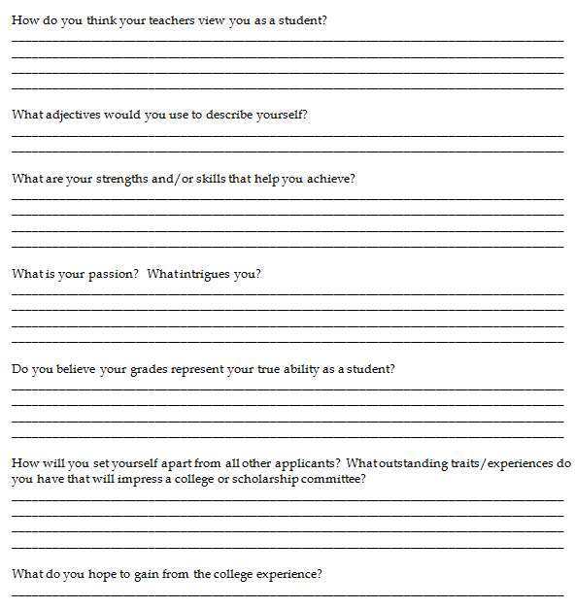
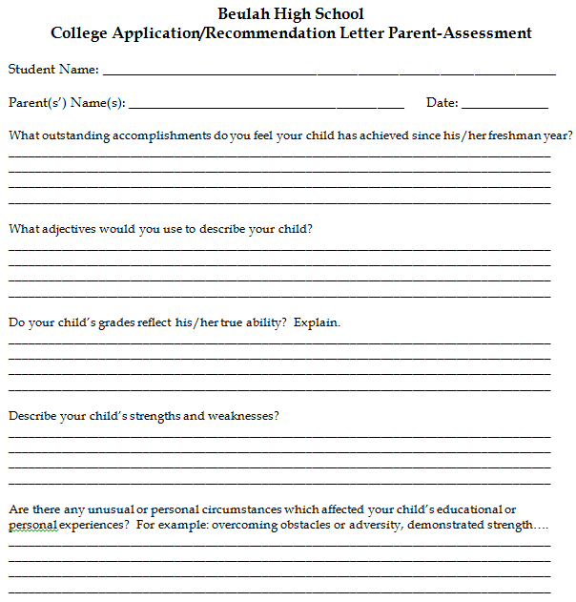

Slide 18
College Checklist
Contact a financial aid counselor at the colleges to which you apply.
  http://beulah.lch.schoolinsites.com/?PageName=Guidance&Page=%27DocumentsCategory%27&CategoryID=197226&iSection=Guidance&CorrespondingID=
  Scholarships
    From colleges/universities
    From external sources

Slide 22
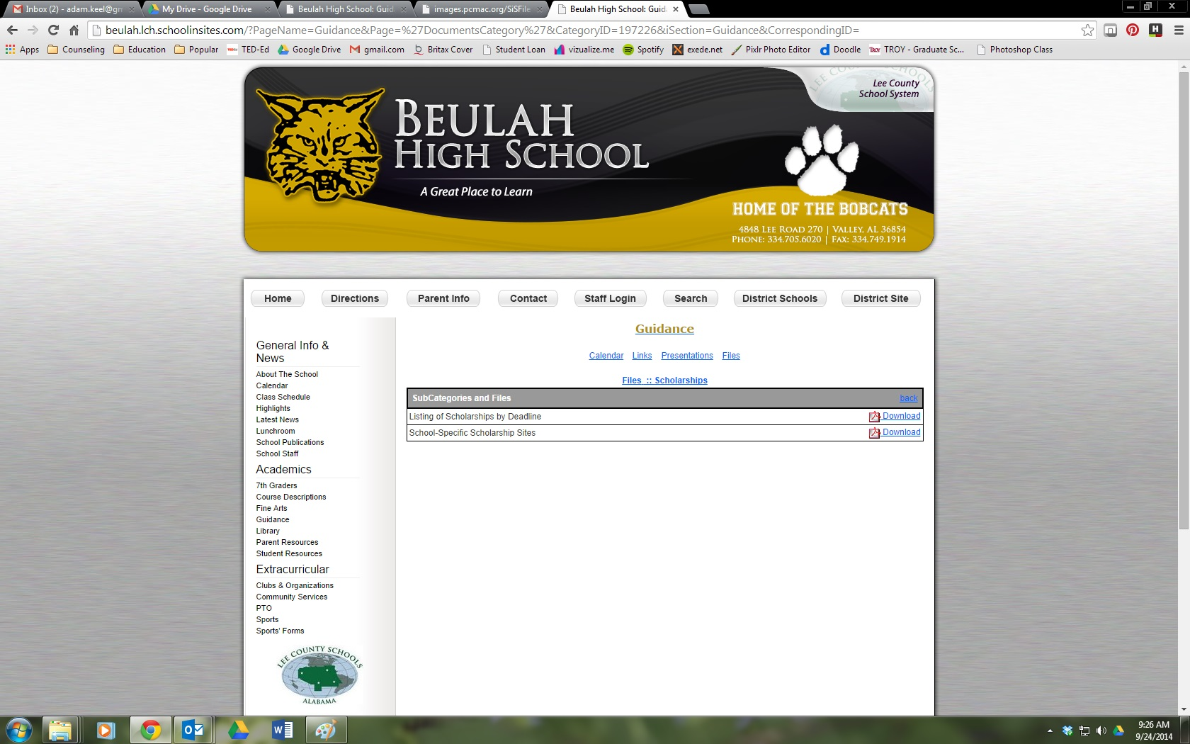

Slide 23
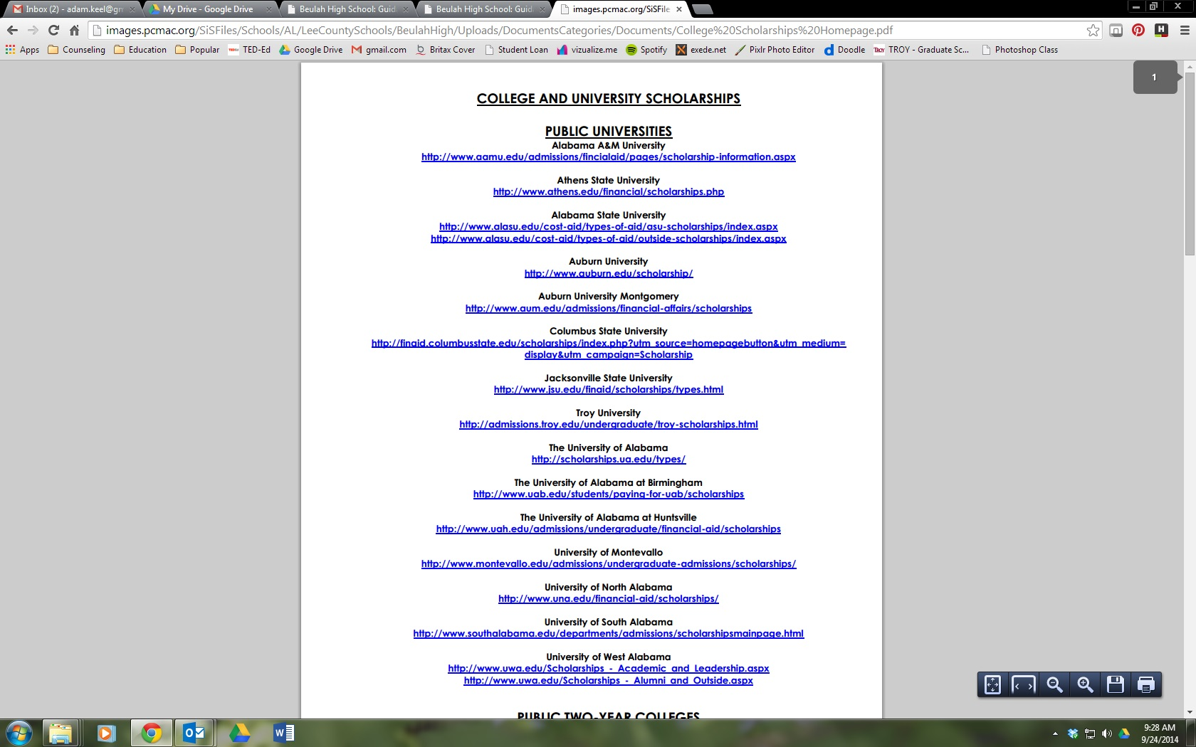

Slide 24
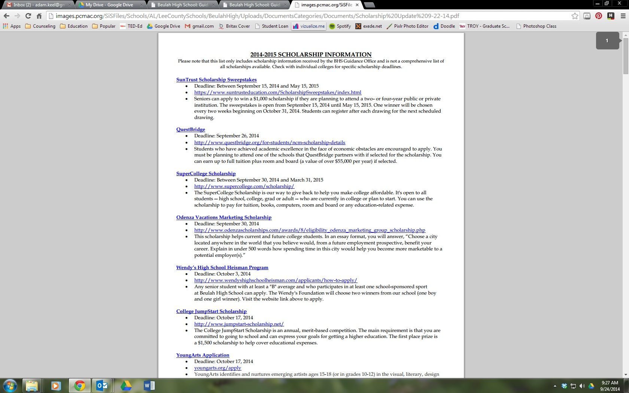

Slide 25
College Checklist
Contact a financial aid counselor at the colleges to which you apply.
Visit the colleges you are considering.

Slide 26
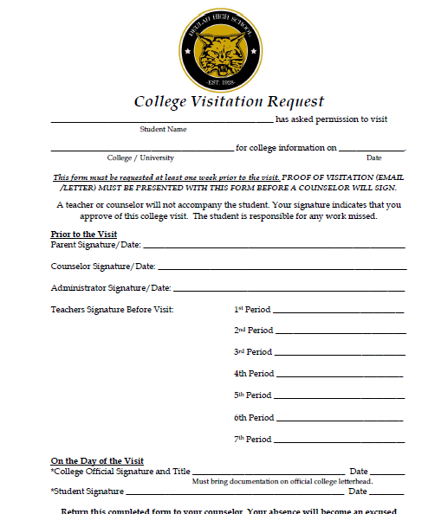

Slide 27
College Checklist
Contact a financial aid counselor at the colleges to which you apply.
Visit the colleges you are considering.
Let us know when you receive a letter of acceptance from a college or a scholarship. We want to celebrate with you!

Slide 28
College Checklist
Contact a financial aid counselor at the colleges to which you apply.
Visit the colleges you are considering.
Let us know when you receive a letter of acceptance from a college or a scholarship. We want to celebrate with you!
It is your responsibility to check with your individual schools for application and scholarship procedures.

