Slide 1

College and Career Exploration Night
Tuesday, October 21, 2014
Beulah High School

Slide 2
Dr. Cincrystal Poythress, Principal
Mr. David Owen, Assistant Principal
Mr. Adam Keel, Last Names A-K
  keel.adam@lee.k12.al.us
Ms. Veronica Jefferson, Last Names L-Z
jefferson.veronica@lee.k12.al.us
Mrs. Beth Parkman, Career Coach
parkman.Elizabeth@lee.k12.al.us

Slide 3
What Parents Need to Know
Increased competition
Focusing on “likely” school/employment
Demonstrated interest
Earlier deadlines
Needs-based, gender may be factors
Economic factors
GPA, community service/involvement, course rigor, standardized test scores, letters or recommendation, essays

Slide 4
Diploma with Advanced Academic Endorsement: First Choice
4 Units English
4 Units Mathematics (must take Algebra II w/ Trig.)
4 Units Science (must include Biology, Physics or Chemistry, and 2 additional advanced courses)
4 Units Social Studies
1 Unit Physical Education/LIFE
½ Unit Health
½ Unit Business Technology Apps/Computer Apps
½ Unit Fine Arts (Band, Chorus, Art, Theater, etc.)
2 Units Foreign Language (2 courses in sequence)
4 ½ Units Electives (3 Units in CTE for CTE endorsement)
Minimum: 25 Units/Credits

Slide 5
Standard Diploma
4 Units English
4 Units Mathematics (must include Geometry)
4 Units Science (must include 1 biological, 1 physical, and 2 additional)
4 Units Social Studies
1 Unit Physical Education/LIFE
½ Unit Health
½ Unit Business Technology Apps/Computer Apps
½ Unit Fine Arts (Band, Chorus, Art, Theater, etc.)
2 Units Foreign Language (2 courses in sequence)
6 ½ Units Electives (3 Units in CTE for CTE endorsement)
Minimum: 25 Units/Credits

Slide 6
Regular | Advanced: First Choice
English 9 | English 9
English 10 | English 10
English 11 | English 11
English 12 | English 12
Algebra A/Algebra I | Algebra A & B/Algebra I
Algebra B/Geometry | Geometry
Geometry*/Alg Connections | Alg II w/ Trig*
Alg Connections/Alg II w/ Trig | Other:
Biology* | Biology*
Physical* | Chemistry/Physics*
Science: | Science:
Science: | Science:
World History | World History
US History 10 | US History 10
US History 11 | US History 11
Am Gov’t/Econ | Am Gov’t/Econ
LIFE PE | LIFE PE
Health (½) | Health (½)
Comp Apps (½) | Comp Apps (½)
Fine Art (½) | Fine Art (½)
6 ½ Electives | Lang I:
 | Lang II:
 | 4 ½ Electives
Class of 2015/2016 Diploma Credit Check
for __________________________________
* = Indicates specifically required courses.

Slide 7
GPAs
Contact a college to find out have they calculate GPAs.
They will be looking closely at the student’s academic courses!

Slide 8
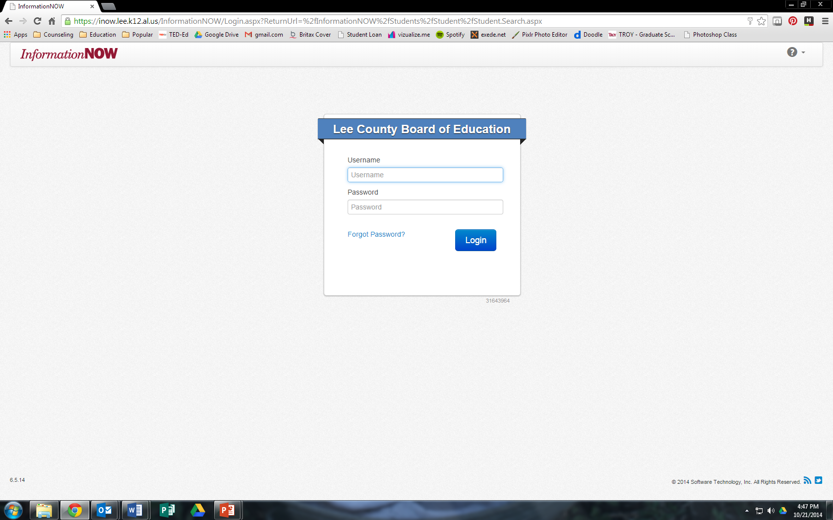
inow.lee.k12.al.us/informationnow

Slide 9
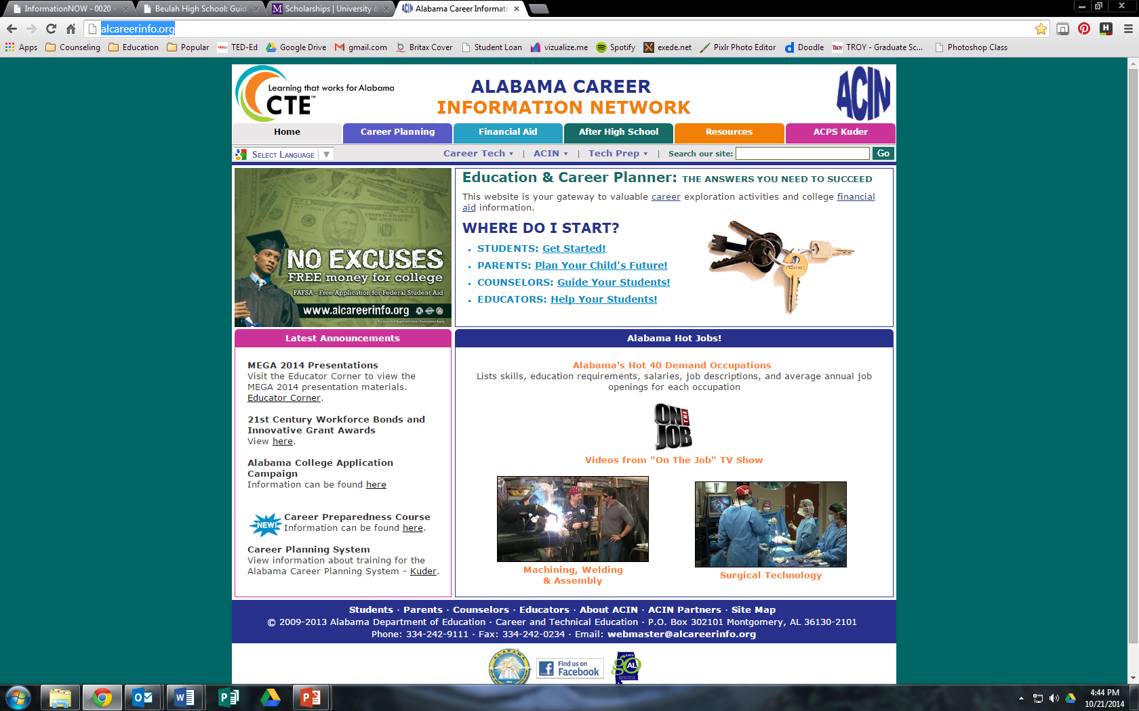
alcareerinfo.org

Slide 10
Credit Recovery
If you see that you are missing a credit, you need to sign up for credit recovery at the table.
Eligible students must meet all of the following criteria:
  Currently enrolled in Lee County Schools
  Must be classified in grades 9-12
  Must complete an application process
  Must receive consent from parent/guardian
  Must have failed the course with a baseline score of 40-59 on a 100-point scale

Slide 12
ACT
Taking the ACT test is recommended for college-bound juniors and seniors. All juniors will take the ACT at school this spring.
For more information and to register, visit www.actstudent.org.
See the table for handouts related to the ACT.

Slide 13
ACT Subject Description
Test |  |  | Content
English | 75 questions | 45 minutes | Measures standard written English and rhetorical skills.
Mathematics | 60 questions | 60 minutes | Measures mathematical skills students have typically acquired in courses taken up to the beginning of grade 12.
Reading | 40 questions | 35 minutes | Measures reading comprehension.
Science | 40 questions | 35 minutes | Measures the interpretation, analysis, evaluation, reasoning, and problem-solving skills required in the natural sciences.
Optional Writing Test | 1 prompt | 30 minutes | Measures writing skills emphasized in high school English classes and in entry-level college composition courses.

Slide 14
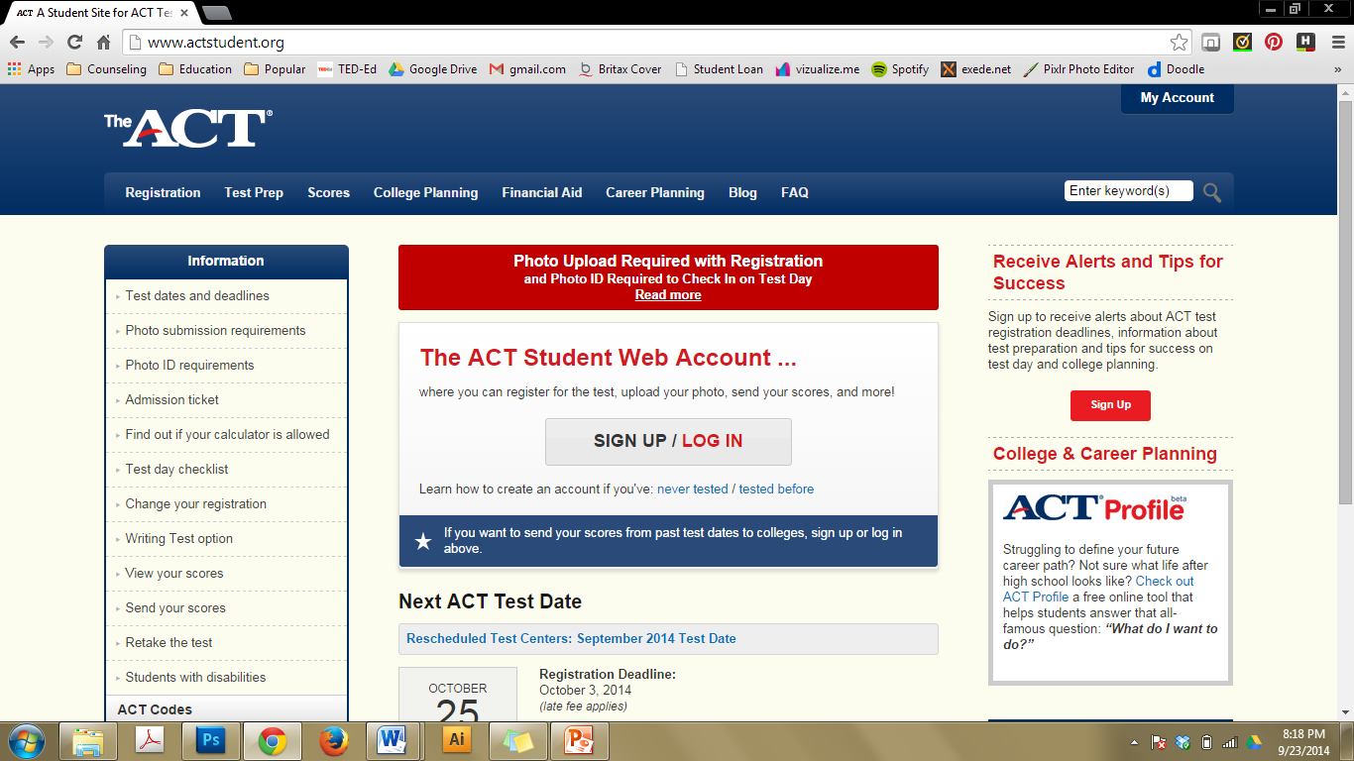

Slide 15
College Exploration
It begins now!
Colleges are on site tonight to answer your questions. But it doesn’t stop there. We recommend getting as much information online as you can.
Once you narrow your choices down to two or three colleges, schedule campus tours. Call or e-mail admissions offices, they are there to help you get through the application process.

Slide 16
Letters of Recommendation
Ask in advance.
You want to give them a couple of weeks to write the best letter for you!
Your counselors should have your “all about me” (Senior Brag Sheet) worksheet on file.
Don’t wait until the last minute.

Slide 17
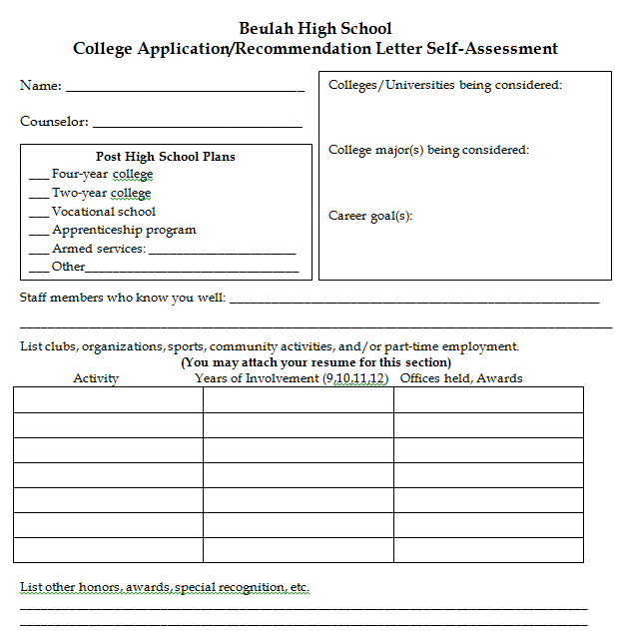
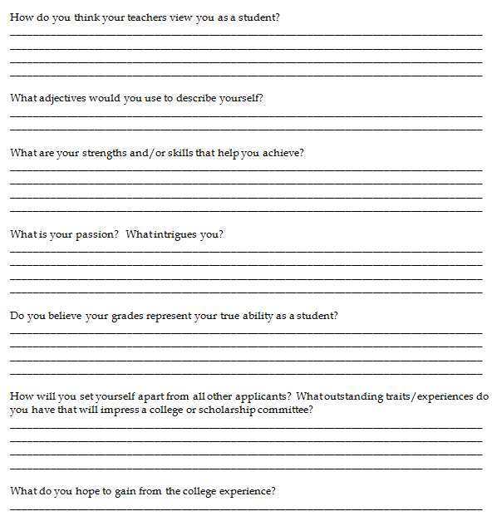
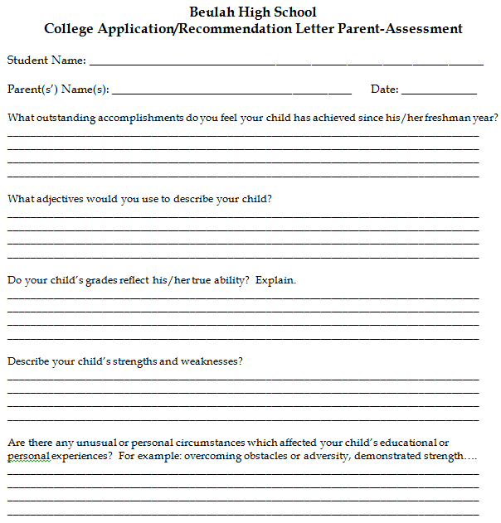

Slide 18
College Visits/Preview Days
Take advantage of these two “excused” days to visit around.
Review procedures and paperwork to make your visits official and excused absences.
Your counselors have your “all about me” (Senior Brag Sheet) worksheet on file.

Slide 19
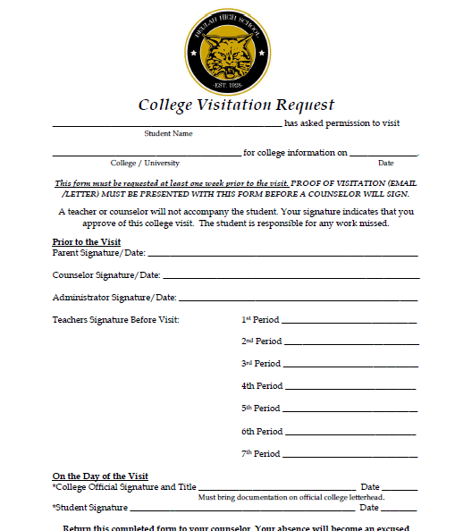

Slide 20
Applications and Scholarships
Be VERY mindful of deadlines.
Read the instructions. If they ask for an essay, include an essay. If it requires a counselor’s signature, make sure you get the signature. You don’t want to be overlooked due to a minor error.
If you write one essay for a couple of different applications, be sure to change names of schools and programs to match the college/university.

Slide 21

CAST
  College Application and Scholarship Thursdays starting Thursday, October 23

Slide 22
Grades/GPAs
Keep your grades up. You’re almost there!
Colleges evaluate your GPA. Make sure you’re working hard to earn good grades.
You want them to see your best possible grade!
It is never too late to excel in your classes that you are currently taking.

Slide 23
College Selection
Look at the whole package. A college choice shouldn’t be based solely on your favorite ball team.
Ask about majors, Fine Arts, social activities, clubs, fraternities or sororities, intramural sports, etc.
This will be your home for the next two to four years. Choose wisely!

Slide 24
Websites
Visit the college/university’s website. They are the “know-it-alls” of that school
Visit the BHS guidance page. Lots of links to resources all in one spot. It’s a great resource!

Slide 25
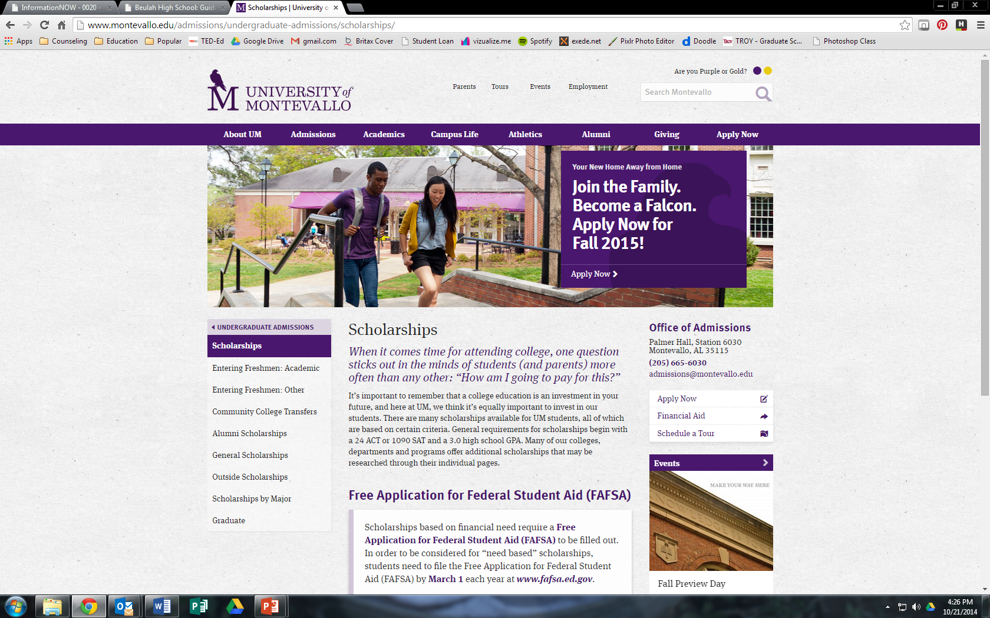

Slide 26


Slide 27


Slide 28
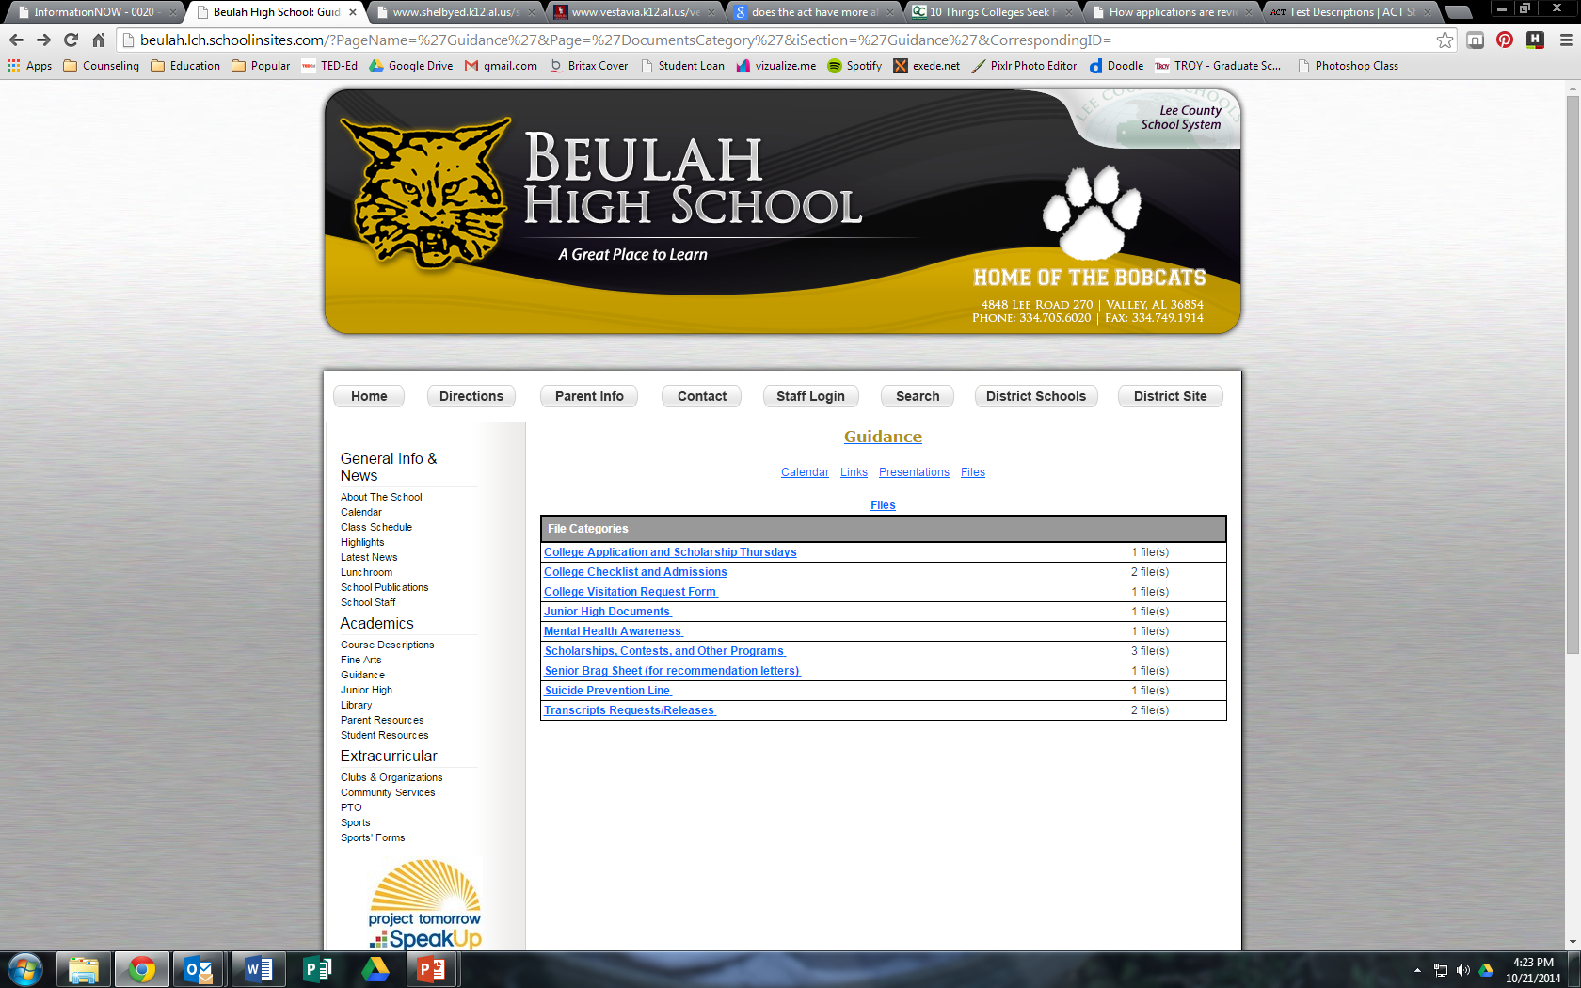

Slide 29
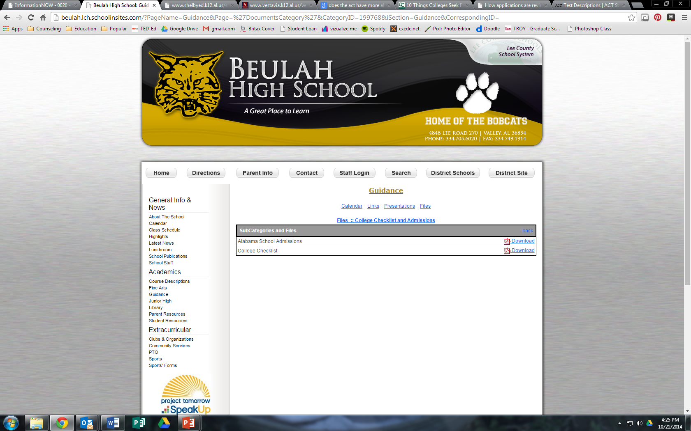

Slide 30


Slide 31
Q & A Time

