Slide 1

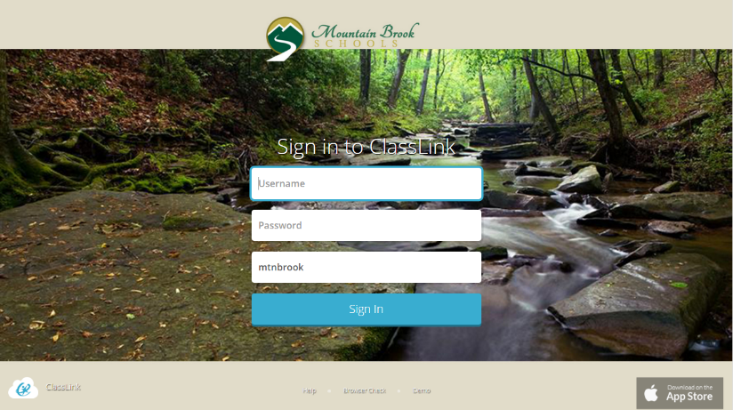
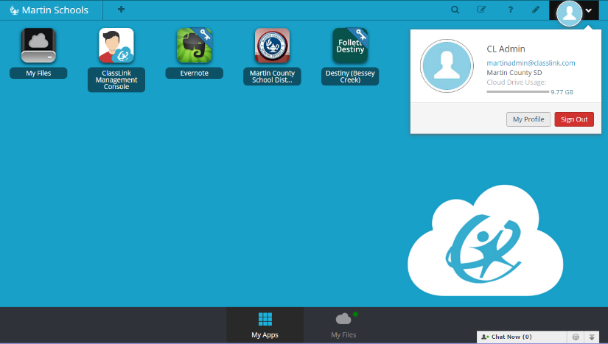
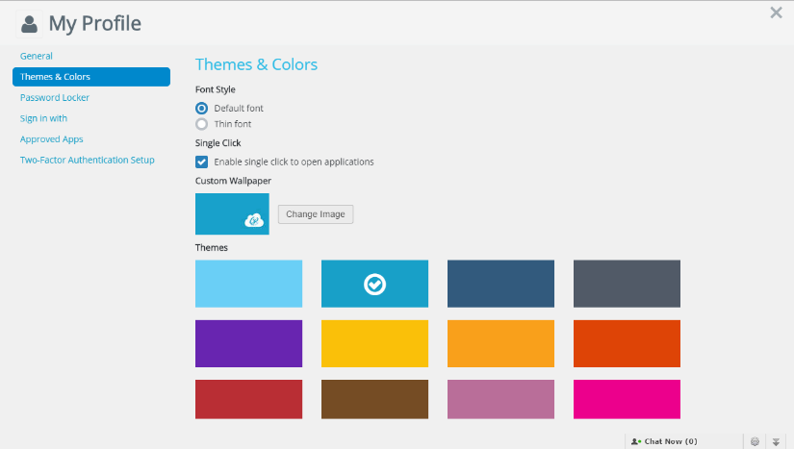
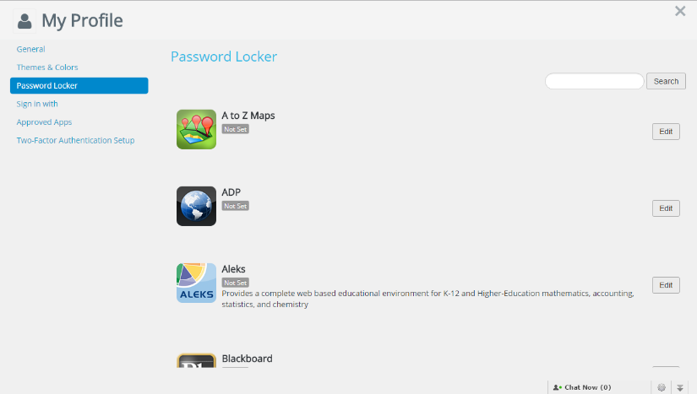
Quick Guide
My.classlink.com/mtnbrook
1. Sign In
2. Profile Settings
Sign in with your school network login and password. If you are off campus the code may be required. The code is mtnbrook
Here is where you change your profile picture, access your password locker, sign in options, and password recovery options.
3. General Settings & Themes
4. Password Locker
My Profile > General allows you to choose an avatar for your profile. You can edit your theme in Themes & Colors.
Profile Settings > Password Locker allows you to update and change your stored username and passwords for your Single Sign On applications.

Slide 2
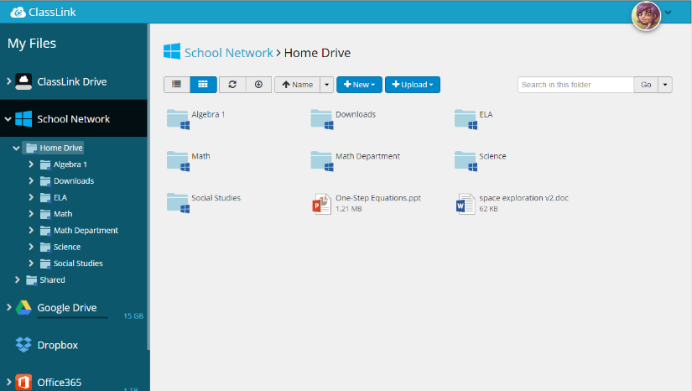
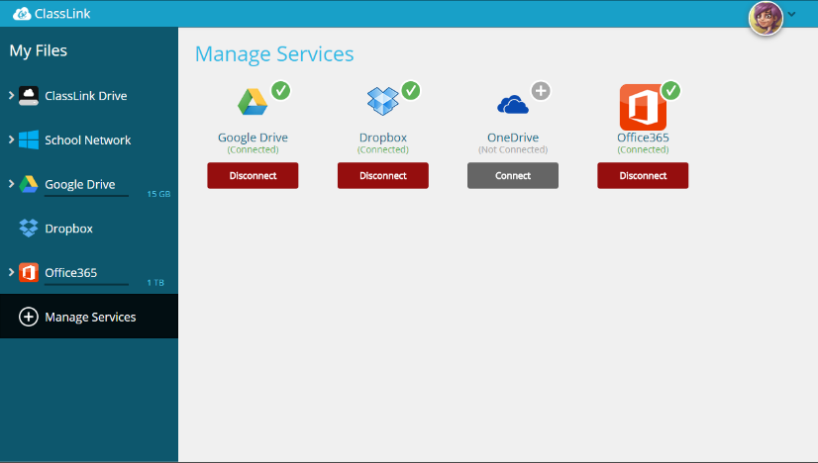
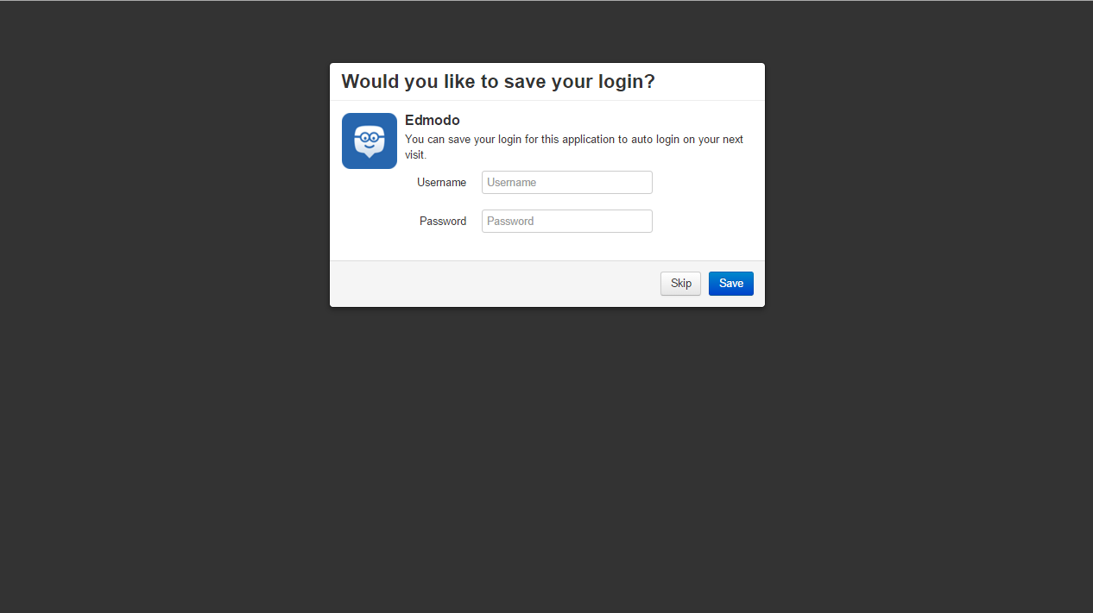
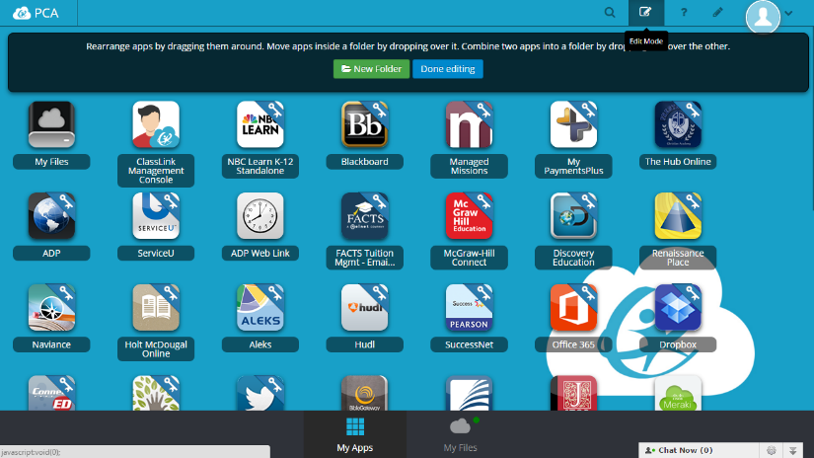
Quick Guide
My.classlink.com/mtnbrook
5. My Files
6. Cloud Drives
My Files> School Network/Home Directory allows access to your G drive (school network folders) from any device, any where, any time..
My Files >Manage Services > Connect allows you to connect other Cloud services with ClassLink to access all of your files in one location! Connect School Google and Office 365 Accounts. No personal drives.
7. Single Sign-On
8. Edit Mode
To add your login to the Single Sign On Apps, Click on the apps individually to enter your username and password, click save.
Click the ‘pencil and paper’ symbol on the top right to access the My Apps edit mode. This allows you to change the order of your apps and create folders.

