Slide 1

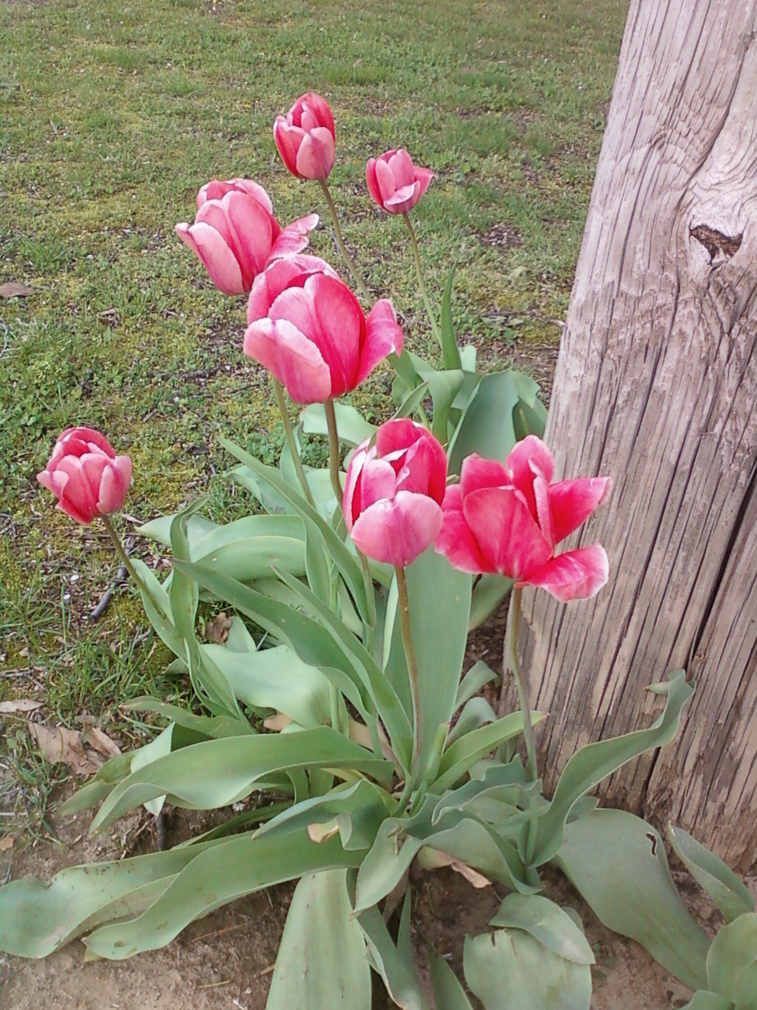
Chemistry
Class Information
Dr. Ellen Holloway
Fall 2022- Spring 2023
Grading: Your grades are figured on a basis of total points possible. Grades will include, but are not limited to, tests, quizzes, labs, and homework assignments. Lab report grades will include how well you follow the lab safety rules. With online learning, your grades in MS Teams and CK12 are only part of your overall grade which will be in TAC/HAC.
Extra Credit: There will be limited opportunity, if any, for extra credit so it is important for you to do your best on tests and assignments and turn them in on time.
Notebooks: An organized notebook will help you to study and work assignments more efficiently. We are using an online notebook this year through Microsoft Teams. However, you will still need a binder to keep loose papers and handouts. Make sure you have a section for the five minute focus assignments.
Homework: Each assignment is worth 5 points and is checked at the beginning of the period. Minimal credit is given for late work.
Absences: You are responsible for making up work that you missed if you are absent from class for any reason.

Slide 2
Class Procedures:
Beginning of Class:
1. Enter the room quietly. Make sure you have all your materials—pen, binder, and laptop. Place your phone in the phone caddy on the wall. If I see any phone out for any reason, I take it up and give it to Mr. Kersey at the end of the period. NO exceptions. Please sit at your assigned seat.
2. Open your notebook to the “Five Minute Focus” section and complete the “Five Minute Focus” assignment. It is on the Smartboard as well as in your online Teams notebook.
3. Leave your completed assignment out so you can make corrections if necessary when we discuss it. On Thursdays, I check for the previous five days’ assignments. Failure to have all 5 assignments results in a 0/5 score. Full credit will be given if you attend Friday morning detention in my room at 7:30 am.
4. If you come into class after the tardy bell rings, you are tardy. If you have a teacher’s note, please hand it to me quietly, and then sit down at your seat.
During Class:
5. NO food or drink is allowed in class, except for bottled water. Restroom needs should be taken care of before you come to class.
6. To get your attention as a class, I will stand at the front of the room. Please cooperate so we can transition smoothly to the next activity.
7. Remain seated unless you have permission to get up.
8. Raise your hand to speak.
9. The temperature of the room is not a topic for discussion.
10. If you need to sharpen your pencil, please do it quietly.
11. Please keep paper or trash to be thrown away at your desk until the end of the class period.

Slide 3


End of Class:
12. Please do not leave your belongings in the classroom. Objects left behind will be taken to the “lost and found” in the office.
13. Please remain in your seat. When the bell sounds, wait for me to dismiss the class.
Following directions will allow us to have a smoothly running classroom, and we will get more done. We are going to have great year!
Contact Information:
Remind app – the class code is docchem
Email – ellen.Holloway@bobcats.k12.ar.us
Desk phone – 870-819-0469

