Slide 1
Claim 4: Modeling and Data Analysis
The Smarter Balanced summative mathematics assessment and its relationship to instruction
Notes:
Hello and welcome to the OSPI video series on the Smarter Balanced assessment claims and their relationship to instruction.
This video focuses on Claim 4: Modeling and Data Analysis.
We hope this video increases your understanding of Claim 4 and its relationship to the Washington State K—12 Learning Standards for mathematics.

Slide 2
What is Claim 4?
Analyze real-world scenarios
Construct and use mathematical models to interpret and solve complex problems
Bridge between “school math” and the “real world”
Modeling is a mathematical practice at all levels and a category in the high school standards.
Claim 4 are not well-posed as in Claim 2.
Notes:
Claim 4 addresses students’ abilities to analyze real-world scenarios and to construct and use mathematical models to interpret and solve complex problems. Modeling is the bridge between “school math” and the “real world.” Claim 4 highlights the usefulness of mathematics and its application beyond a classroom setting.
Modeling is both a mathematical practice for all grades and a content focus in high school. In the early years, Claim 4 items focus largely on writing equations to represent problem situations. As students enter middle school, because of their work with content in the Statistics and Probability domain, Claim 4 item become more real-world and complex. By high school, Claim 4 items present sophisticated situations that require students to use a variety of content and models.
While Claim 2 items are well-posed, Claim 4 items can be “messy.” Real-world problems are often “messy” because they have too little or too much information. Students must first figure out what information they will use when working with a Claim 4 item. Often times, student must evaluate real-world data. They may create a model that fits the given situation. Other times, the student must make a reasonable guess for a measurement related to the situation. After taking these steps, then the student can tackle the problem, and interpret the results in terms of its reasonableness

Slide 3
More Information
More information about modeling for Claim 4 is available in the Mathematics Content Specifications, online at http://www.smarterbalanced.org/smarter-balanced-assessments/
Notes:
More information about modeling for Claim 4 is available in the Mathematics Content Specifications, online at this website.

Slide 4
Claim 4 requires use of content in the Standards
Making assumptions and approximations to simplify a complicated situation
Adjustments to these assumptions and approximations may be needed
Standards suggest the model or ask students to create one
Notes:
Mathematically proficient students are comfortable making assumptions and approximations to simplify a complicated situation. They also know these assumptions might need to be adjusted later. This ability to look at a problem that is not neatly packaged and determine how to solve it is at the heart of Claim 4. As with Claim 2, content may be at grade-level or below. Modeling language in standard may ask students to write an equation to fit a situation, or in a more complex ways in later grades.

Slide 5
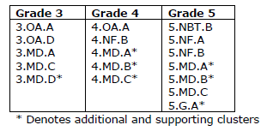
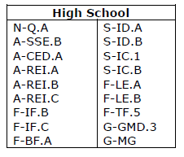
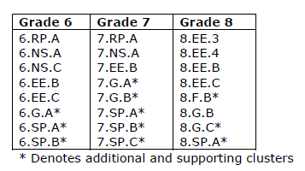
Primary emphases by grade
Notes:
As with Claim 2, clusters are the best way to view the content of items written for Claim 4. Often clusters that require problem-solving and are assessed in Claim 2 are also assessed in Claim 4. However, Claim 4 also includes clusters not assessed in Claim 2; clusters that mention modeling and data analysis. These tables represent clusters that lend themselves to Claim 4, and should be emphasized, when working with real-world situations in grades 3 through 8 and high school.
In general, those clusters throughout the grades that refer to solving problems are assessed in Claim 4.
In grades 3 through 5, the domain of Measurement and Data is emphasized. Equations and expressions are powerful modeling tools beginning in grade 3 and extending through middle grades up through high school. All but one cluster in the domains of Geometry and Statistics and Probability in Grades 6 through 8 are emphasized. In high school, modeling is a specific conceptual category which is embedded in the content of the standards. That content spans a wide range of conceptual categories.

Slide 6
More information on Claim 4
The three Claim 4 documents, Grades 3 through 5, Grades 6 through 8, and High School, are available online at http://www.smarterbalanced.org/smarter-balanced-assessments/#item
Look under “Mathematics” in the Item/Task Specifications section.
Notes:
The three Claim 4 documents, Grades 3 through 5, Grades 6 through 8, and High School, are available online at this website.
Look under “Mathematics” in the Item/Task Specifications section.

Slide 7
Claim 4 is based on the Mathematical Practices
Mathematical Practices 2, 4, and 5 are foundational support for Claim 4.
  2. Reason abstractly and quantitatively.
  4. Model with mathematics.
  5. Use appropriate tools strategically.
Notes:
Mathematical Practices 2, 4, and 5 are the foundational support for Claim 4. These practices ask students to:
reason abstractly and quantitatively,
model with mathematics, and
use appropriate tools strategically.
Claim 4 items present students with situations that are non-routine, messy, and have no clear path to a solution. Students must be flexible, thinking both contextually and decontexually, to work toward a solution. They must often sift through extraneous data to find relevant information or conduct research to get more data needed to solve the problem. Students need to be able to take the information presented in the problem and create an abstract, sometimes simplified, model. Students may be asked to select and use tools, including external sources for research, to help construct or interpret their models.

Slide 8
Additional information on Claim 4 and the Mathematical Practices
The Smarter Balanced Content Specifications, with additional information on how these practices inform Claim 4, is available online at http://www.smarterbalanced.org/smarter-balanced-assessments/
Notes:
The Smarter Balanced Content Specifications, with additional information on how these practices inform Claim 4, is available online at this website.

Slide 9
Modeling and Data Analysis: A variety of skills
Mathematics is a tool to analyze complex, real-world situations.
Creating and using a model to solve problems is one skills.
Targets are the same for all grades
Some targets in Claim 4 resemble those in Claim 2 or 3 but are applied to different situations.
Notes:
Mathematics is a tool used to analyze complex, real-world situations, both to understand the situation and solve related problems. Creating a model and using that model to solve a problem are not the only skills assessed in Claim 4 items. The targets for Claim 4 are the same for all grades. These targets are very similar to the targets in Claims 2 and 3, so many of the targets will seem familiar to those who have viewed previous videos in this series. However, in Claim 4, the targets will be applied to situations that are not neatly packaged.
Claim 4 targets are inter-related. As with Claim 2 and 3, often more than one Claim 4 target will be found in one item.

Slide 10
Target A: Solving real-world problems
Apply mathematics to solve problems arising in everyday life, society, and the workplace.
Students can be expected to solve problems that involve
  extracting relevant information from within the problem,
  finding missing information through research or the use of reasoned estimates, or
  identifying extraneous information.
Notes:
The first target is:
Apply mathematics to solve problems arising in everyday life, society, and the workplace.
While this is the same target as in Claim 2, in this case the problems will be more real world and, therefore, messier. Students will be expected to solve problems that require them to extract relevant information from within the problem, find missing information - sometimes through research -, use reasoned estimates, or identify extraneous information that is irrelevant to solving the problem.

Slide 11
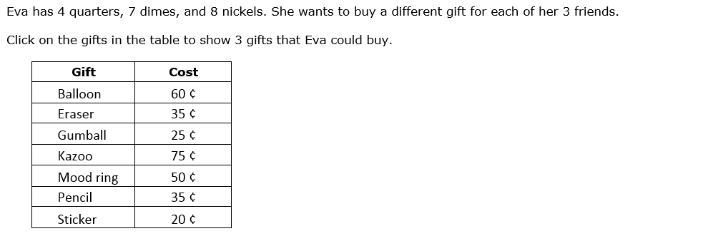
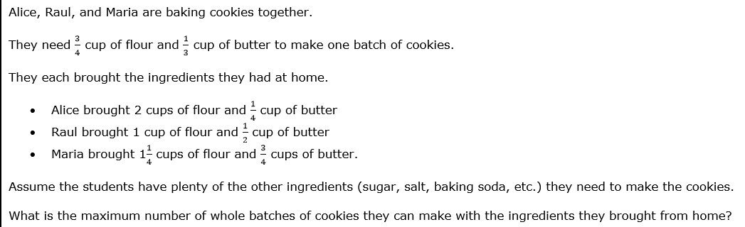
Grade 4
Grade 6
Grade 11
Notes:
These Grade 4 and 6 items show examples where students need to consider a number of data points and come to a conclusion based on them. Take a moment to determine the data points that students are considering.

Slide 12
Target B: Construct chains of reasoning
Construct, autonomously, chains of reasoning to justify mathematical models used, interpretations made, and solutions proposed for a complex problem.
The student:
  justifies the mathematical model(s) used,
  justifies the interpretation(s) shown, and/or
  justifies the solution(s) given to a complex problem.
Notes:
The second target is:
Construct, autonomously, chains of reasoning to justify mathematical models used, interpretations made, and solutions proposed for a complex problem.
We saw this target in Claim 3. In Claim 4 items, though, students will be asked about the models that are being used, the interpretations made, and how those justify the solution to a problem. Target B is usually assessed in conjunction with Target E, described later. As in Claim 3, Target B items present students with a single, complex question to answer without additional directions given to the student.

Slide 13
Target C: State logical assumptions
State logical assumptions being used.
Tasks ask student to use stated assumptions, definitions, and previously established results in developing their reasoning.
In some cases, the task may require students to provide missing information by researching or providing a reasoned estimate.
Notes:
The third target is:
State logical assumptions being used.
The student is presented with a problem and must either identify information or assumptions needed to solve the problem, research to provide information needed to solve the problem, or provide a reasoned estimate of a quantity needed to solve the problem.

Slide 14
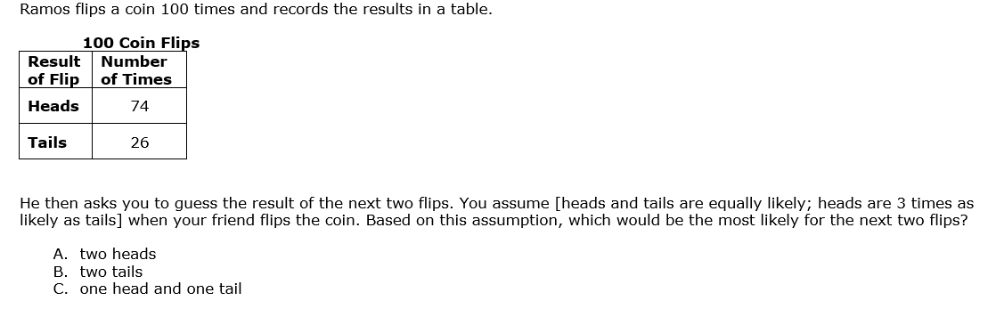
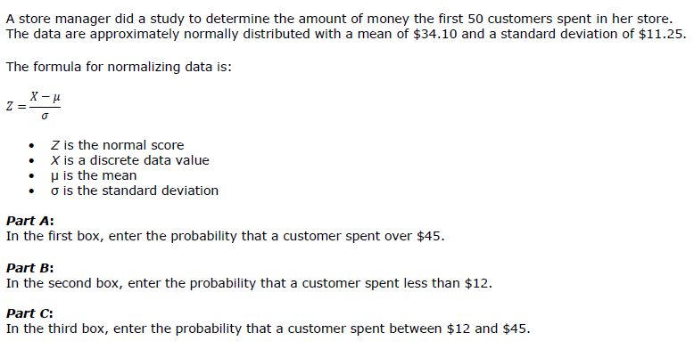
Grade 7
Grade 11
Notes:
These Grade 7 and high school items ask students to make a prediction based on assumptions stated in the problem. Take a moment to identify the assumptions in these items.

Slide 15
Target D: Interpret results in context
Interpret results in the context of a situation.
Tasks should ask students to link their response back to the problem’s context, e.g., a judgment by the student of how to express an answer to a division problem or a rationalization for the domain of a function being limited to positive integers.
Works with Target A: Apply mathematics to solve problems arising in everyday life, society, and the workplace.
Notes:
The fourth target is:
Interpret results in the context of a situation.
Students assessed on this target are given a real-world problem and they must interpret a solution to the problem in terms of the context. Because the problem is real-world, this target is often assessed with Target A.

Slide 16
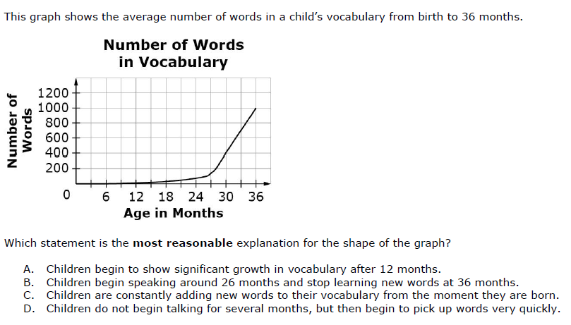
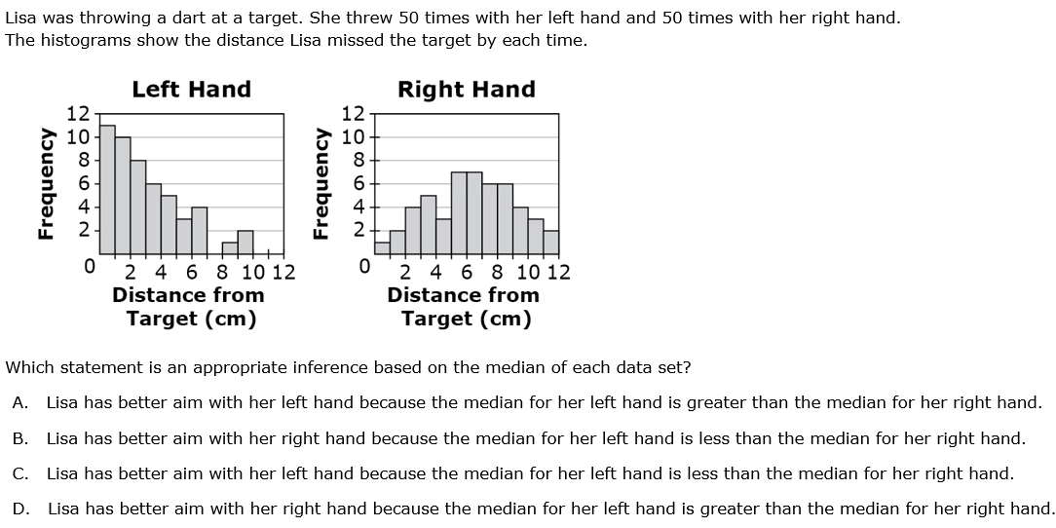
Grade 8
Grade 11
Notes:
These Grade 8 and high school items require that the student have the context of the problem in mind as they work toward an answer. As you read these problems, consider how students will need to refer to the context of the problem in order to find the answer.

Slide 17
Target E: Analyze a model or develop one
Analyze the adequacy of and make improvements to an existing model or develop a mathematical model of a real phenomenon.
Works with Target B: Construct, autonomously, chains of reasoning to justify mathematical models used, interpretations made, and solutions proposed for a complex problem.
Student creates or justifies a model
Notes:
The fifth target is:
Analyze the adequacy of and make improvements to an existing model or develop a mathematical model of a real phenomenon.
Target E is often assessed in conjunction with Target B. In determining the adequacy of a model or in developing one, the student also either creates or justifies a model, states why the interpretation of the model works in a given situation, or justifies a solution based on a chain of reasoning that supports the solution.

Slide 18
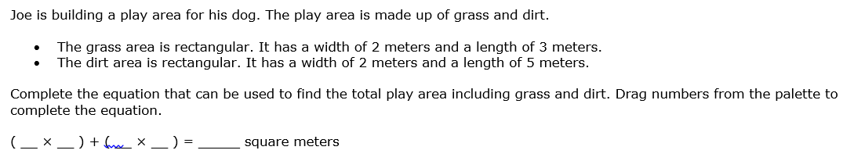
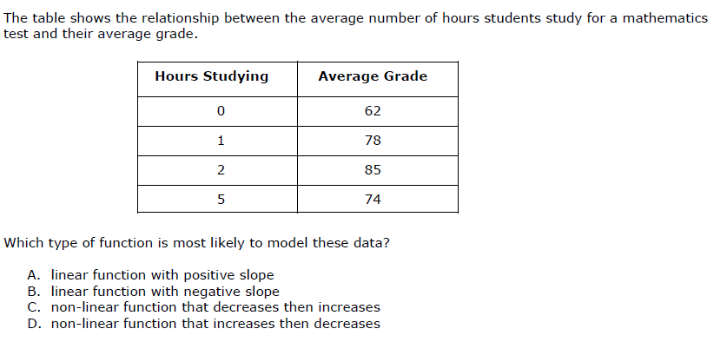
Grade 3
Grade 8
Notes:
These Grade 3 and Grade 8 items are examples where students are asked to provide a model for a given situation. The Grade 3 example is also assessing Target B, chains of reasoning, which is used to develop the equation. Take a moment to determine the models in these items and the reasoning students would use to create the models.

Slide 19
Target F: Identify and map relationships
Identify important quantities in a practical situation and map their relationships (e.g., using diagrams, two-way tables, graphs, flowcharts, or formulas).
Often assessed with Target A: Apply mathematics to solve problems arising in everyday life, society, and the workplace and Target C: State logical assumptions being used.
Notes:
The sixth target is:
Identify important quantities in a practical situation and map their relationships (e.g., using diagrams, two-way tables, graphs, flowcharts, or formulas).
To understand almost any Claim 4 problem, students must identify the quantities that are needed to work towards a solution. Therefore, this target is often assessed in conjunction with Target A and Target C. It is important to realize that these targets represent the skills that are important to modeling and data analysis. Because of the messiness of Claim 4, students have to use more than one skill to find a solution pathway.

Slide 20
Target G: Using external resources
Identify, analyze, and synthesize relevant external resources to pose or solve problems.
This target is measured in performance tasks only
Students will have access to external resources
Notes:
The seventh target is:
Identify, analyze, and synthesize relevant external resources to pose or solve problems.
This target is measured in performance tasks only. To assess this target, students will need access to external resources. These external resources are often hyperlinks to “mock” internet pages so that students do not have free reign to use the internet while in a testing situation. However, this target can be addressed in the classroom setting where access to such resources may be more readily available.

Slide 21
More information on Claim 4 examples
More example items for each target are available in the Claim 4 item specifications, online at http://www.smarterbalanced.org/smarter-balanced-assessments/#item
Look under “Mathematics” in the Item/Task Specifications section.
Notes:
More example items for each target are available in the Claim 4 item specifications, online at this website. Look under “Mathematics” in the Item/Task Specifications section.

Slide 22
How Claim 4 informs assessment
Connection between “school” and “real world”
Students have to apply their mathematics at a deeper level than in Claim 1.
Requires flexible item development
Claims 2 and 4 are combined for reporting purposes.
Together Claim 2 and 4 account for one-fourth of the summative test.
Notes:
Claim 4 items allow opportunities for students to make the connection from “school” mathematics to real-world applications of the mathematics. Students, therefore, have to apply their mathematics at a much deeper level than what is expected of them in Claim 1. Because of the high cognitive demand of Claim 4 items, the problem will sometimes use knowledge and skills learned at lower grades.
As in Claims 2 and 3, item development in Claim 4 is flexible to elicit a wide range of problem solving and modeling. Item writers must combine the skills described in the Claim 4 targets with content described in the standards. This is why there are no set task models in the Claim 4 documents, only descriptions and example items.
Because of their strong connection, Claims 2 and 4 are combined for reporting purposes of the summative assessment. Approximately one-sixth of the computer-adaptive portion of the Smarter Balanced test assesses Claims 2 and 4 combined. Claim 4 is also assessed on the performance task. When combined with Claim 2, these two claims make up approximately two-thirds of a performance task. Altogether, approximately one-fourth of the summative test assesses skills from Claims 2 and 4 combined.

Slide 23
More information on Claim 4 assessment
More information about Claim 4 on the summative assessment, both the computer-adaptive and the performance task portions, is available in the Test Blueprints, online at http://www.smarterbalanced.org/smarter-balanced-assessments/
Notes:
More information about Claim 4 on the summative assessment, both the computer-adaptive and the performance task portions, is available in the Test Blueprints, online at this website.

Slide 24
How Claim 4 informs instruction
Students need to deal with problems that are not neatly packaged.
Textbook problems do not often mirror authentic tasks in mathematics.
Modeling often involves working with incomplete or “messy” sets of numbers or where estimations must be made.
Performance tasks are a model for the types of tasks students should see in the classroom.
Students ability to model and analyze data develops alongside their mathematical understanding.
Notes:
Real-world situations and problems rarely come neatly packaged. Instruction around modeling and data analysis should help students develop skills and tools to solve these types of problems. Students have, for years, been given problems that had one unique response. To a great extent, students have not even needed to analyze the response. That approach, as seen in many textbooks, sets up a false premise in students’ minds about how mathematics is applied beyond the classroom.
Real-world situations that call for mathematical models often contain sets of data that do not have nice whole number statistical values associated with them. For instance, an unknown shape may have rugged edges and an approximation is needed to determine its area. How are these situations dealt with? Is there a way to overlay a mathematical model that will help to approximate a solution? Often estimation must be used to determine a model that might help to solve a problem. Students may need to search resources beyond the textbook for missing pieces of information. Assumptions need to be made when using a particular solution pathway.
The performance task that students complete as part of the summative assessment sets the stage for the type of tasks they should see on a regular basis in the classroom. While performance tasks have Claim 2, 3, and 4 items, it is the combination of these claims that best models a rich problem for students to solve. Given the restrictions inherent in any assessment, the classroom offers the best opportunity to dig deeply into mathematics in an authentic way.
Because mathematical knowledge in the standards is based on a progression of knowledge and skills, more complex problem-solving tasks may ask students to draw from the knowledge and skills acquired at lower grade levels. The Claim 4 targets show that, just as a student’s understanding of the mathematics grows over the years, their ability to apply that understanding to more and more complex situation should also grow.

Slide 25
Further help
We encourage you to view the videos for Claims 1 through 3 to get a more complete picture of the skills and practices students should develop.
Notes:
We hope this brief introduction to Claim 4 gives you greater insight into assessing students’ abilities to model situations and analyze data, as described in the Washington State K—12 Learning Standards and mathematical practices.
We encourage you to view the videos for Claims 1 through 3 to get a more complete picture of the skills and practices students should develop. Thank you.

