Slide 1
Early Civilizations of Mesoamerica
Olmec—1st civilization in America
Mayan—calendars based on stars, engineering and mathematics (Yucatan Peninsula)
Inca—most prominent of these empires. Empire stretched 2,500 miles along the mountainous western coast of South America. (Andes Mountains) Machu Picchu= famous ancient city
Aztec—conquer other people, huge empire, human sacrifice, tribute
  Tenochtitlan= Capitol (Mexico City)

Slide 2
North American Cultures
Hohokam—elaborate system of canals, world’s first etchings, decorative pottery, turquoise jewelry
Anasazi—cliff dwellers
Adena—mound builders, woodworking tools, built canoes and nets, clay pots
Hopewell—built geometric earthworks
Mississippian—new strains of crops, mound builders
No longer nomadic, become stationary

Slide 3
Native American—West
Southwest: began to leave the cliff sides and build settlements near waterways for irrigational purposes
  Pueblo Tribe-1300
  Built near the Rio Grande for irrigational purposes
Pacific Northwest Coast: built totem poles (represents wealth and status)
  Hunted the ocean for; whales, sea otters, and seals
  Potlatches=ceremonies where possessions were given away
Great Plains: followed buffalo, tamed horses and became great warriors

Slide 4
Native Americans—Far North
New inventions to deal with environment
  Harpoon
  Dogsled
  Kayak
  boots with ivory spikes
Use whale oil and blubber for fuel

Slide 5
Native Americans—Eastern Woodlands
Hardwood forest and rich soil
  Blended agriculture with hunting and gathering
  Vast supply of trees lead to using wood for many items
Northeast:
  Slash and burn agriculture; also hunt and fish
  Live in longhouses and wigwams
  Relied on wild animals for clothing and food
Southeast
  lived in towns: houses made of mud, thatch or grass
  women farmed, men hunted
  Grew corn, crops, and beans

Slide 6
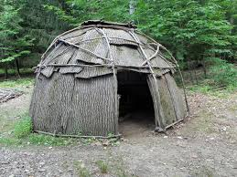
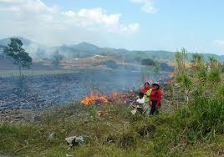
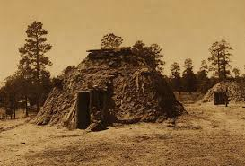

Slide 7
Trading Networks
Trade brought tribes in contact with one another
Elaborate transcontinental trading network allowing people to trade from all over
Trade routes reached from Mexico to the Atlantic coast
Land Use- Native Americans did not trade land. (Regarded as the source of life)

Slide 8
Social Organizations
Division of labor-the assignment of tasks according to gender, age, or status—formed basis for social order
The family= basic unit of organization among all Native American groups
  Clans- or groups of families descended from a common ancestor
  All families participated in community decision making
  Families that lived in the grasslands would only reunite to celebrate important occasions

Slide 9
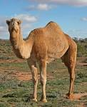
West Africa
Established trade system prior to arrival of Europeans
mid 1400’s= Europeans arrive
Salt and Gold mines
Camels
Islam arrives from the middle east through trade

Slide 10

Islam
Founded in Arabia
Muhammad
second largest of the three major monotheistic religions
  Monotheistic= one god
Muslims believe that the Quran is God's word as revealed to the prophet Muhammad (570-632 C.E.) through the angel Gabriel.

Slide 11

Portuguese Arrive
Established trade post on the West African coast
  Gold
By pass trade route across the Sahara
Began the European trade of west Africans
Slaves used to grow sugarcane

Slide 12
Early Empires
Ghana: West Africa’s first empire, empire falls because trade shifts
Mali: elaborate government, trade shifts again
Songhai- power extended across West Africa
  Sunni Ali= never lost a battle
  Askia Muhammad= administrative districts

Slide 13
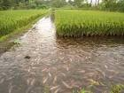
West Africa
Farming, herding, hunting and fishing,
Mining and trading
Collective ownership of land
Skilled at growing rice

Slide 14
Slave Labor
Slavery already exist in West Africa
Not born in to slavery
Not a lifetime punishment
Different than slavery in the Americas where slavery continued from generation to generation
Not Portuguese original objective

Slide 15
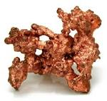
Forest Kingdoms of Guinea
Surplus food
Traded copper and salt
Benin = dominated a large region around the Niger Delta
Kongo= West Central Africa
  Manikango= Oversaw 4 million people
  Government resembled many of the European governments at the time

Slide 16
Central and Southern Africa
Age carried rank with in the family
Chief
  Consulted the council of elders for all decision making events
Matrilineal- people traced their lineage through their mother’s family
  Lineage ties determined:
    Family loyalties
    Inheritances
    Marriage

