Slide 1
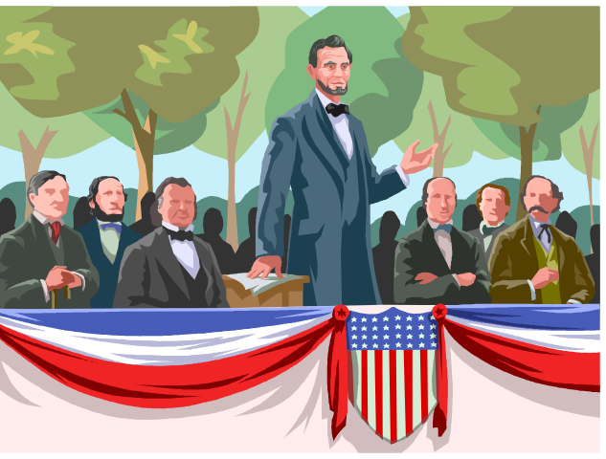
Civil War Web Photo Analysis
Go to the website: www.civilwarphotos.net/
Look through the Civil War photos available on this site
Specific topics:
Medical and Hospitals
African Americans
Military Life
Casualties
Describe the action or subject of the photograph.
What details yield the most information?
How is the photograph useful in making inferences or generalizations about the subject?
What questions do you have about the photograph?

