Slide 1
XXX – Area #
State, DC, Guam Puerto Rico, Virgin Islands, RR Board & “outside”
Social Security Numbers
…the hidden meaning!
XXX – XX - XXXX
XX – Group # assigned in blocks to each state
XXXX – Serial # assigned in blocks to each state
SSN = capacity of nearly 1 billion numbers
…as of November 1982 = ~ 277 million number issued
leaving 75% still available.

Slide 2
Section 4.2
Quantum Numbers
(SSN for Electrons)
Each electron in an atom has a unique set of FOUR quantum numbers which describe it.

Slide 3
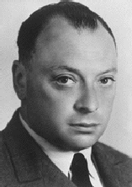
Pauli Exclusion Principle
No two electrons in an atom can have the same four quantum numbers.
Wolfgang
Pauli

Slide 4
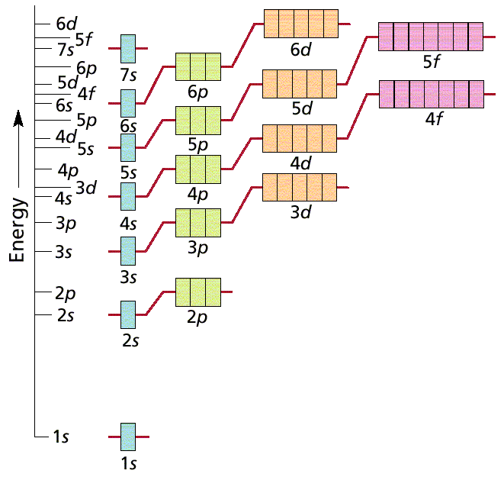
Aufbau Principle
Scientific Terms:
Electrons fill the lowest energy orbital first.
Layman Terms:
“Lazy Tenant Rule”

Slide 5
Hund’s Rule (Principle)
Within a sublevel, place one electron per orbital before pairing them.
Spread out before doubling up!
WRONG
RIGHT

Slide 6
Octet Rule
Octet means EIGHT valence electrons
Valence Electrons are located in the highest S & P energy level
Filled octets have noble gas characteristics.
Layman Terms:
Magic “8” – count major 8 columns

Slide 7
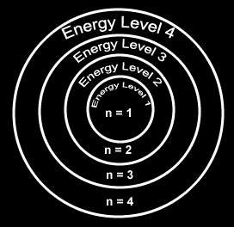
Principal Quantum Number
-symbolized by “ n ”
denotes the SHELL (ENERGY level) in which
the electron is located.
- Orbitals with the same value of
n are said to be in the
same principal shell.
Number of electrons that can fit in a shell:
# electron/energy level = 2n²

Slide 8
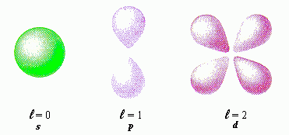
Angular Momentum Quantum Number
symbolized by “ l ”
denotes the orbital SHAPE (subshell) in which the
electron is located.

Slide 9
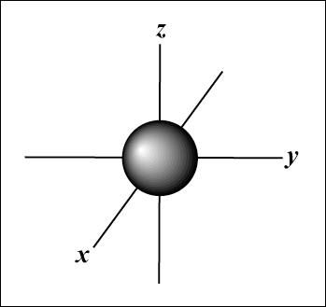
Magnetic Quantum Number
symbolized by “m_{l}”
denotes the orientation (AXIS) of the electron’s
orbital with respect to the three axes (X,Y & Z)
in space.
-Any integer from –L to +L
The s orbital has a spherical shape centered around
the origin of the three axes in space.

Slide 10
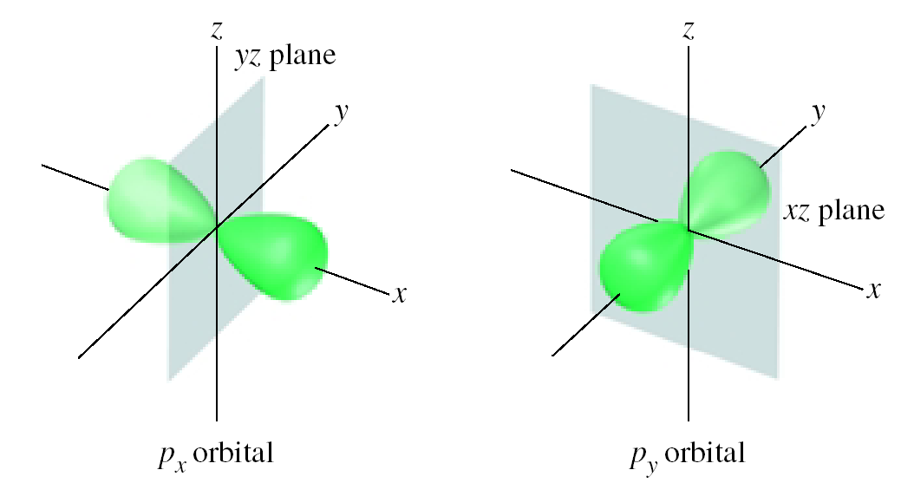
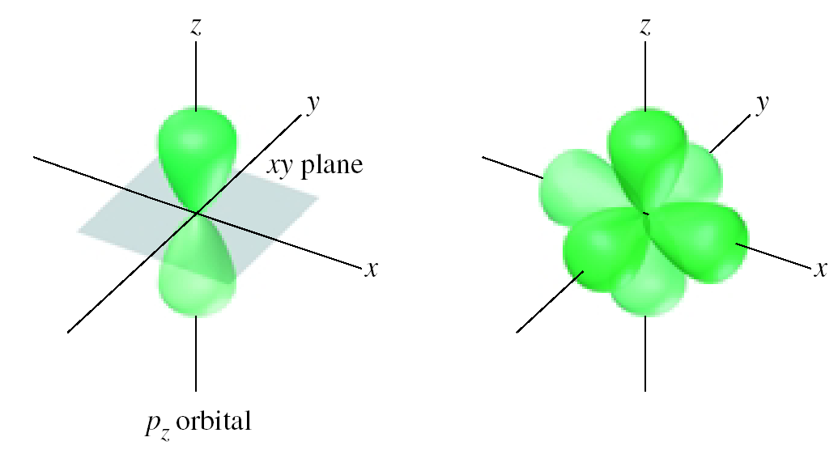
The Three p Orbitals
Three values of m_{l} gives three p orbitals in the p subshell.
Notes:
10

Slide 11
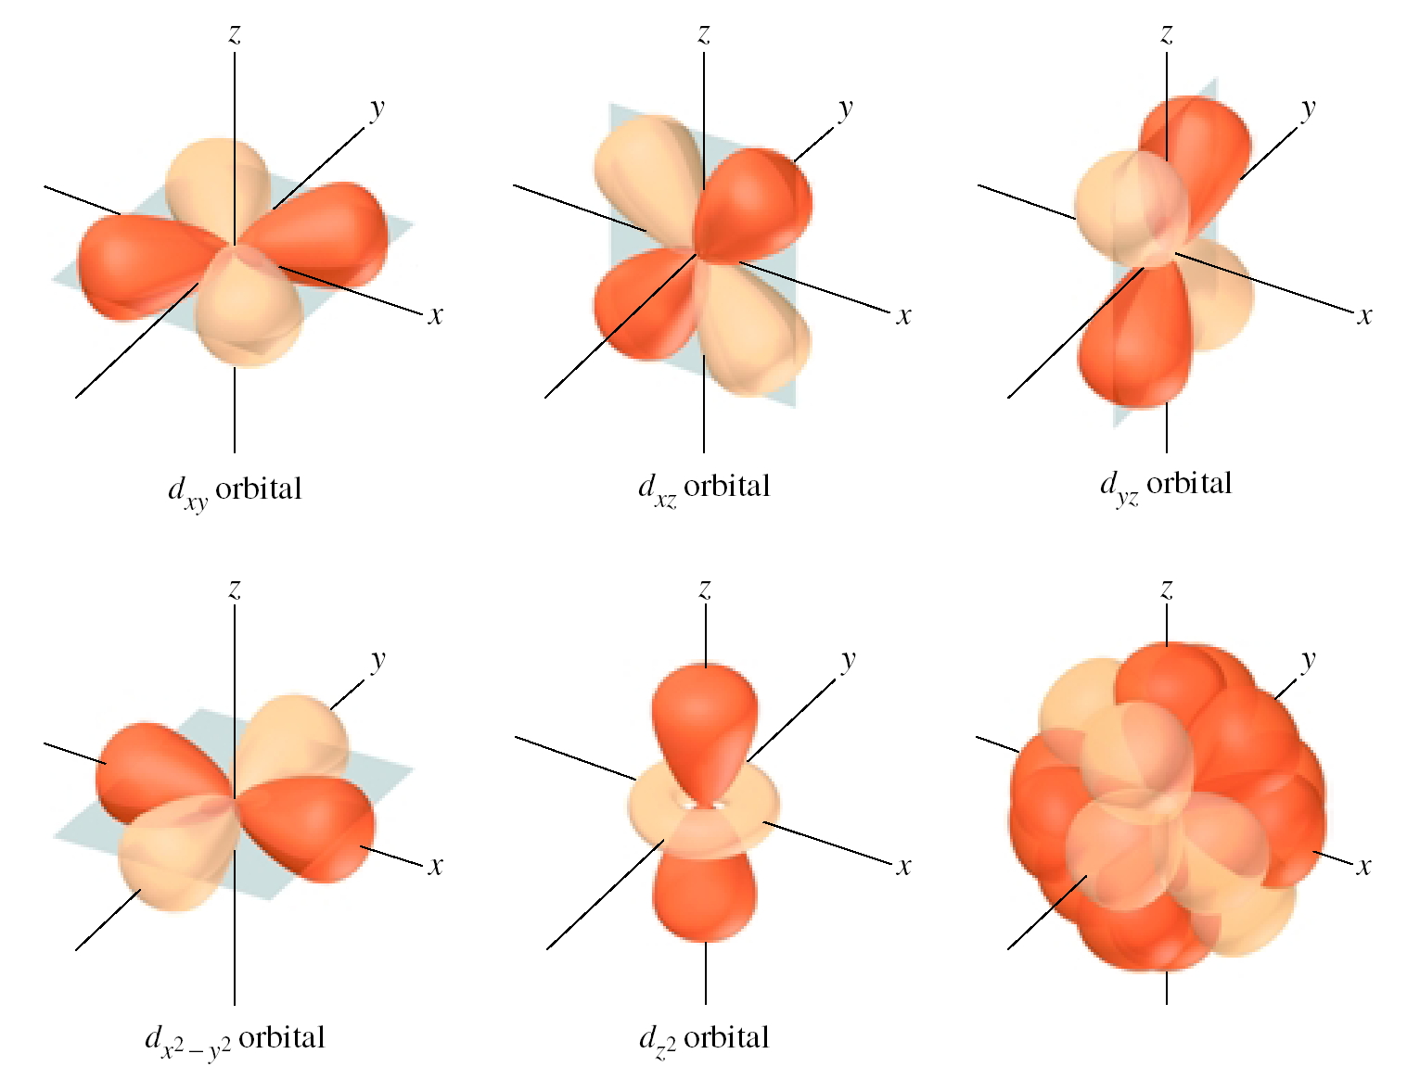
The Five d Orbitals
Five values of m_{l} (–2, –1, 0, 1, 2) gives five d orbitals in the d subshell.
Notes:
11

Slide 12
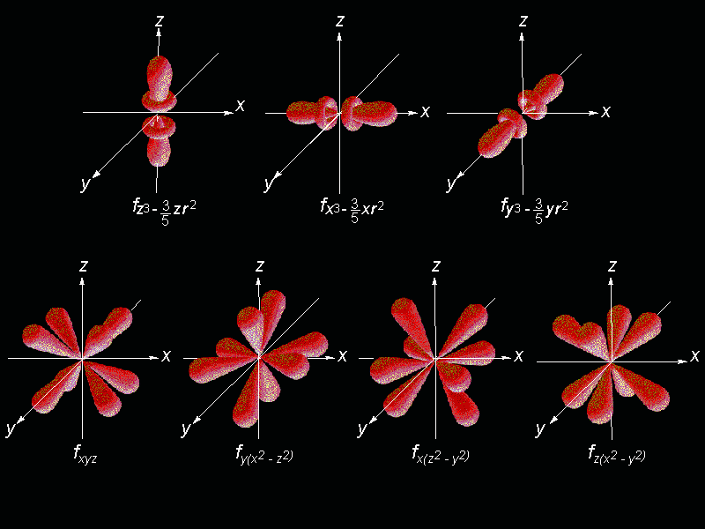
Shape of f orbitals

Slide 13
Assigning the Numbers
n = principal quantum number= row #
DISTANCE from Nucleus
l =angular momentum quantum = 0 & n-1
SHAPE
n = 3, l = 0, 1, or 2.
m_{l} = magnetic quantum number= -l to +l
ORIENTATION (axis)
l = 2, m = -2, -1, 0, +1, +2.

Slide 14
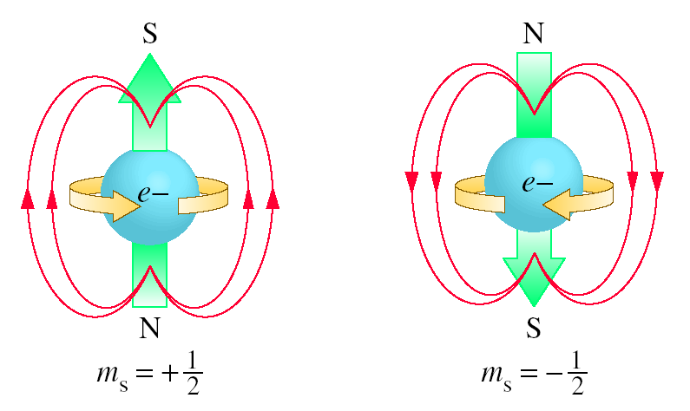
Spin Quantum Number, m_{s}
-symbolized by “ m_{s} “
-denotes the behavior (direction of spin) of an electron
within a magnetic field.
Possibilities for electron spin:
+ ½ - ½

