Slide 1
Nuclear Chemistry
Nuclear Power Plants
Radioactive Dating
Help treating certain cancers
Radioactive Tracers

Slide 2
Nuclear Chemistry
NUCLEUS
*Nuclear Chemistry involves changes in the__________
*Transmutation __________________________________
_____________________________________________
*Stability of Nuclei- _____________________________
_____________________________________________ *Should be between equal numbers of protons and neutrons to 2x protons as neutrons
**Nuclei above atomic # 83 are unstable**
When the atomic nucleus of 1 element
is changed into the nucleus of a different element
The ratio of protons to neutrons
determines the stability of a given nucleus.

Slide 3









Radioisotopes- Unstable nuclei spontaneously decay to form products that are more stable
They Emit (give off) radiation in the following forms:
*Alpha Particles: or
*Beta Particles: or
*Positron or
*Gamma Radiation
Symbol
Penetrating Power
Largest and least
able to penetrate
Smaller, can be stopped by a few mm of Al foil
Not a particle, highest
Penetrating power

Slide 4
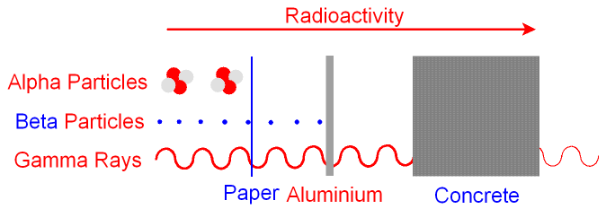
Penetrating Power
Check Table O and N for info on these types of problems

Slide 5
Radioactive Decay
Examples:
Alpha Decay:
Beta Decay:
Positron Emission:
⁴He
Alpha Particle
²²⁶Ra
²²²Rn
₂
₈₈
₈₆
Beta Particle
²¹⁴Pb
²¹⁴Bi
⁰e
₈₂
₈₃
₋₁
Positron
³⁷K
³⁷Ar
⁰e
₁₉
₁₈
₊₁
Law of conservation of mass and charge:
Mass and charge can not be created or destroyed, what is on one side of the reaction MUST equal what is on the other side.

Slide 6
Types of Transmutations
Natural Transmutation: ____________________________
___________________________________________
Artificial Transmutation: _____________________________
____________________________________________________
Type 1: _____________________________________
_____________________________________
Type 2: ___________________________________
Occurs naturally. Alpha,
Beta and Positron emission.
When we bombard a nucleus
With high energy particles to bring about a change.
Collide a charged particle (proton or )
with a target nucleus
A neutron collides with a target nucleus

Slide 7
Natural vs Artificial Transmutation
Examples:
Natural Artificial
**Single Reactant**
**2 Reactants**
Decay
¹⁴N
⁴He
¹⁷O
¹H
₇
₂
₈
₁
⁴³Sc
⁴³Ca
₂₁
₂₀
⁴He
²⁷Al
³⁰P
¹n
₂
₁₃
₁₅
₀
¹⁴C
¹⁴N
₆
₇

Slide 8

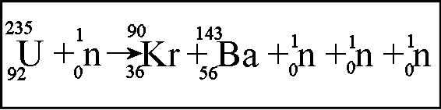
Fission
A reaction involving the SPLITTING of a
*Fission: __________________________________________
___________________________________________________
*The nucleus of a heavy atom ____________________
___________________________________________
*The product will be ________________________
___________________________________
*These products will be ______________
heavy nucleus to produce a lighter one.
“captures” (collides with)
a Neutron = unstable, so it splits
2 middle weight nuclei
+ neutrons + energy
Radioactive

Slide 9
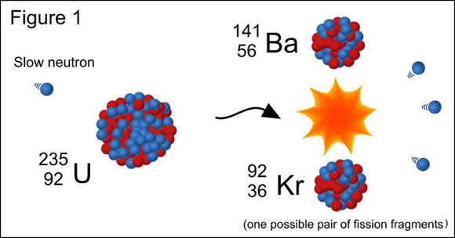
Fission
Nuclear Power Plant
Fission Reaction

Slide 10
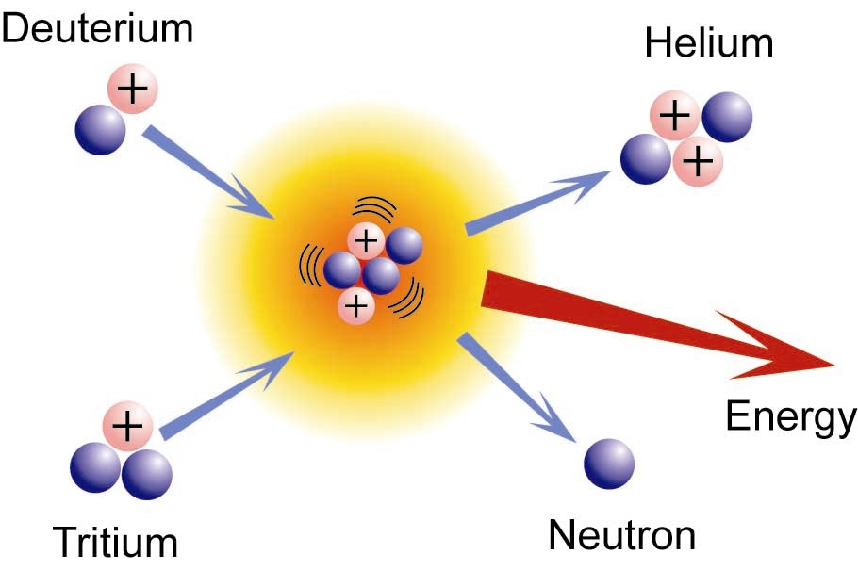

Fusion
A reaction involving the COMBINING
*Fusion: ______________________________________
_____________________________________________
* Produces _____________________________
*Products are ___________________________
*Fusion occurs ___________ and takes the _________ nuclei and converts it to _________ with the aid of a lot of energy and high pressure.
of light nuclei to produce a heavier nucleus
a HUGE amount of energy
not as radioactive
in the sun
Hydrogen
Helium

Slide 11

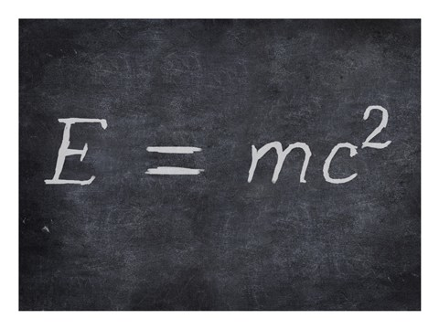
Matter to Energy
Conversion of matter to energy: There is NO loss of mass
in there nuclear reactions but a conversion of very little matter
into a great deal of energy!!!

Slide 12
Half Life
*Radioactive substances decay at a constant rate=
__________
__________, _______________ and ________________
Does NOT affect the half life period!!!!!!!!
Half Life: ____________________________________________
_____________________________________________________
**The shorter the half life, the ________________________
the isotope is.
Half Life
Pressure
Temperature
Concentration
The time it takes for ½ of the atoms in a
Given sample of an element to decay.
Less stable

Slide 13
Half Life
50 g
1 half
life
25 g
C¹⁴
1 half
life
12.5 g
C¹⁴
1 half
life
6.25 g
C¹⁴
C¹⁴
(1 half life)
5,730y
(2 half lives)
11,460y
(3 half lives)
17,190y

Slide 14
How to Calculate a Half Life Problem
Divide them and get the Number of Half Lives
*If given 2 times: ____________________________________________
*If given 2 masses: __________________________________________
_____________________________________________________________
*If there is only 1 mass and 1 time in the problem :
_____________________________________________________
***Always find out how many half lives you are dealing with before
you do anything else.***
Start with the larger mass and keep cutting
it in half until you get to the smaller mass in the problem.
(The number of times you cut it in half is the number of half lives.)
Look at table N for another time (half life if specific isotope)
(Then follow the rule for 2 times given)

Slide 15
Example: Part A
*Cr-51 has a half life of 28 days. What fraction will remain after 168 days?
Answer:
168d =
28d
6 half
lives
½ x ½ x ½ x ½ x ½ x ½ =
1/64
1hl 1hl 1hl 1hl 1hl 1hl

Slide 16
Continuation of last problem Part B
If the original mass of Chromium-51 was 52g, what mass will remain after 168 days? (use info from last problem)
Answer: Use the info of 6 half lives from last part.
1hl
1hl
1hl
1hl
1hl
1hl
52g
26g
13g
6.5g
3.25g
1.625g
.813g
Hint: When you are given an amount and asked to back track to the original amount.. (how much was in the original) =Multiply by 2
Hint: When you are given an amount and asked how much will be left after X amount of time… (total mass remaining) = cut in half

Slide 17
Uses for Radioisotopes
I – 131 –
*Patients are given small amounts and then a radiogram can be used to help diagnose a disorder.
*Large doses will accumulate in the thyroid to destroy some of it to reduce the production of thyroxin.
Detection and treatment of thyroid conditions.

