Slide 1

Nuclear Chemistry

Slide 2
Standards Addressed in this Chapter
SPS3. Students will distinguish the characteristics and components of radioactivity.
  Differentiate among alpha and beta particles and gamma radiation.
  Differentiate between fission and fusion.
  Explain the process half-life as related to radioactive decay.
  Describe nuclear energy, its practical application as an alternative energy source, and its potential problems.
SPS5. Students will compare and contrast the phases of matter as they relate to atomic and molecular motion.
  Compare and contrast the atomic/molecular motion of solids, liquids, gases and plasmas.

Slide 3
10.1 Radioactivity
Radioactivity is the process in which an unstable atomic nucleus emits charged particles and energy.
Radioisotope is short for radioactive isotopes, which is any atom containing an unstable nucleus.
Radioisotopes spontaneously change into other isotopes over time and is said to undergo nuclear decay.
During nuclear decay, atoms of one element can change into atoms of a different element altogether.

Slide 4
Types of Nuclear Radiation
Nuclear radiation is charged particles and energy that are emitted from the nuclei of radioisotopes
Common types of nuclear radiation include alpha particles, beta particles and gamma rays

Slide 5
1. Alpha Decay
  Alpha particle is a positively charged particle made up of two protons and two neutrons (the same as helium nucleus)
  Alpha particles are the least penetrating type of nuclear radiation.
  They can be stopped by a sheet of paper of by clothing.
  The alpha particle has no electrons so it has a 2+ charge.
  ⁴₂He is the symbol for an alpha particle

Slide 6


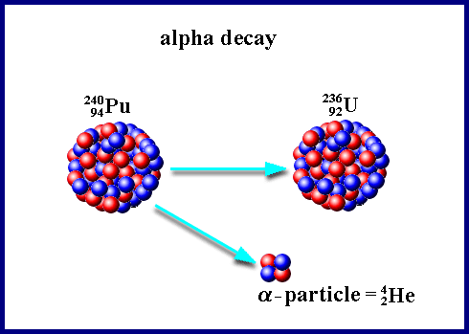
Alpha Decay
Alpha decay is expressed as an equation

Slide 7
2. Beta Decay
  Beta particle is an electron emitted by an unstable nucleus
  Beta particles are abbreviated β or ⁰₋₁e
  Beta particles are more penetrating than alpha particles.
  Beta particles pass through paper but can be stopped by a thin sheet of metal.

Slide 8
2. Beta Decay
  The beta particle has no mass
  During beta decay a neutron decomposes into a proton and an electron
  The proton stays trapped in the nucleus while the electron is released

Slide 9



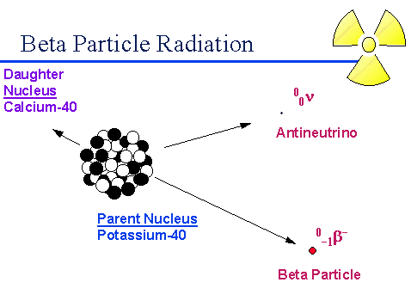
Beta Decay
Beta decay is expressed as an equation

Slide 10
3. Gamma Decay
  Gamma ray is a penetrating ray of energy emitted by an unstable nucleus.
  The symbol for a gamma ray is γ
  The gamma radiation has no mass and no charge
  During gamma decay the atomic number and mass number of the atom remain the same but the energy of the nucleus decreases

Slide 11
Gamma Decay
  Gamma decay often accompanies alpha or beta decay.
  Gamma rays have the most energy of the three,
  gamma rays can pass through paper and aluminum but is stopped by thick concrete or lead

Slide 12
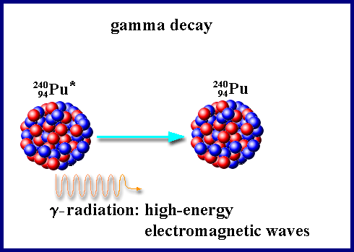
Gamma Decay
Gamma decay

Slide 13
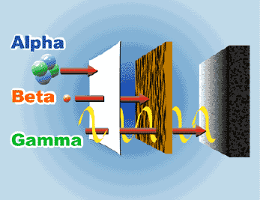
Comparing Strength of Nuclear radiation

Slide 14
Nuclear Ration Summary
Alpha Particles
Symbol ⁴₂He
2 protons & 2 neutrons
Has a charge +2 and mass of 4 atm
Weakest
Stopped by paper
Beta Particles
Symbol β or ⁰₋₁e
An electron
Has no mass
Stronger than Alpha
Stopped by sheet of metal
Gamma Ray
Symbol γ
Only energy
No mass, No charge
Strongest
Stopped by thick lead or thick concrete

Slide 15
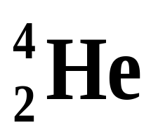
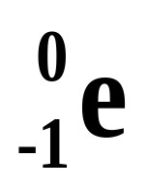

Types of Radiation
Alpha (α)
  helium nucleus
2+
paper
Beta-minus (β-)
  electron
1-
lead
Gamma (γ)
  high-energy photon
0
concrete

Slide 16
10.2 Rates of Nuclear Decay
Half-life is the time required for one half of a sample of radioisotope to decay
After one half-life, half of the atoms in a sample have decayed, while the other half remains unchanged.
Half-lives can vary from fractions of a second to billions of years
Time in which ½ of the original isotopes decay

Slide 17
A. Half-Life
First Half-life ½ original isotopes remain ½ decayed
Second Half-life ¼ original isotopes remain ¾ decayed
Third Half-life 1/8 original isotopes remain 7/8 decayed
Unlike chemical reaction rates, which vary with the conditions of a reaction, nuclear decay rates are constant.

Slide 18
Half-Life progression of Iodine-131
100 gram sample with 8.1 day ½ life
16.2 days
25 g remains
0 days
100 g
8.1 days
50 g remains
First ½ life
Second ½ life
24.3 days
12.5 g remains
32.4 days
6.25g remains
40.5 days
3.125 g remains
Third ½ life
Fourth ½ life
Fifth ½ life
Etc.

Slide 19
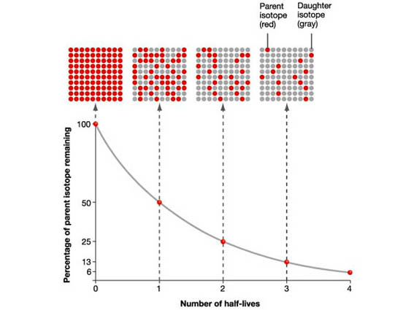
Half-life graph
http://einstein.byu.edu/~masong/htmstuff/Radioactive2.html

Slide 20
½ life calculations
Amount of sample divide by two for each ½ life that passed
Amount of time = (# of ½ lives) X ( length of one ½ life)

Slide 21
A. Half-Life Practice
If we start with 400 atoms of a radioactive substance,
  how many would remain after one half-life?_________
  after two half-lives? _________
  after three half-lives? _______
2. If we start with 48 g of a radioactive substance with a 2 hour ½ life ,
how much is left after two half-lives? _____
after four half-lives?___
how much time has passed for 4 ½ lives? ______
If we start with 16 grams of a radioactive substance that has a 6 day ½ life,
  How much will remain after three half-lives?________
  How much time would have passed?_______
200 atoms
100 atoms
50 atoms
12 g
3 g
8 hours
2 grams
18 days

Slide 22
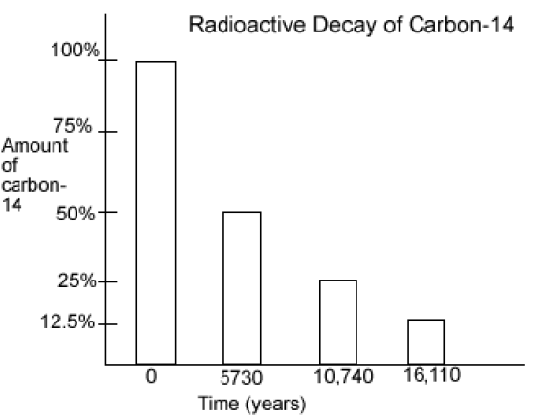
4. What is the half life of carbon-14?________
5. If only 25% of the carbon-14 remains, how old is the material containing the carbon-14? ___________
5730 years
10740 years old
6. If a sample originally had 150 grams of carbon-14, how many atoms will remain after 16,110 years? _______
18.75 grams

Slide 23
10.4 Fission and Fusion
Strong nuclear force is the attractive force that binds protons and neutrons together in the nucleus.
Over very short distances the strong nuclear force is much great than the electric forces among protons.

Slide 24
1. The effect of size on Nuclear Forces
The greater the number of protons in a nucleus the greater is the electric force that repels those protons.
In larger nuclei, the repulsive electric force is stronger than in smaller nuclei
Larger numbers of electric forces make larger nucleus less stable

Slide 25
2. Unstable Nuclei
A nucleus becomes unstable (radioactive) when the strong nuclear force can no longer overcome the repulsive electric forces among protons.
All nuclei with more than 83 protons are radioactive

Slide 26
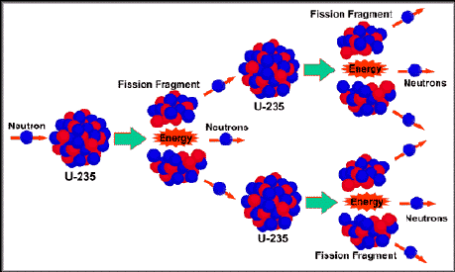
Fission
Fission is the splitting of an atomic nucleus into two smaller parts.
In nuclear fission, tremendous amounts of energy can be produced from very small amounts of mass.

Slide 27
Chain Reaction
A chain reaction refers to a process in which neutrons released in fission produce an additional fission in at least one further nucleus.
This nucleus in turn produces neutrons, and the process repeats.
The process may be controlled (nuclear power) or uncontrolled (nuclear weapons).

Slide 28
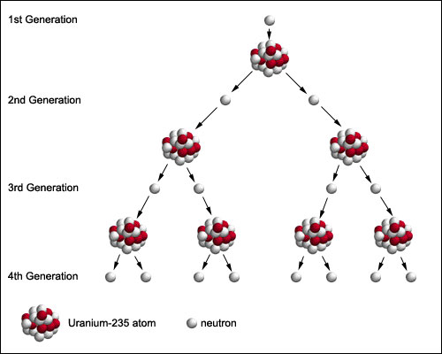

Slide 29
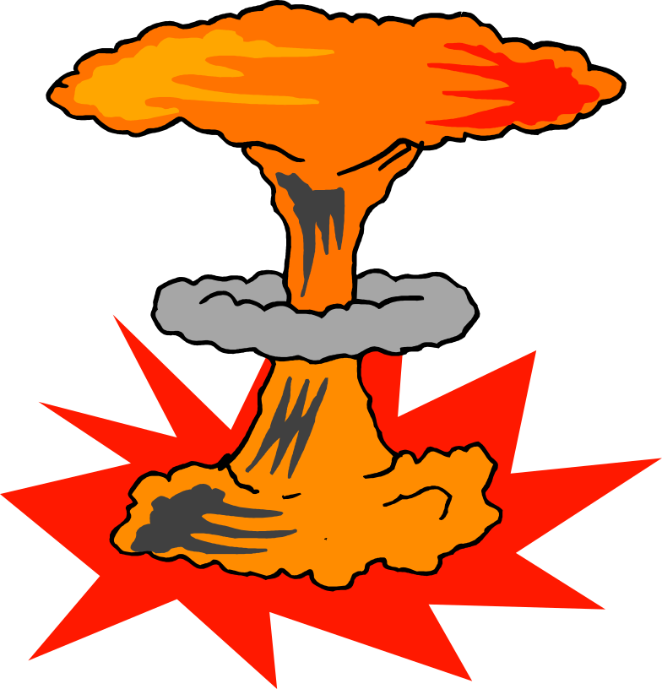
Critical Mass
The minimum amount of a substance that can sustain a chain reaction.
It takes very little Uranium-235 to reach critical mass.

Slide 30
Fusion
Fusion is a process in which the nuclei of two atoms combine to form a larger nucleus.
During fusion a small fraction of the reactant mass is converted into energy.
Inside the sun an estimated 600 millions tons of hydrogen undergo fusion each second
Fusion requires extremely high temperatures (10,000,000◦C).
At these temperature matter can exist as plasma

Slide 31
C. Fusion
Plasma is a state of matter in which atoms have been stripped of their electrons.
Fusion reactions produce much more energy per gram of fuel and produce less radioactive waste than fission.
Two main problems in designing a fusion rector
  1st they need to achieve high temperatures required to start the reaction
  It requires a heat of about 10 million degrees Celsius. Scientist have to find a way of producing and containing that much heat.
  2nd they must contain the plasma
  Fusion can occur only in the plasma state of matter (super-heated gas).

Slide 32
Fusion
Combining small atoms into a larger atom
Requires very high temperatures
Releases large amounts of energy
Fission
Splitting a larger atom into smaller atoms
Releases two or three neutrons
Releases large amounts of energy
Used as a source for electricity

Slide 33
3. Nuclear Energy from Fission
Nuclear power plants generate about 20% of the electricity in the US
Nuclear power plant do not emit air pollutants
But workers are made to wear protective clothing to recue their exposure to nuclear radiation.

Slide 34
Nuclear power plants produce radioactive waste that must be isolated and stored so that it does not harm people or the environment.
If the reactors cooling systems failed a meltdown might occur
During a meltdown the core of the reactor melts and radioactive material may be released.

Slide 35
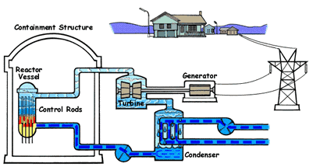
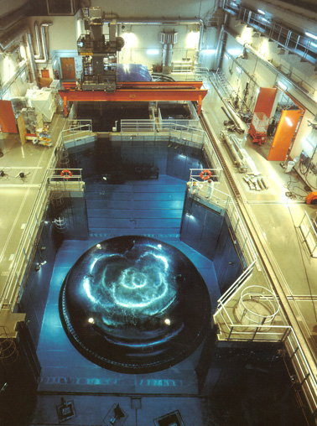
Nuclear Power
Fission Reactors

Slide 36
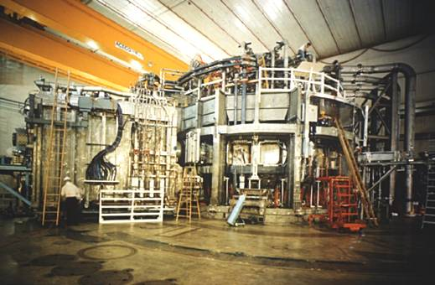
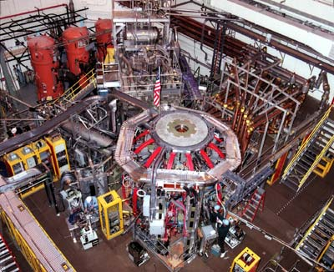
Nuclear Power
Fusion Reactors (not yet sustainable)
National Spherical Torus Experiment
Tokamak Fusion Test Reactor
Princeton University

Slide 37
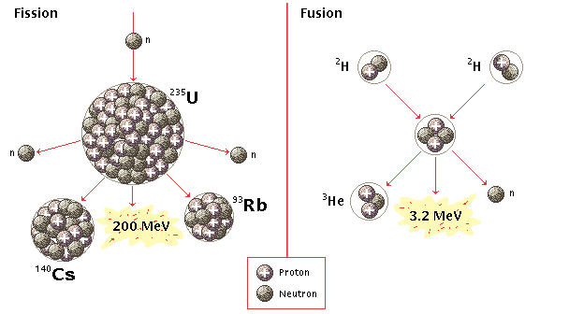
Nuclear Power
FISSION
FUSION
vs.
²³⁵U is limited
danger of meltdown
toxic waste
thermal pollution
Hydrogen is abundant
no danger of meltdown
no toxic waste
not yet sustainable

Slide 38
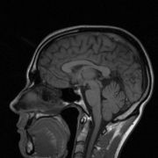
Dangers Nuclear Decay –
  nuclear waste
  Nuclear radiation
Benefits –
  Medical
    Cancer Treatment
    Radioactive tracers
  Nuclear Power

Slide 39
Other Uses of Radiation
  Irradiated Food (p.676)
  Radioactive Dating (p.683)
  Nuclear Medicine (p.692-693)

