Slide 1
Warm up 10/21
Turn in your signed lab safety sheet.
What is an atom? An element? The periodic table? If you can’t remember dig waaaay back into your brain and try to make a really close guess.
What do you think the four macromolecules are that are listed on the state standard?

Slide 2
Unit 3
Chemistry of Life

Slide 3
Matter is made up of atoms.
Proton (positive charge)
Neutron (neutral)
Electron (negative charge)
–
+
+
+
–
–
atom
nucleus

Slide 4
Human Demonstration
Orange = proton
  In nucleus, move very slightly
Yellow = neutron
  In nucleus, move very slightly
Green = electron
  Revolve around outside of
  atom, move a lot.
–
+
+
+
–
–

Slide 5
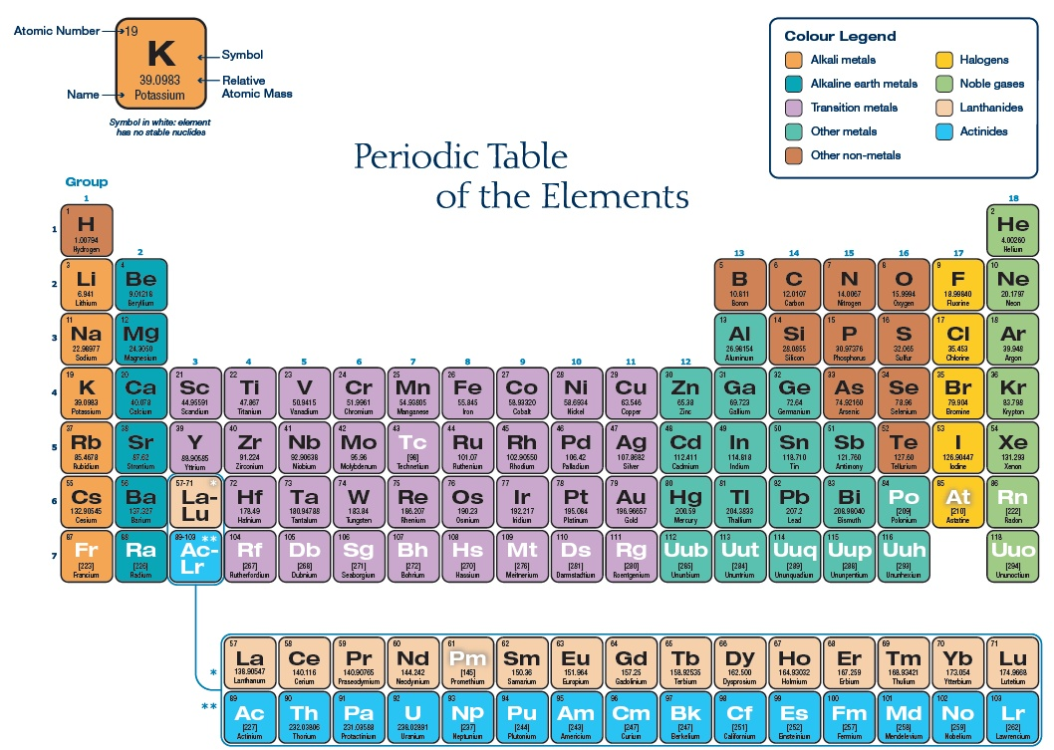

Slide 6
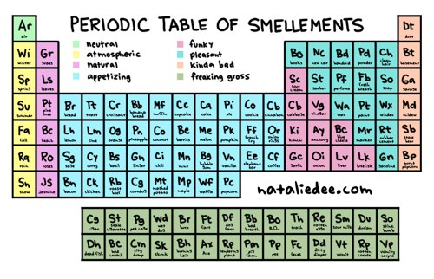

Slide 7
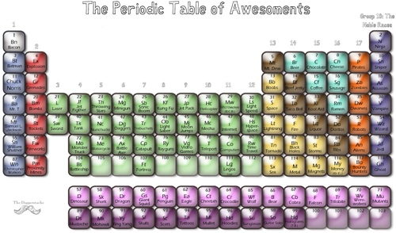

Slide 9
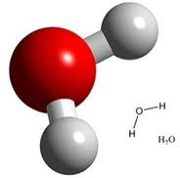
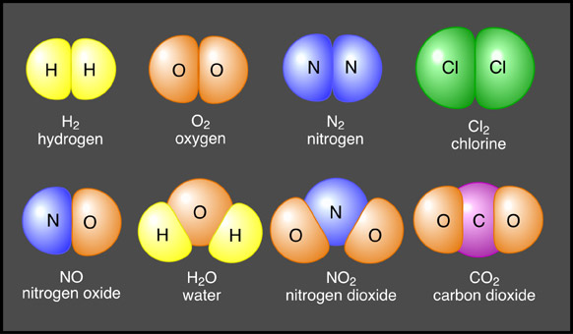
Molecule
  Compound in which the atoms are held together by covalent bonds (when electrons are shared).

Slide 10
Compound
A pure substance formed when two or more different elements combine. Each has a chemical formula from the periodic table.
    EX: H₂O, NaCl, CH₄
    Can be broken down by chemical means.

Slide 11
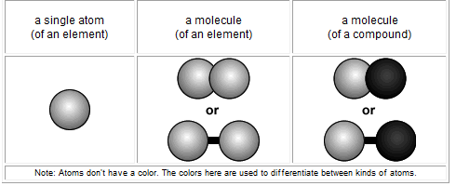

Slide 13
Exit Ticket
Use your notes. Explain to me how protons, neutrons, electrons, atoms, molecules, and compounds are related to one another. Use complete sentences and the connecting words we talked about.

Slide 14
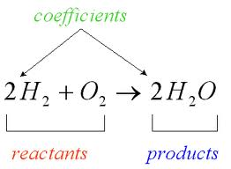
Warm Up 10/24
Copy the folowing into your notes for today:
Chemical Reaction: Process by which atoms or groups of atoms in substances are reorganized into different substances.
  Chemical bonds are broken and/or formed.
Chemical equation:

Slide 15
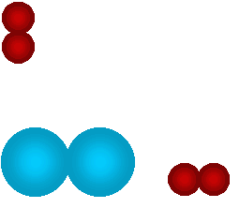
Chemical Reaction (rxn)
Process by which atoms or groups of atoms in substances are reorganized into different substances.
  Chemical bonds are broken and/or formed.
Notes:
http://web.jjay.cuny.edu/~acarpi/NSC/6-react.htm

Slide 16
Chemical equations

Slide 17
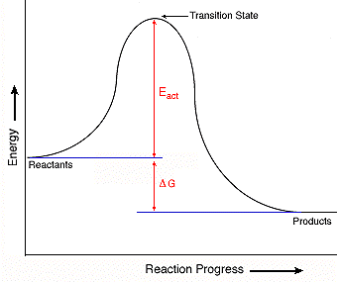
Activation Energy--minimum amt. of energy needed for reactants to form products in a chemical reaction.

Slide 18
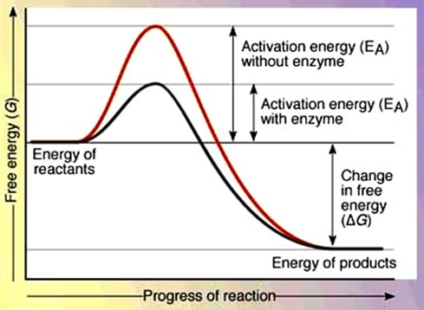
Catalyst—substance that lowers the activation energy needed to start a chemical reaction.
Enzyme—special protein that speeds up the rate of a chemical reaction.

Slide 19
How an Enzyme works.
Substrate—reactants that bind to the enzyme.
Active site—specific location where a substrate binds on an enzyme.
Product—result; what you end up with.
Notes:
http://highered.mcgraw-hill.com/sites/0072495855/student_view0/chapter2/animation__how_enzymes_work.html

Slide 20
Warm-up 10/26
Write this down:
“All compounds are molecules but not all molecules are compounds.” Explain why this is true.
Molecules are two or more atoms. Compounds are two or more DIFFERENT atoms.

Slide 21
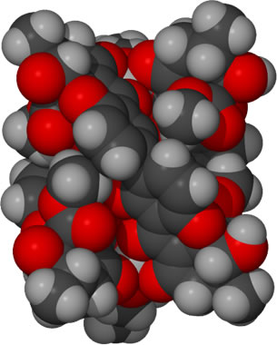
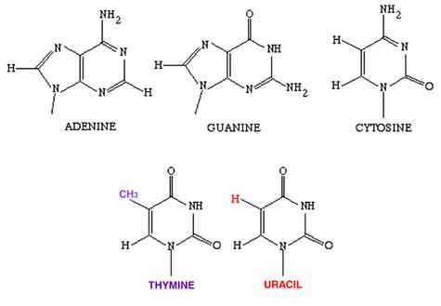
Macromolecules
Large molecules that are formed by joining smaller organic (containing C) molecules together.

Slide 22
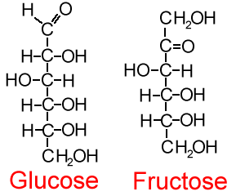
Carbohydrates
CH₂O
Monosaccharides
  glucose, fructose, galactose
Disaccharides
  Sucrose, lactose
Polysaccharides
  Starch, glycogen, cellulose
Store energy
Provide structural support

Slide 23
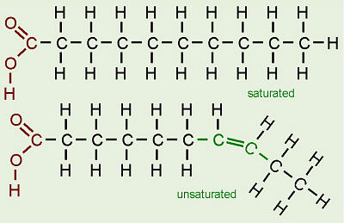
Lipids
Fats, oils, waxes
Store energy
Phospholipids
  Allows cells to let some things in and not others.
  Do not dissolve in water.

Slide 24
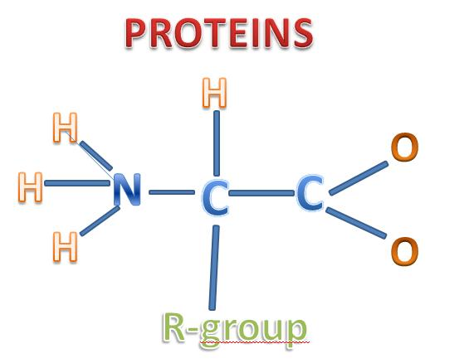
Proteins
Made up of amino acids
Transport substances
Structural support
Make hormones

Slide 25
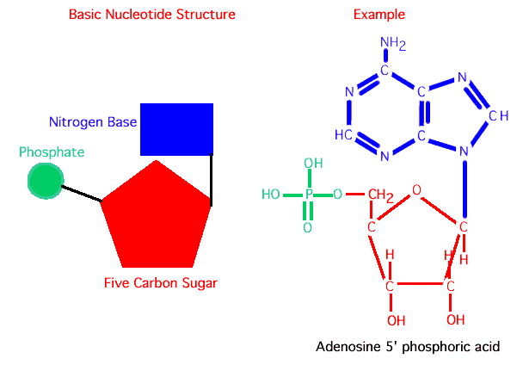
Nucleic Acids
Store and transmit genetic information.
Made up of repeating subunits called nucleotides
DNA, RNA, ATP

Slide 26
Warm up 10/28
What is the name of the protein that speeds up chemical reactions?
Catalyst
2. A chemical reaction takes place during which the molecules of a toothpick are broken down, but without any assistance of the protein mentioned in #1. How would the graph showing this reaction look different than the one you made for the toothpickase lab?
The curve would extend slightly higher, showing that the reaction used more energy.

Slide 27
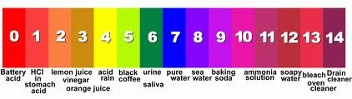
pH
The measure of the concentration of H+ in a solution.
pH of pure water = 7
Acid: pH lower than 7
Base: pH higher than 7

