Slide 1
Article IV Special Projects
Supplemental Instruction (SI)
FY 2017
Rutgers, Ernest Mario School of Pharmacy
Educational Opportunity Fund Program
Nancy Cintron, Associate Dean & Founding EOF Director
Jerlissa Rivas, Program Development Specialist

Slide 2
Historical Overview
The Ernest Mario School of Pharmacy (EMSOP) is one of the oldest and highly ranked pharmacy schools in the country. This Fall marks the 125th year of our school's existence in preparing and producing pharmacists, scientists, and healthcare professionals. Students across all of our academic offerings, from PharmD and graduate degrees to postgraduate and continuing education programs, benefit from the broad resources of Rutgers, a major research university and a leader in academic health training and education.

Slide 3
The Doctor of Pharmacy
(PharmD)
The PharmD is the professional degree required to become a newly licensed pharmacist. Combining didactic with experiential learning, the six-year curriculum is grounded in both basic and clinical sciences with an emphasis on collaborative, inter-professional learning and patient-centered care. Students graduate fully prepared for licensure requirements, post educational specialty training as well as any of the various career pathways.
The PharmD at Rutgers is one of the few 0-6 PharmD programs in the country, offering students the opportunity to enroll right after high school. Students may also transfer into the program from other schools or after having completed other degree programs.

Slide 4
SI Target Audience
First Year students benefit from:
Enhanced Supplemental Instruction (SI) Sessions
Added Individual Tutoring Sessions
Focused Workshops
Professional Students benefit from:
Individual tutoring sessions for core Pharmacy courses
Flexible tutoring appointments to meet their demanding schedules

Slide 5
Project Goal and Objectives
Group Tutoring Sessions and Mandatory Study Hall for Core Science and Math courses
  Chemistry, Biology, and Calculus
Individual Tutoring Sessions with Highly Skilled Instructors in the following subjects:
  Organic Chemistry, Systems Physiology, Pharmaceutical Chemistry, Intro to Pharmacology, Molecular Biology and Pharmaceutical Biotechnology, Biopharmaceutics and Pharmacokinetics, Medicinal Chemistry, Poison Management and Drug Abuse, Infectious Disease Therapeutics, Pharmacology, Endocrine Therapy, and Neuropsychiatric Therapeutics.
Workshops addressing topics such as:
  Test Taking Strategies, Study Habits, Test Anxiety, Focused Professional Year Survival Strategies, etc.
Notes:
Other workshops offered were Rotation Round Table, Dress for Success, Professionalism (Resume Critique, Email Etiquette, & Interview Skills)

Slide 6
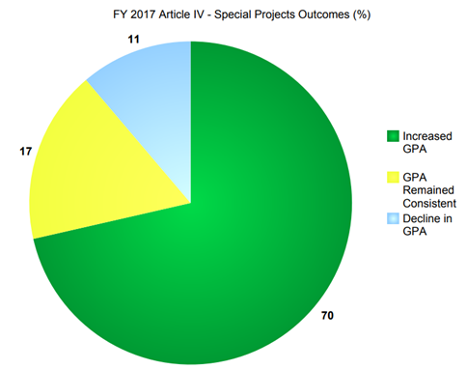
Assessment Measures/Intended Impact for PP1’s
SI success for our First Year students was measured by comparing significant changes in GPA from cohorts previous semester
Of our pre-professional year students, 70% who participated in SI, significantly increased their GPA from the previous semester
Notes:
Breakdown of the 17 students in PP1 year, 11 = green, 4 = yellow and 2 = blue

Slide 7
Professional Year
SI Outcomes
Of our professional year students who participated in the SI, their GPA remained consistent (these students had previously attended SI sessions)
Of note, two of our most academically challenged professional year students successfully attained a B or higher in the course for which they sought the most SI assistance
Additionally students receiving individual tutoring obtained a C+ or higher in the Medicinal Chemistry course (considered the most difficult course in their Second Professional (P2) Year)

